Slide 1
How to do research
Maarten van Steen
Notes:
Who is Maarten van Steen?
Why, how, what (golden circle)
Examples
There is hardly any curiosity-driven research (anymore)
Fundamental versus applied (Pasteur’s Quadrant)
The research motivation
The research question
The research methodology
Approach 1: first invent, then read
Approach 2: first read, then invent
Understanding the problem
A well-understood problem can be explained well
A poorly understood problem cannot be explained.
Understanding the solution
Make your assumptions explicit
What are the criteria for a good solution?
How to evaluate a solution

Slide 2

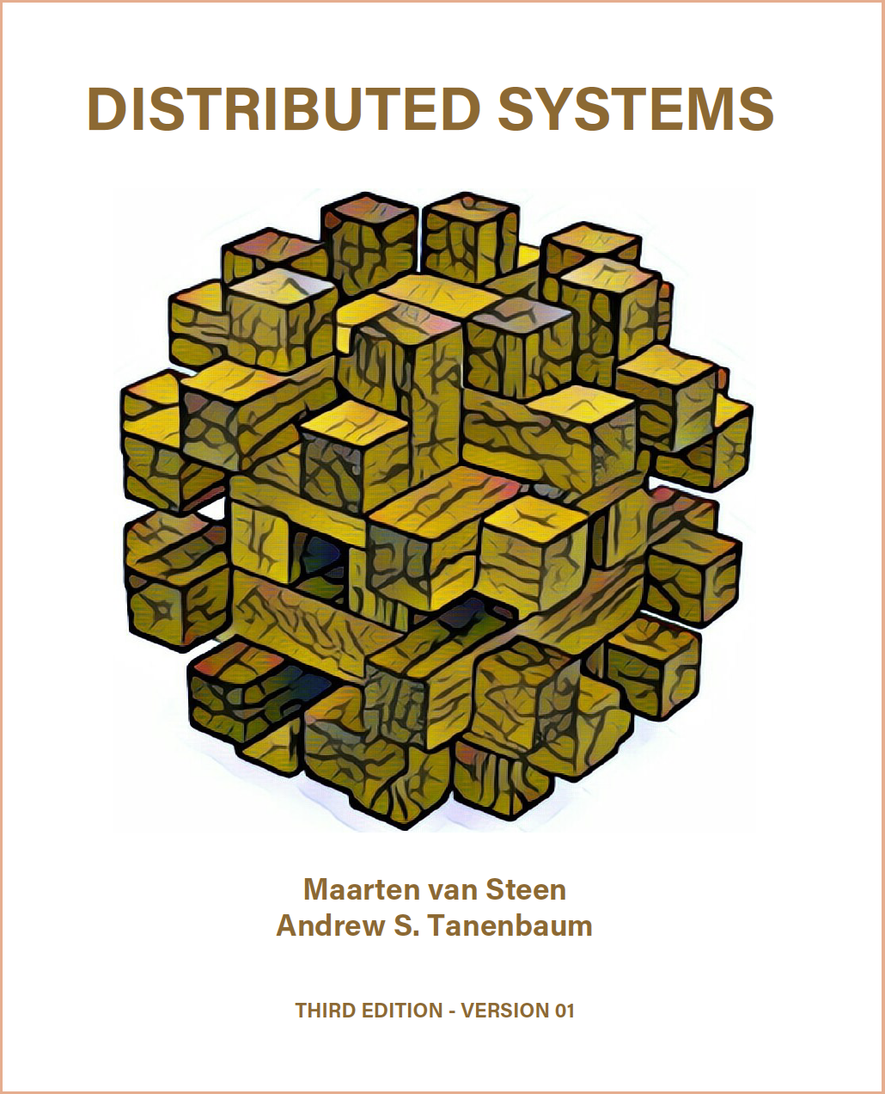

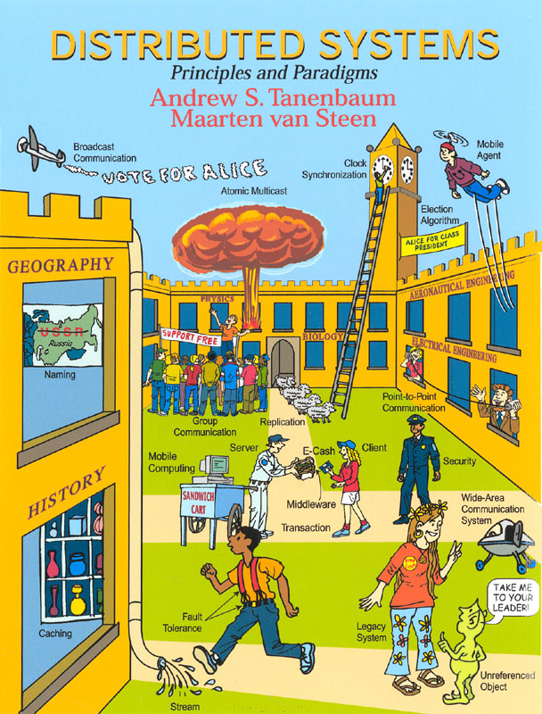
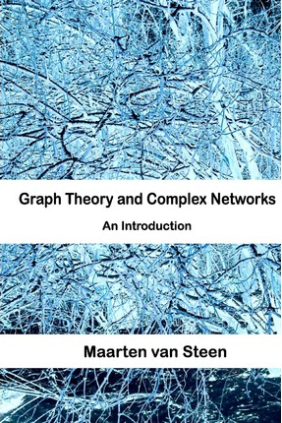
Computers & networks
INTRODUCTION
MAARTEN VAN STEEN
Large-scale distributed systems
Professor in Computer Science
Scientific Director of Digital Society Institute
Large-scale distributed computer systems
Complex networks

Slide 3
The golden circle

Slide 4
WHAT
Your current project
HOW
Your way of working
WHY
HOW
WHY
The reason why you do the things you do
WHAT

Slide 5
How to do research:
it starts with
identifying
a good problem

Slide 6
WHAT MAKES A GOOD (RESEARCH) PROBLEM?
BE INTERESTING (THE “WHY”)
BE SPECIFIC
BE NONTRIVIAL
BE SEEMINGLY SOLVABLE (THE “HOW”)
Notes:
Seemingly solvable means that you have an idea of the type of solution.

Slide 7

EXAMPLE:
MONITORING PEDESTRIANS BY WIFI SIGNALS

Slide 8
THE PROBLEM
To what extent can we preserve privacy while capturing MAC addresses of wifi-enabled devices?
WHY
THERE IS A SOCIETAL NEED
  Understanding pedestrian dynamics
THERE IS A SOCIETAL CONCERN
  Privacy of individuals may be at stake
THERE IS A SIMPLE CONSTRAINT
  Don’t bug the pedestrian

Slide 9
BEING SPECIFIC: PRESERVING PRIVACY
To what extent can we provably show that an individual cannot be identified from the data collected for capturing pedestrian dynamics?
BEING MORE SPECIFIC: PRESERVING PRIVACY
To what extent can we provably show that we can preserve k-anonymity based on collecting the network address of WiFi-enabled devices for capturing pedestrian dynamics?

Slide 10
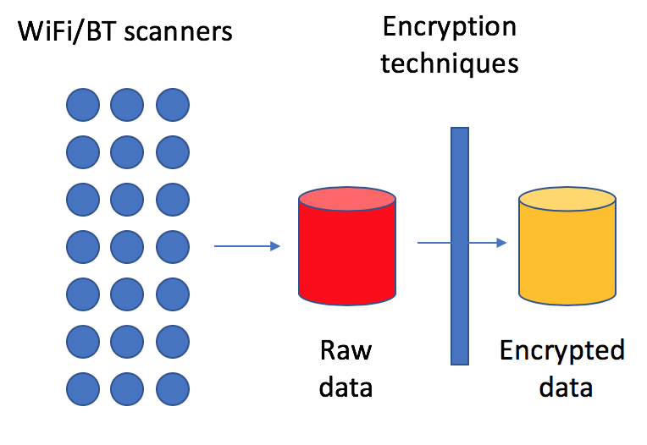
CURRENT APPROACHES

Slide 11
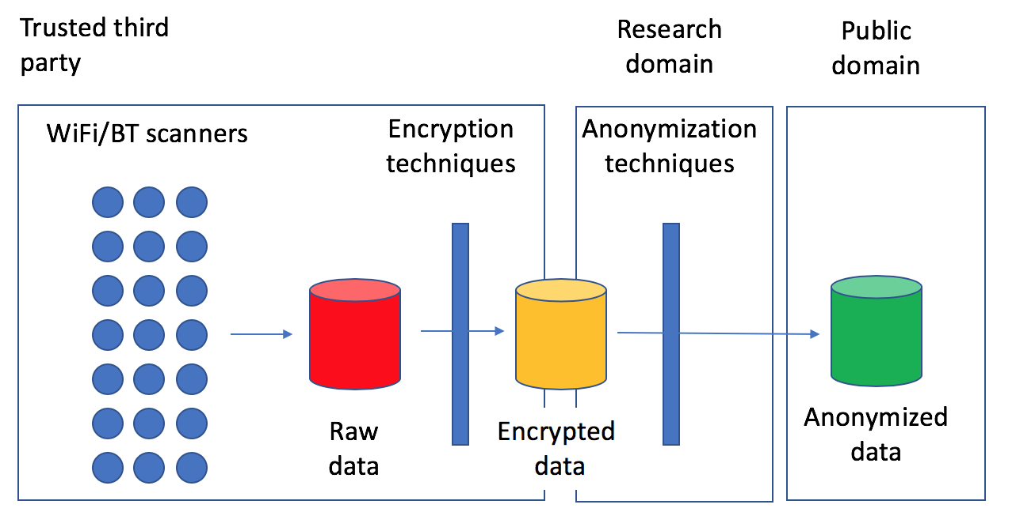
CURRENT APPROACHES: BETTER

Slide 12
OUR APPROACH
We have something
  Essence k-anonymity: each raw detection can be matched to no fewer than k detections in our data sets.
  We store only data subsets that preserve k-anonymity: every detection for a specific ID, has at least k other detections for that ID.
  Combining these data subsets preserves k-anonymity.
Current steps
  Formally prove our approach preserves k-anonymity (it does)
  Take measures to obtain high accuracy in counting
  Run experiments for cases where assumptions are violated.

Slide 13
How to do research:
finding solutions

Slide 14
Extreme 1:
read first, then invent
Notes:
Q: what are the pros and cons of this approach?
You get to know a lot about the topic.
You have no idea if what you read contributes to a solution
Where do you start with reading [come back to that later]
Essentially: everything is equally important.

Slide 15
Extreme 2:
invent first, then read
Notes:
Q: What are the pros and cons?
You may be doing something that has already been done
You may be wasting a lot of time
You will get a pretty good understanding of the problem
You will be able to be much more selective in reading related material

Slide 16



THE SWEET SPOT
Notes:
Start with relevant survey/overview/tutorials.
Be sure to check the relevant references in those overviews.
Rule: understanding the problem requires that you really dig into exploring solution spaces. It really doesn’t matter that your first attempts fail. Research is not the same as an assignment.

Slide 17
How to do research:
getting to results
Notes:
The essential question is: how good is your solution?

Slide 18
Pick a random paper on a new solution to a known problem, and you’ll see that the solution is better when compared to all presented competitors.
Notes:
What’s the problem?
There are always data sets that will prove you right
Situations are barely comparable to each other
Assumptions on the underlying systems are different
The graphs really are often pretty meaningless
However, without the comparisons, your solution will not even be looked at.

Slide 19
Getting to results:
analysis of quicksort

Slide 20
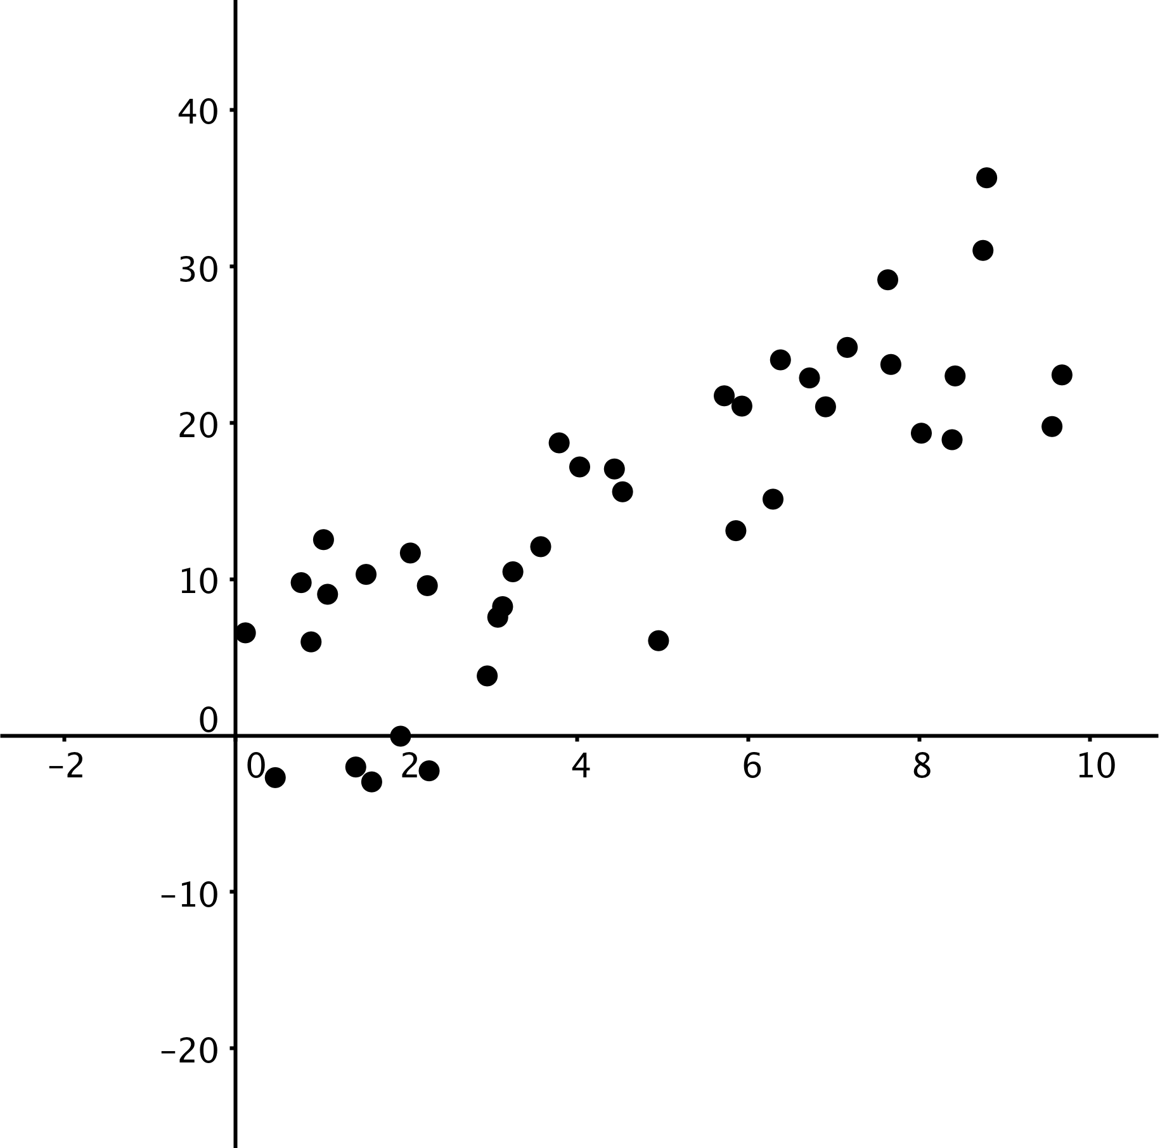
ASK YOURSELF: WHICH GRAPH(S) DO YOU WANT TO PRODUCE?
ANALYSIS OF QUICKSORT:
Problem size versus compute time
x-axis: number of elements to sort
y-axis: time

Slide 21
FORMAL ANALYSIS (N = elements to sort)
Best-case analysis (simple): N log₂ N
Worst-case analysis (simple): N²
Average-case analysis (not trivial at all): 4 (N+1) log₂ N
Doing the formal analysis is typically something that contributes to the research question: what is the time complexity of quicksort?
Important rule: always ask yourself why you’re doing exactly that specific part of research, and why it makes sense.
No answer? You’re not doing the right thing.

Slide 22
EXPERIMENTAL ANALYSIS (N = elements to sort)
Run the algorithm on a computer
Play with the problem size
Measure the time it takes to finish

Slide 23
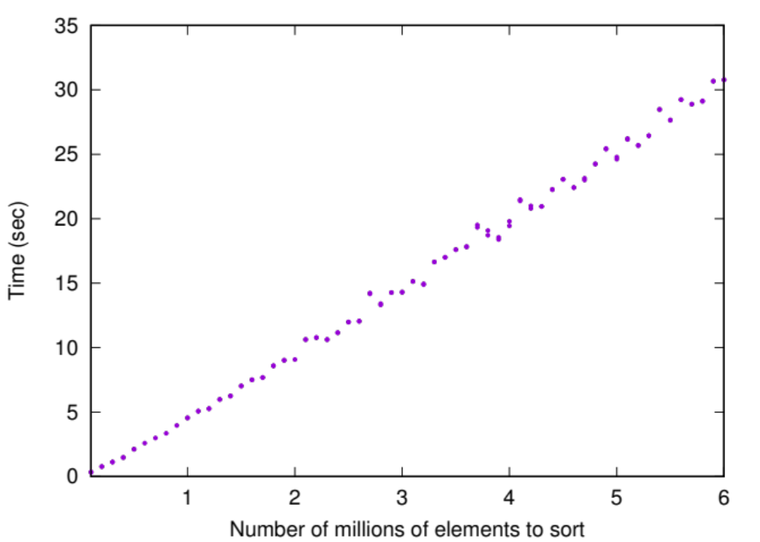

Slide 24
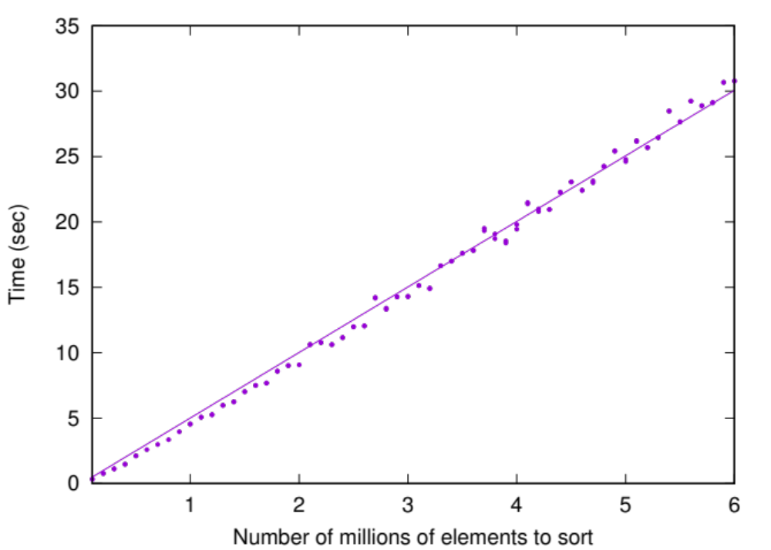
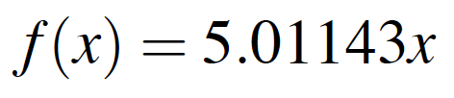

Slide 25
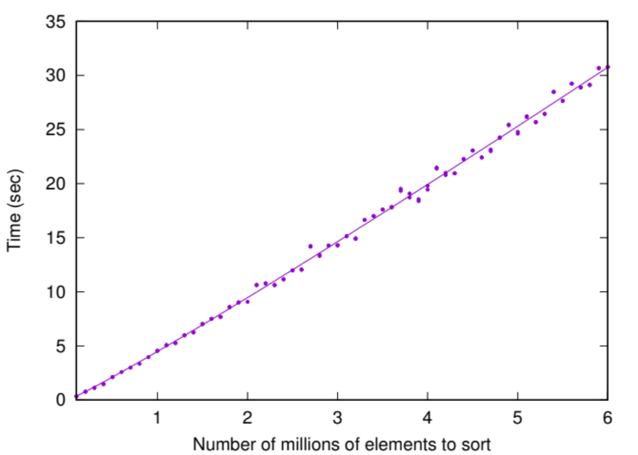
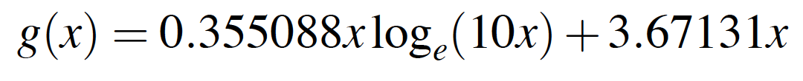

Slide 26
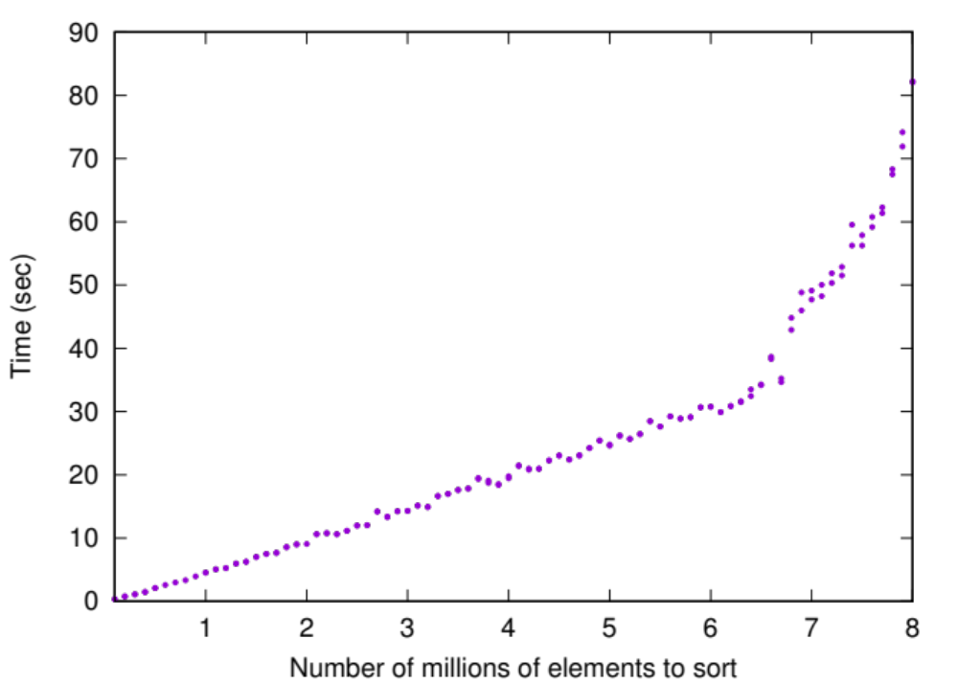
Problem fits in
physical memory
Problem also needs
virtual memory
Important rule: explore the corner cases, as there may be valuable information tucked away.
Important rule: always make sure you understand your results to the best extent possible.

Slide 27
TAKE-AWAY MESSAGES

Slide 28
1
IDENTIFY A GOOD PROBLEM: INTERESTING, SPECIFIC, SOLVABLE
2
SEARCH FOR RELEVANT RELATED WORK IN SURVEYS AND TUTORIALS
3
CONTINUE TO ASK WHY YOU’RE DOING SPECIFIC TASKS IN YOUR RESEARCH
4
EVALUATE, STARTING BY ASKING HOW TO MEASURE RESULTS

