Slide 1
HCI Design & Evaluation tutorial
Week 7

Slide 2
Before we start
Please remember that in the end you need to deliver a project report. You can use your reports as building blocks to write your final project report, but make sure that the final report is one story. Make sure the report reflects the process of the project, and make clear how and based on what decisions were made.
(reminder from week 4 lecture on next slide)

Slide 3
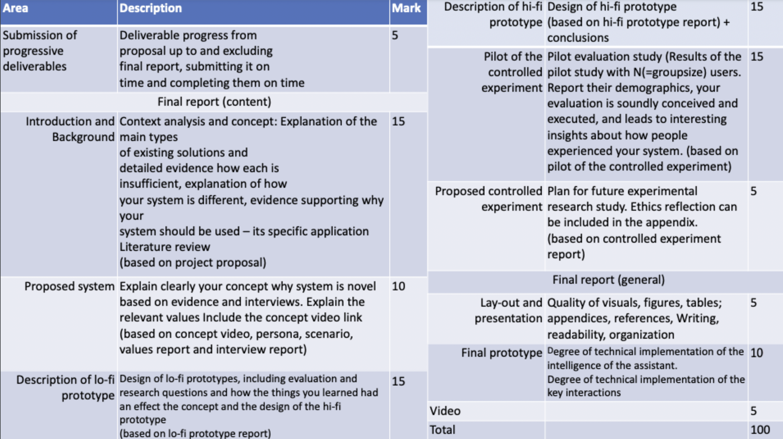
*The user test
with hi-fi prototype

Slide 4
Overview
Finish the hi-fi prototype
Controlled experiment proposal and Ethics
Please join the guest lecture this Friday (14-01-2022 13:45 – 15:30)
Instructions for the final report can be found on Canvas

Slide 5
Today
What
  Finish the hi-fi prototype
Hi-fi prototype
  Key user interfaces and user interactions with the system for smooth interactions
  Real-time interactive demo
  Beyond wireframes and/or cardboard
  “Intelligent” – include preferably a SDKs, APIs or Frameworks to include intelligence in your prototype (e.g. as mentioned in lecture 5)
  Degree of (technical) implementation is significantly higher than your lo-fi prototype, but lower than a full functional prototype
  We don’t make full systems, not everything is working, use of test or dummy data, hard coded, and NO personal/medical/private data of users!!
  Discuss your ideas for the hi-fi prototype with us before starting prototyping

Slide 6
Today
What
  Controlled experiment proposal
    It is not about the final usability study (with re-sit students) in week 8. This is an experiment that you will PLAN ONLY and you will not execute in this course.
    In the tutorial of week 8, you will execute a usability test of your hi-fi prototype with resit students (similar to the lo-fi prototype test)
  There are 2 possible options for doing a controlled experiment. You need to select one.
    Option 1: Experiment about a difference in your system.
    Option 2: Proof-of-concept.

Slide 7
Option 1
Identify a “difference” in your system that you think would make a “difference” to the user’s experience of your system
  (see lecture week 6)
  A difference in the system is called an “independent variable”. E.g.
  Human appearance versus robotic appearance (for virtual agent) – difference in virtual agent appearance.
    Displaying high level advice versus low level advice (for recommendations) – difference in information type.
    …
  A difference in the user’s experience is called a “dependent variable”. E.g.
    Higher trust – measured by questionnaire ratings of trust in the system on a scale from 1-100.
    Better performance – measured by response time.
    Attention – measured by more eye gaze (attention) at agent.
    …
RQ: “To what extent does <“difference in your system”> influence <“difference in user’s experience”>?”

Slide 8
Option 2
Proof-of-concept
1st condition is your prototype, and a 2nd condition (the ‘control’) is an existing state-of-the-art system. E.g. a smart assistant for mental health might have a human therapist as the control; an augmented reality app might select a non-augmented reality app as its control.
Evaluate how the novel part of your system (e.g., a virtual agent instead of a human, or that it’s augmented reality) affects user experience (e.g., augmented reality is better, or virtual agent results in similar performance as human)
RQ: “What effect does <“the novel part of your system compared to the control”> have on <“dependent variable”> in <“application area”>?”

Slide 9
Pilot testing
If possible, the pilot tests of the hi-fi prototypes can be executed on Campus, otherwise they will be moved online.
Remote desktop tools, such as AnyDesk (Android, iOS, Windows, macOS, Linux, …) can be useful to let participants interact remotely with your prototypes.
In case when this is not possible, it is ok to test with persons (adults, competent, non-vulnerable) within the same household. But take the corona regulations into account!! (we have permission from the EEMCS ethics board to have this exception)
To be checked depending on Corona rules

Slide 10
Ethics
Every member of the project group picks a different subject from the list below
Write a section (length: towards approximately 1 page, or longer as needed) addressing that topic.
Submit the sections in a combined document; indicate clearly which section was written by which group member.
Subjects:
  Participant selection
  Informed consent
  Data management plan
  Task, stimuli and measurements
  Desirability of the product
  (so a group of 5 will address all topics, a group of 4 will address 4 topics etc.)

Slide 11
Reports
See details in the assignments
Deadlines:
  Hi-fi prototype: 14-01-2022
  Controlled experiment & ethics 16-01-2022

Slide 12
Next week
Hi-fi prototype testing with resit students.
  Bring your hi-fi prototype to the tutorial
  You will have some time to setup the prototype

