Slide 1
HCI Design & Evalution tutorial
Week 6

Slide 2
Overview
1,5 tutorials for this hi-fi prototype assignment (deadline Fri 14-01-2022)
  Other ½ of the tutorial in week 7 will be about the controlled experiment proposal and the ethics
Hi-fi prototype
  Not about writing perfect code, we need to be hackers and explore the (tech) possibilities for our key interactions
  And we will try out libraries for AI. The goal is to explore if this library is something useful
  Low commitment!

Slide 3
Today
What
  Based on the results of the lo-fi prototype test, decide what the interaction scenario with the hi-fi will be and start designing the hi-fi prototypes. We move forward from lo-fi prototypes to hi-fi prototype(s)
  Start implementing the hi-fi prototype. The prototype will be tested in week 8 with resit students; thinking already what you want to know or learn from the test can help deciding what to implement.
Notes:
We don’t make full systems, not everything is working, use of test or dummy data, …

Slide 4
Today
Hi-fi prototype
  Key user interfaces and user interactions with the system for smooth interactions
  Real-time interactive demo
  Beyond wireframes and/or cardboard
  “Intelligent” – include preferably a SDKs, APIs or Frameworks to include intelligence in your prototype (e.g. as mentioned in lecture 5)
  Degree of (technical) implementation is significantly higher than your lo-fi prototype, but lower than a full functional prototype
  We don’t make full systems, not everything is working, use of test or dummy data, hard coded, and NO personal/medical/private data of users!!
Discuss your ideas for the hi-fi prototype with us before starting prototyping
Notes:
We don’t make full systems, not everything is working, use of test or dummy data, …

Slide 5
Report (deadline: 14-01-2022)
A report that presents and explain (with your name and group number on it! Thank you again)
  The design of your hi-fi prototype. Add pictures of your hi-fi prototype.
  The interactions with key aspect of the system. Add pictures that illustrate the interactions.
  A high-level technical description, including the integration and motivation for SDKs / APIs / Frameworks of your hi-fi prototype.
  (you are also allowed to add a link to video that helps to explain your hi-fi prototype and the user interaction)

Slide 6
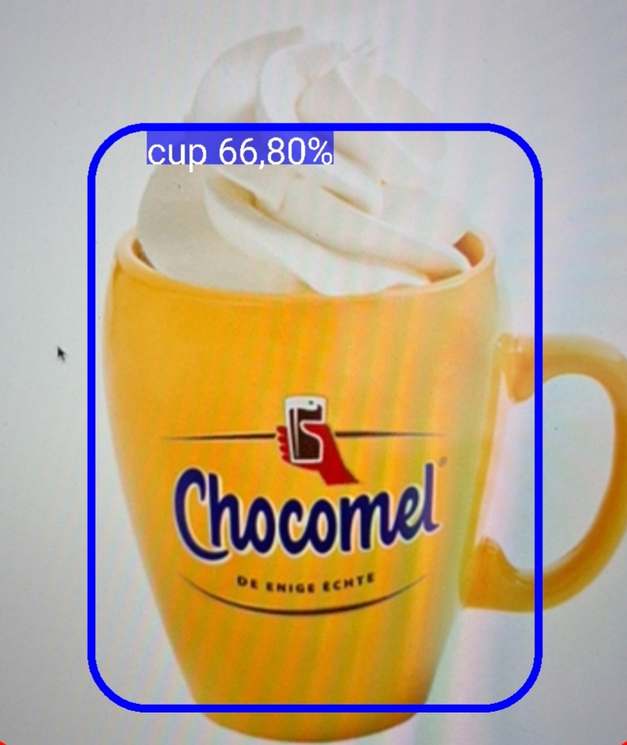
± 14:30 / ± 10:00

Slide 7
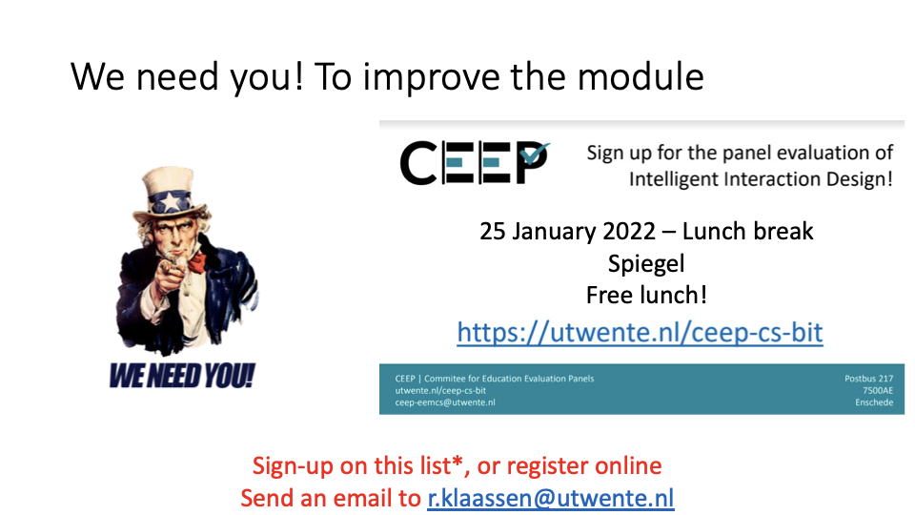

Slide 8
Sneak preview – week 7 and week 8
Controlled experiment and hi-fi prototype test
There are 2 possible options for doing a controlled experiment
  Option 1: Experiment about 1 difference in your system
  A difference in the system (called “independent variable”) can be:
    Male voice vs. female voice (for voice system) – difference in voice gender
    Human-like motions versus robotic motions (for robot gestures) - difference in motion style
  Option 2: Proof-of-concept
    Same as above, except for the following:
    Instead of finding a difference in your system, you select 1 condition to be your system and a 2nd condition (the ‘control’) to be the existing state-of-the-art system that your system would replace.
    For example, a smart assistant for mental health might have a human therapist as the control; an augmented reality app might select a non-augmented reality app as its control.
In week 8 we do a test with users to evaluate your hi-fi prototype

