Slide 1
HCI Design & Evaluation tutorial
Week 4

Slide 2

http://www.youtube.com/watch?v=w7Q6bHVESsE

Slide 3
Lo-fi prototype
Intended purpose of a prototype:
"Communicate the story of your concept to your stakeholders for feedback or research sessions"
With your lo-fi prototype(s) you will be able to test the first response of the users with regards to 2 to 3 key interactions of the system.
Key interactions are interactions with the key aspects or elements of your system that showcase the user experience while using your assistant in the intended practice. E.g. receiving feedback at the trash bin about where to put trash.
You can argue that installing an app, registering or logging in to a system are key interactions, since without them the system can’t be used. In this assignment we consider these aspects as a given facts. We focus instead on the actual use of the system by the user to help or support them in the context of use.
For this, you will use a mock-up version of your system. You will use (digital/paper) prototyping tools to develop your lo-fi prototype.

Slide 4
Overview
2 tutorials for this assignment (deadline 17-12-2021)
Lo-fi prototype
User evaluation of the lo-fi prototype

Slide 5
Today
What (±30 minutes)
  Design an interaction scenario* that shows what you are going to test.
  Define a research question that you can answer with the test (so you know what to prototype) (let it check before going to next step)
* a description of a person's interaction with a system; this can be based on the scenarios from week 2, including the changes you discovered in week 3 and
the feedback on the deliverables.

Slide 6
Today
What (±30 minutes): interaction scenario + research question (to be checked)
Lo-fi prototype creation (to test the first response of the users) (±3 hours)
  2 to 3 key interactions of the system.
  Remember it should be ‘cheap’ to throw away your lo-fi prototype.
  Paper and/or digital prototyping, but no tech. implementation
    If you need materials, ask your tutorial leader
  You can (and it’s a good idea) already make multiple versions of your system (and you can change your prototypes while testing)

Slide 7
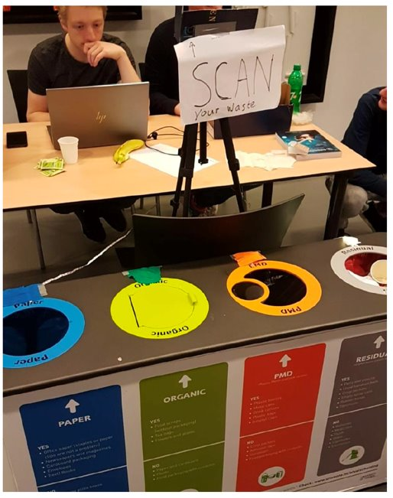
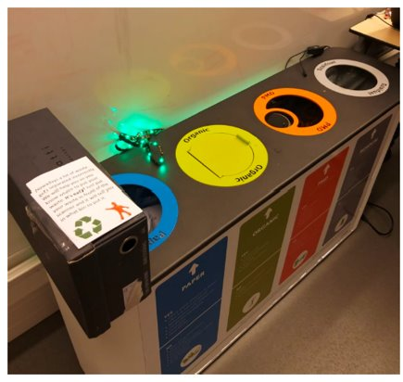
Manual controlled lights
Voice/speaker (hidden, via Skype)
No real scanning, just watch
RQ: What is the best modality to give instant feedback at the trash bin?
RQ: How will student present trash to a smart bin?
Light
Text

Slide 8
Today
What (±30 minutes): interaction scenario + research question (to be checked)
Lo-fi prototype creation (±3 hours): 2/3 key interaction, paper or digital
How - setup of the user evaluation test (±30 minutes)
  Test the lo-fi prototype with N colleague students, where N is ≥ the number of members in your group (executed next week).
  The procedure and methods, what roles are there, what do we record? how to make notes? WoZ? Who is the experiment leader, how to welcome the participant?, observers? What to observe? Think out loud? Etc?
Actual testing will be in the tutorial of week 5!

Slide 9
What to deliver (deadline 17-12-2021)
A report that presents and explain (with your name and group number on it! Thank you :)):
  The research question for the evaluation test.
  The interaction scenario that shows what you are going to test.
  The design of your lo-fi prototype and the interaction with the key aspects of the system. Add pictures and/or sketches of your lo-fi prototype.
  The setup for the evaluation study, what is the procedure, tasks, roles in the team.
  Notes and observations of the user test.
  Results and conclusions from your test
    How will it affect your concept/hi-fi prototype?

Slide 10




Paper prototypes

Slide 11
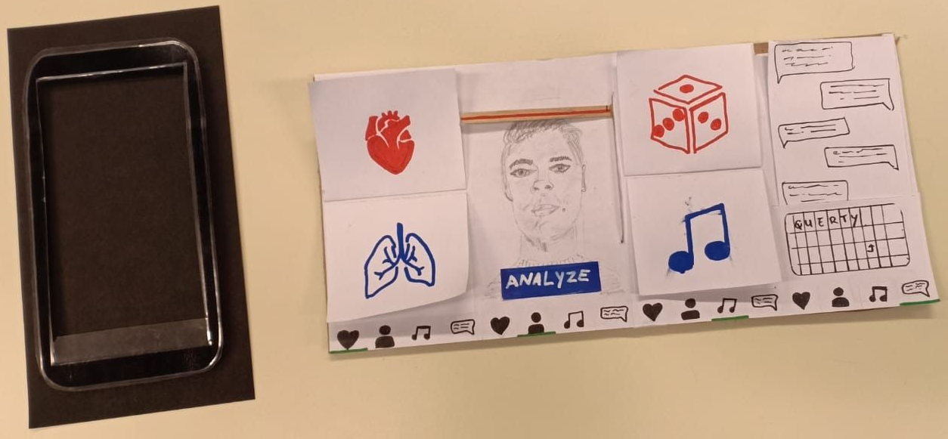
Paper prototypes

Slide 12
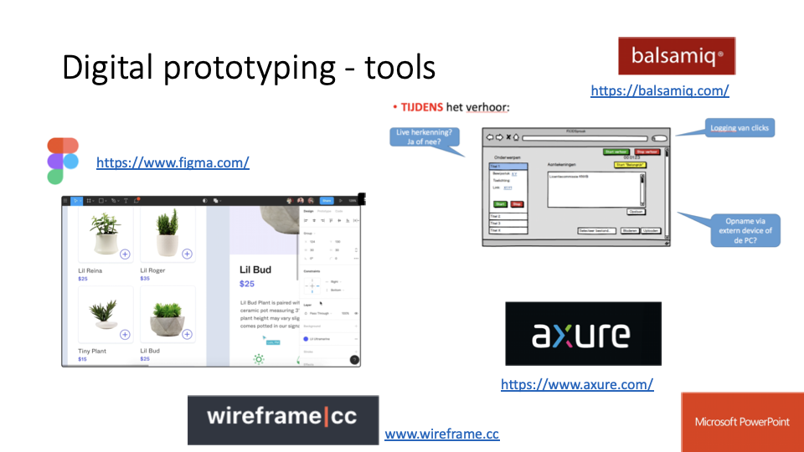

Some may be paid apps, free trial/version are available

