Slide 1
HCI Design & Evaluation tutorial
Week 3

Slide 2
Overview
Research questions (reminders on next slides)
  Let them be checked by the teaching team before you go to step 2
Prepare your interview
  Semi-structured questions
  Define your roles during the interview
  Let them be checked by the teaching team before you go to step 3 and 4
Find other groups to execute your interviews
Execute your interview (at least N participants, where N is the number of group members in your group)
Results and conclusions from your interview
  How will it affect your concept?

Slide 3
Overview
Find other groups to execute your interviews
Execute your interview (at least N participants, where N is your group size)
The participant is a proxy user and should try to empathize with the potential target group following your instructions. E.g. I want to help elderly people → think about how your grandpa will react or answer the questions.
Please note that we have permission from the EEMCS ethics committee Computer & Information Science to do these user studies in the context of this course only with students that are following the course in the (physical) context of this tutorial (today, in this room).
The teaching team is responsible to check if all questions and procedures are within the boundaries of ethical permission we have.

Slide 4

Research question(s) for you interview
The goal is to get a first idea of how your user group evaluates/reacts to your problem statement, and your concept. We formulate this goal as a Research Question (RQ), which will be divided in sub-Research Questions.
Is finding the correct trashcan a problem?
To what extent is finding the correct trashcan a problem for students?
Notes:
What’s the problem here?
Yes/no questions, more specified, target user group added etc.

Slide 5
Research question(s) for you interview
Sub-RQ’s can also be related to further specifying your problem statement. E.g:
What aspect of [activity] do [user group] find particularly problematic when using [current solution]?
Sub-RQ’s can be related to specific design questions you may have. E.g.:
Which of these concepts (as displayed in your concept video) is more likely to motivate [user group] in [activity]?
Ask questions to answer both type of RQs!! And do not ask the RQs directly to your participants!!

Slide 6
Research question(s) – reminder?
There are three general types of questions that we always find in research and design of UX.
1: A knowledge question is answered by collecting and analyzing information such as interviews, observations, or literature.
Q: What are typical activities and experiences in a museum setting?
A: The following activities and experiences: …

Slide 7
Research question(s) – reminder?
2: An evaluation question is answered by doing an experiment or study with your product.
  Q: what is the technical performance of my product?
  A1: it can run uninterrupted without breaking for X hours consecutively.
  A2: It fails in the following conditions: …
  Q: What is the impact of my solution on the daily practice of my users?
  A: It changes their experience in the following ways, …
  Q: How does our solution change the user’s social experience?
  A: …

Slide 8
Research question(s) – reminder?
3: A design question is answered by making something.
  Q: What is a good algorithm for solving X?
  A: this one, because time efficiency is important …
  Q: What is a good product for persuading people to practice their physiotherapy exercises?
  A1: the one I just made, because…
  A2: NOT the one I just made, because…

Slide 9
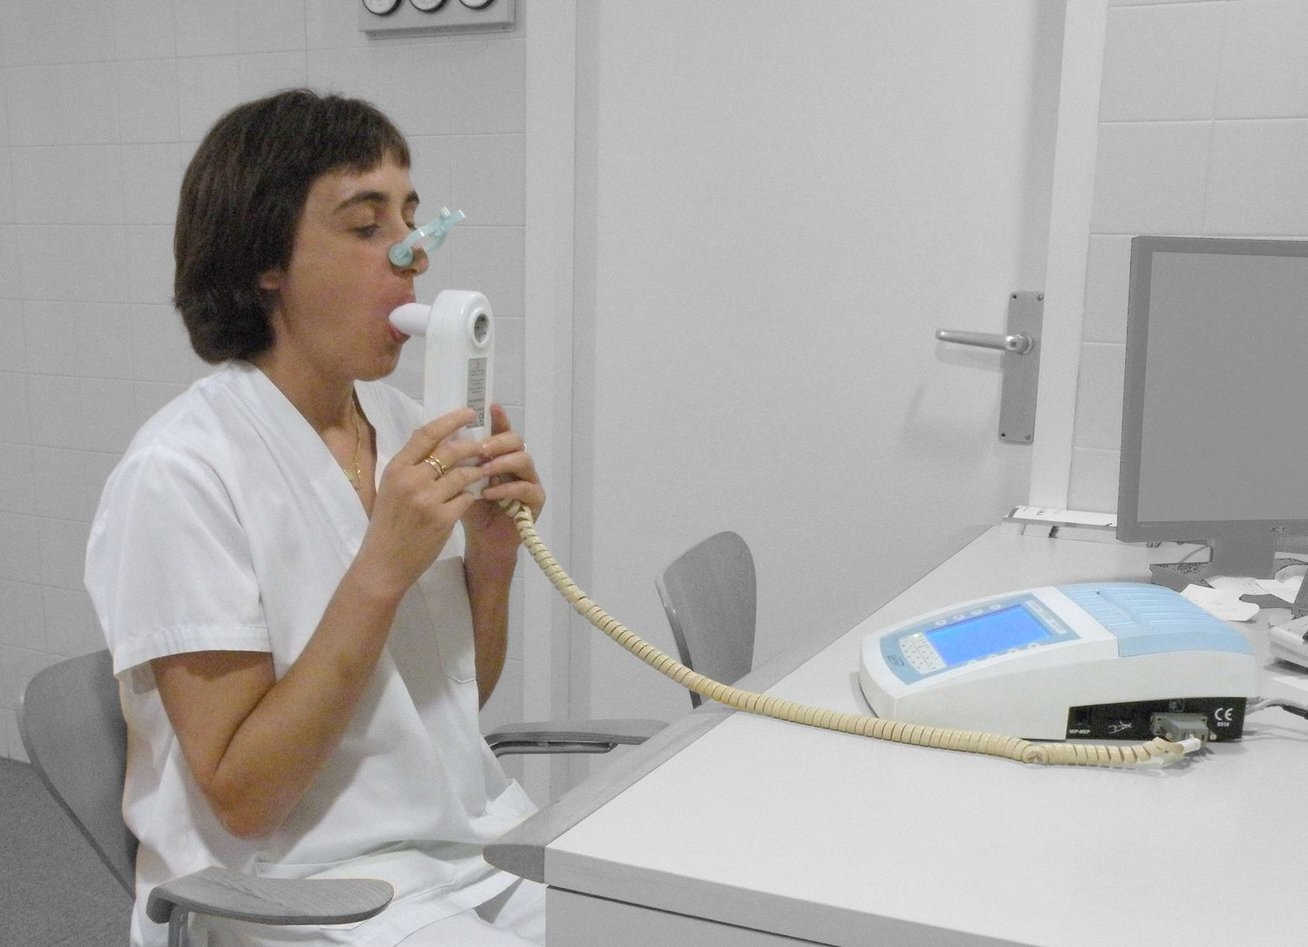
Research questions example
Overall Research Question:
How can we use gamification and metaphors to increase the performance and adherence of home-monitored spirometry for children with asthma? → design question
Sub-Research Questions:
What kind of performance errors are made? → knowledge question (literature + interviews)
How can we recognize these errors? → design question (but engineering oriented)
What kind of metaphors are fitting for children to motivate executing spirometry?
What do children come up with?
What do doctors think of this?
To what extent do these metaphors perform compared to normal supervised spirometry? → evaluation question
https://commons.wikimedia.org/wiki/File:DoingSpirometry.JPG
Notes:
The main RQ is too broad to be answered at once
To find an answer, we divide it in sub-RQs: “What factors are limiting the adherence of children to spirometry at home?”

Slide 10
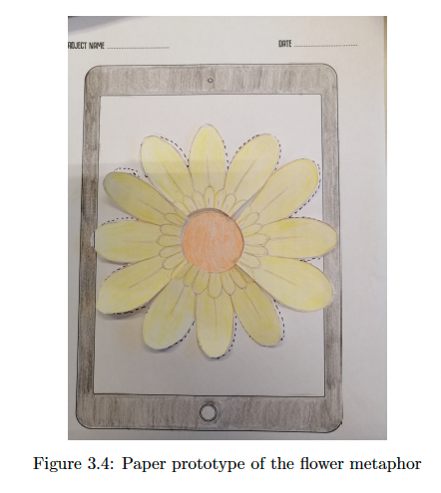
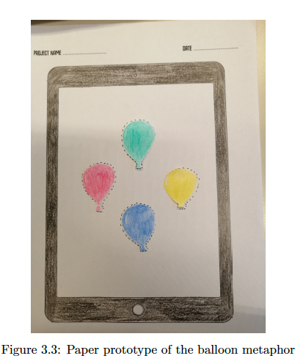
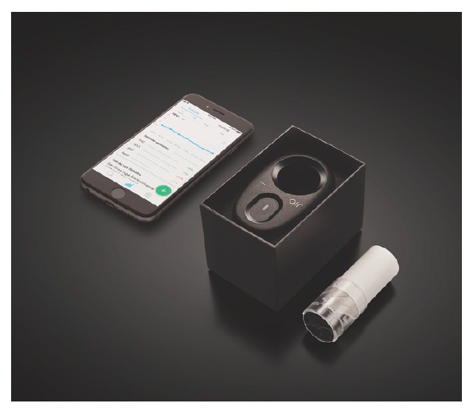

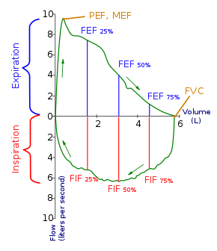
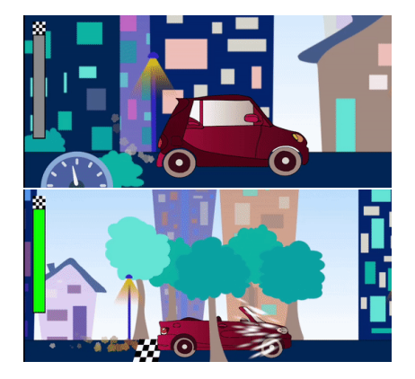
Interview questions example
What kind of performance errors are made? → knowledge question
  To medical doctors:
    How is spirometry executed in daily practice?
    Is there a specific order in which children need to do the tasks?
      Is the order important?
      Do children need support by doing this?
      What are common mistakes they make?
      Will that influence the results?
How can we recognize these errors? → design question
  To medical doctors:
    How does the output of a spirometry look like?
    Can you see from the graphs if the spirometry was successful?
    What error or mistakes can you recognize?
What kind of metaphors are fitting for children to motivate executing spirometry?
  To children after showing 100 examples of metaphors:
    What is your favorite metaphor?
      Why?
https://commons.wikimedia.org/wiki/File:Flow-volume-loop.svg
https://doi-org.ezproxy2.utwente.nl/10.1145/3410404.3414223
Notes:
Recall double-barreled questions: «do children need support in doing this, and will that influence the results?» is a bad interview questions (hard to answer «yes, and no»)

Slide 11
What to deliver (Deadline 03-12-2021)
A report of 3 to 4 pages (ex. appendix)
“Methodology” – Semi structured interview
  Your process, how many participants, basic information about participants, roles in your team, your (sub)RQs etc.
Results
  Identified themes including quotes. Interesting insights.
Your concept / conclusion
  Based on the results of your interview, describe the consequences for your concept. New insights, how and why is it affecting your concept? Or why is your concept in line with what the participants were saying.

Slide 12
Overview
Research questions (reminders on next slides)
  Let them be checked by the teaching team before you go to step 2
Prepare your interview
  Semi-structured questions
  Define your roles during the interview
  Let them be checked by the teaching team before you go to step 3 and 4
Find other groups to execute your interviews
Execute your interview (at least N participants, where N is the number of group members in your group)
  Show your video at the end of the interview to avoid bias towards your problem statement!
Results and conclusions from your interview
  How will it affect your concept?

