Slide 1
HCI Design & Evaluation tutorial
Week 2

Slide 2
Overview
Persona’s
Scenario’s
Values
Shot list
Finally you will record your video.

Slide 3
Concept video
A concept video is a short video that communicates your idea. It describes:
Which problem you are solving (what is your challenge and who are your users)
Current solutions and their shortcomings
Your concept
What is novel and interesting about it, how do you make an impact

Slide 4

Notes:
https://www.youtube.com/watch?v=Cwjy6hEftYo
And here is nothing about values (which was not part of the material in 2019)

Slide 5
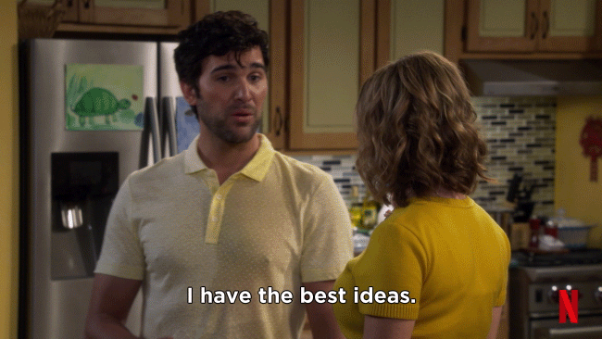
Pick your favorite concept from the top 3

Slide 6
Persona
To reflect on the need of your users you should prepare one (or more) persona
Personas are rich descriptions of typical users for your concept. They are realistic, and characterize the needs and goals of your potential users
Notes:
are rich descriptions of typical users of the product under development on which the designers can focus and for which they can design products. They don’t describe specific people, but rather they are realistic, and not idealized. Any one persona represents a synthesis of a number of real users who have been involved in data gathering, and it is based on a set of user profiles. Each persona is characterized by a unique set of goals relating to the particular product under development, rather than a job description or a simple demographic. This is because goals often differ among people within the same job role or the same demographic.
In addition to their goals, a persona will include a description of the user’s behavior, attitudes, activities, and environment. These items are all specified in some detail. For instance, instead of describing someone simply as a competent sailor, the persona includes
Paper: hypothetical stakeholders—individuals who will represent the different sorts of people studied during the fieldwork. It is important to create a rich but realistic view of these individuals, as they form the basis for describing and later transforming current activities and experiences (the technique is similar to the persona concept in Cooper, 1998)

Slide 7
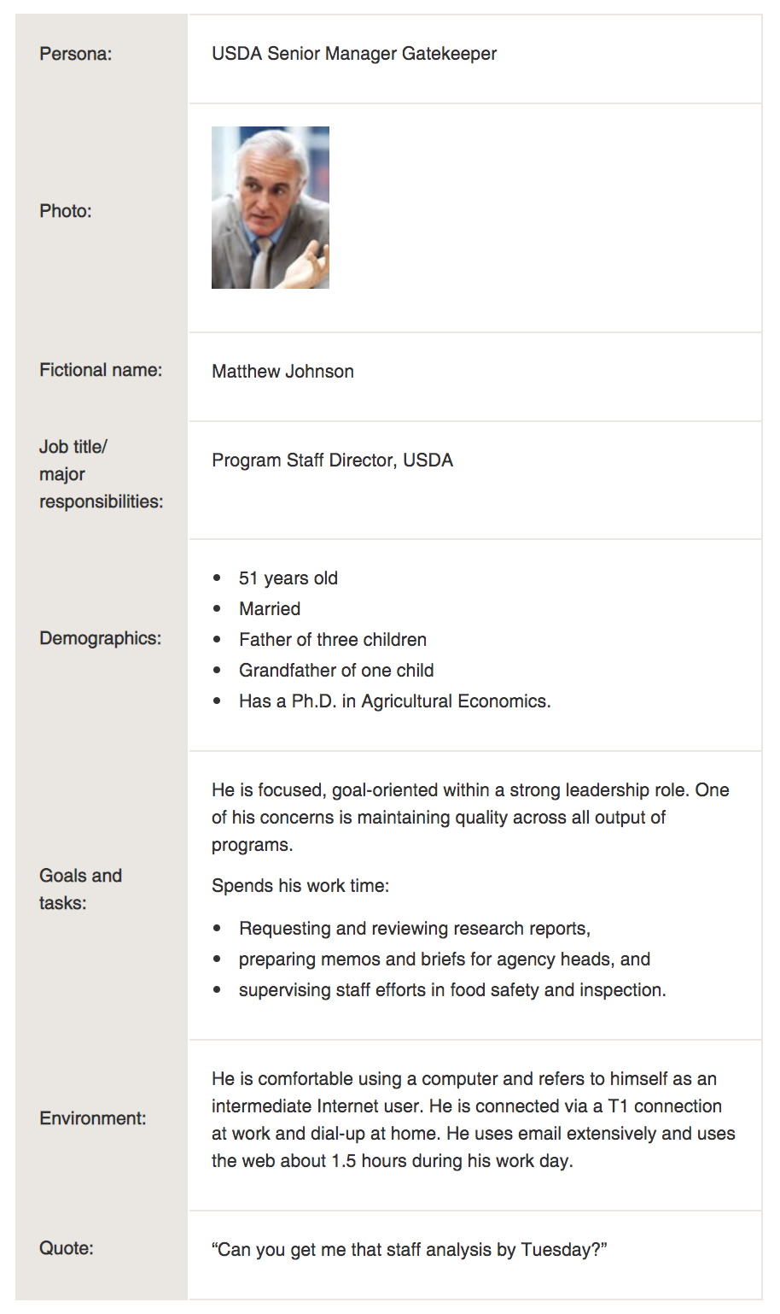
Persona
You (probably) need more than 1 persona, since
many users are going to use your concept, and
they have different goals, interests, needs…
ideally each persona represents one user
https://www.usability.gov/how-to-and-tools/methods/personas.html

Slide 8
Scenario’s
Scenarios are stories. They describe actors (the personas, with their personal motivations, knowledge and capabilities), their goals, and the actions they take to lead to an outcome (in your domain, e.g. the solution of their problem).
Example:
Rosson, M. B. &Carroll, J.M. (2002) Scenario-Based Design.
Table 1: Three scenarios for a university student attending a club meeting online

Slide 9
Scenario’s
You will write 3 scenario’s.
The current situation and current context (without your proposed system). Give a narrative description of how your target direct stakeholders and indirect stakeholders are working/solving/coping with its problem.

Slide 10
Scenario’s
The proposed situation and context where the use of your future smart assistant is concretely described. Give a narrative description of envisioned usage. How will a potential end user use your intelligent assistant in their daily life?

Slide 11
Scenario’s
The proposed situation (from scenario 2) with your proposed assistant, but this time adapt it to support the identification of values that may be affected through your technology. Take into account the following dimensions:
  include indirect as well as direct stakeholders;
  include nefarious and unusual uses of the technology, thinking also of worst-case scenarios;
  include implications of widespread use of your technology by imagining use by a single stakeholder, 100, 1000, and maybe even 100.000 or more users.
  consider different effects for different user groups (biases), and use by vulnerable groups (e.g. children, people with mental illnesses, disabilities, etc.).

Slide 12
  Identification of values
Based on the potential benefits and harms of your technology as in scenario, generate a list of as many potentially implicated values as possible. Possibly extend by checking the lists of commonly used values presented during the (video)lecture.
Deliberate and choose at least three primary values that the system would ideally support.
Give a short description for each of these three values; for each explain what they mean in the context of your envisaged system.
Motivate the choice of these values by linking them to the aspects identified in the scenarios of the previous step.

Slide 13
Shot list
Start by making a shot list in which you describe all the scenes that are included in the video.
For each shot/scene write an explanation of the general picture and message you want to communicate.

Slide 14
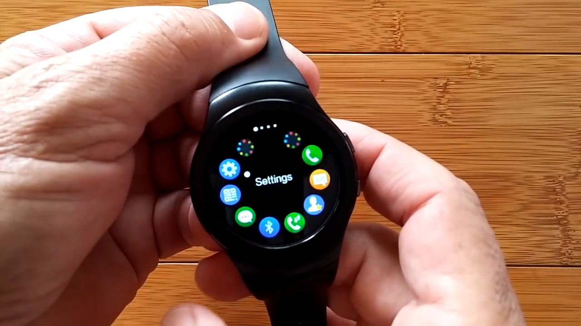
Shot list (concept: rotating bevel smartwatch)

Slide 15
Shot list: example
Shot | Shot content | Detailed content
A | We present [NAME, GROUP], a concept of a rotational bevel keyboard for smartwatches [(Working) Title].

Slide 16
Shot list: example
Shot | Shot content | Detailed content
A | We present [NAME, GROUP], a concept of a rotational bevel keyboard for smartwatches [(Working) Title].
B | Past work in smartwatch text entry uses touchscreens. This can be problematic because of the small displays on smartwatches. | Show wide view of actor touching screen of a smartwatch and having problems touch typing on the screen

Slide 17
Shot list: example
Shot | Shot content | Detailed content
A | We present [NAME, GROUP], a concept of a rotational bevel keyboard for smartwatches [(Working) Title].
B | Past work in smartwatch text entry uses touchscreens. This can be problematic because of the small displays on smartwatches. | Show wide view of actor touching screen of a smartwatch and having problems touch typing on the screen
C | Rotational bevels don’t require users to touch small areas of a smartwatch.

Slide 18
Shot list: example
Shot | Shot content | Detailed content
A | We present [NAME, GROUP], a concept of a rotational bevel keyboard for smartwatches [(Working) Title].
B | Past work in smartwatch text entry uses touchscreens. This can be problematic because of the small displays on smartwatches. | Show wide view of actor touching screen of a smartwatch and having problems touch typing on the screen
C | Rotational bevels don’t require users to touch small areas of a smartwatch.
D | Summarize the concept

Slide 19
Video magic
Possible resources:
Movie Maker
Video Scribe (tool)
Google Content Creator (YouTube)
CHI 2021 Video Guide (https://chi2021.acm.org/for-authors/presenting/papers/technical-requirements-and-guidelines-for-videos-at-chi )
Think about copyrights!! (images, video’s, music etc.)

Slide 20
What to deliver (Deadline 26-11-2021)
A document (with your names and group number on it) containing the personas, three scenarios, a description of the identification of values, your shotlist and a link to the video (make sure we can access the video!)

