Slide 1
HCI Design & Evaluation tutorial
Week 1
Group XX

Slide 2
Who am I?
<Tutorial leaders and TA, Write your own story here>

Slide 3
Expectation of the project
What will we do/make/discuss during the tutorials of this course?
Practice the techniques and methods from the theory course
Develop a concept of an intelligent assistant in the application domain of:
  Eating (e.g. diet, dinner, cooking, …)
  Skills training for sports or language
  Sustainability of energy or waste
Prototype key interactions with the intelligent assistant (!= developing the complete assistant)
Apply knowledge and skill from AI Practice, SDKs, frameworks etc in the hifi prototype (week 6 and week 7)

Slide 4






Expectation of the project: assignments
Assignment 1
Choosing your domain
Ideation of 3 potential concepts
Assignment 2
Focus on single concept
Imagine potential users, scenarios and values
Create video to present your concept
Assignment 3
Interview potential users
Adapt concept based on the interviews
Assignment 4
Lo-fi prototype
Test prototype with user
Adapt concept/prototype
Assignment 5
Hi-fi prototype
Assignment 6
Design a large-scale experiment to test
whether your concept works*
* and do a pilot test of this experiment
Icon design by Eucalyp

Slide 5
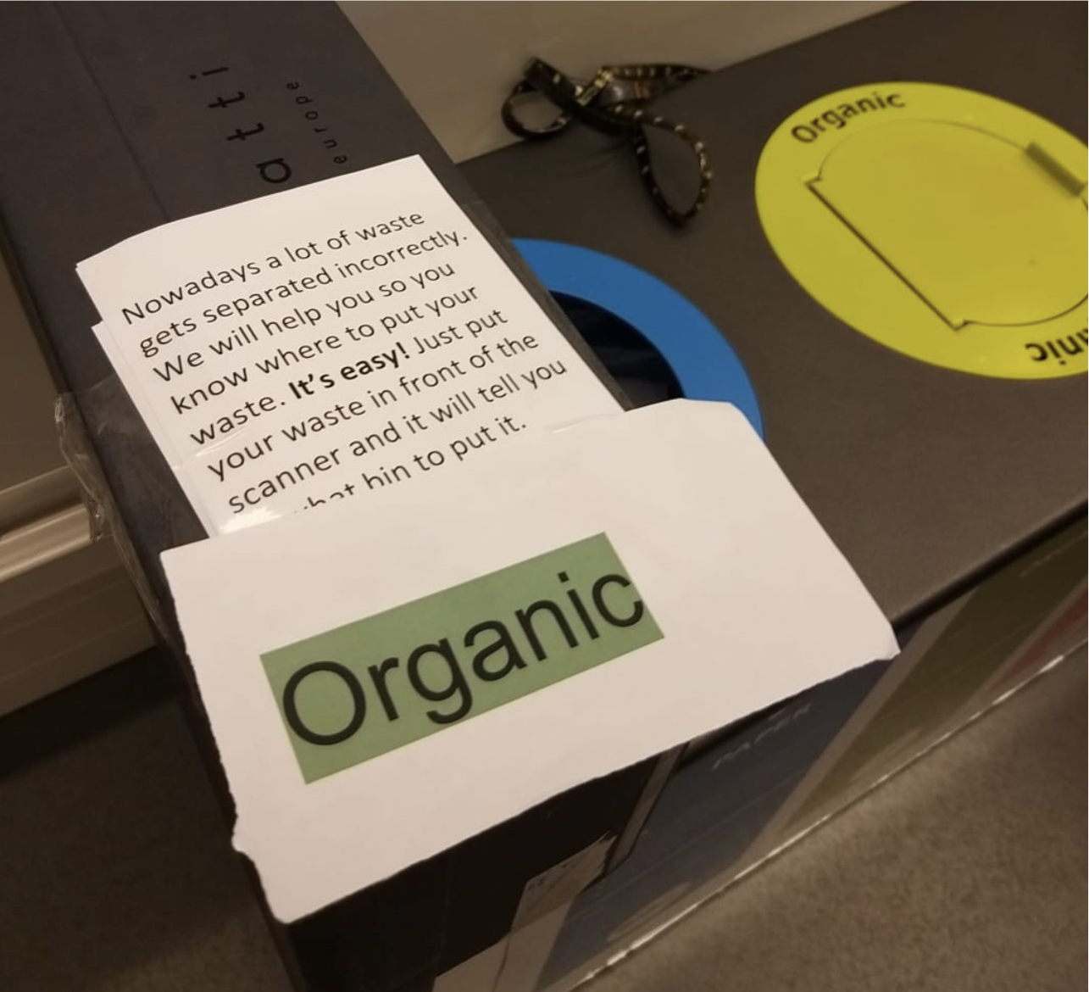
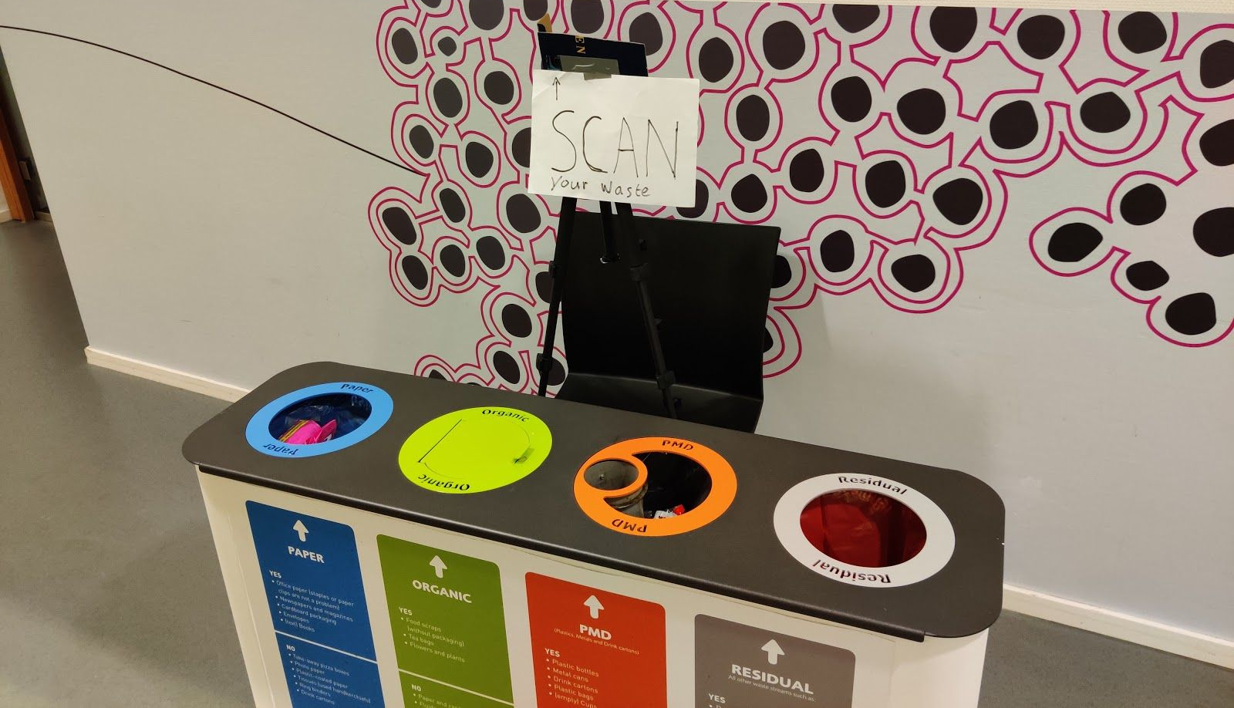
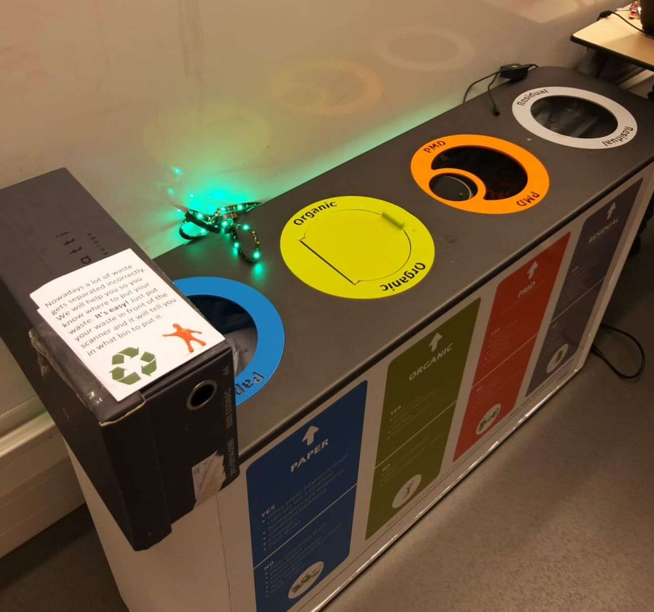
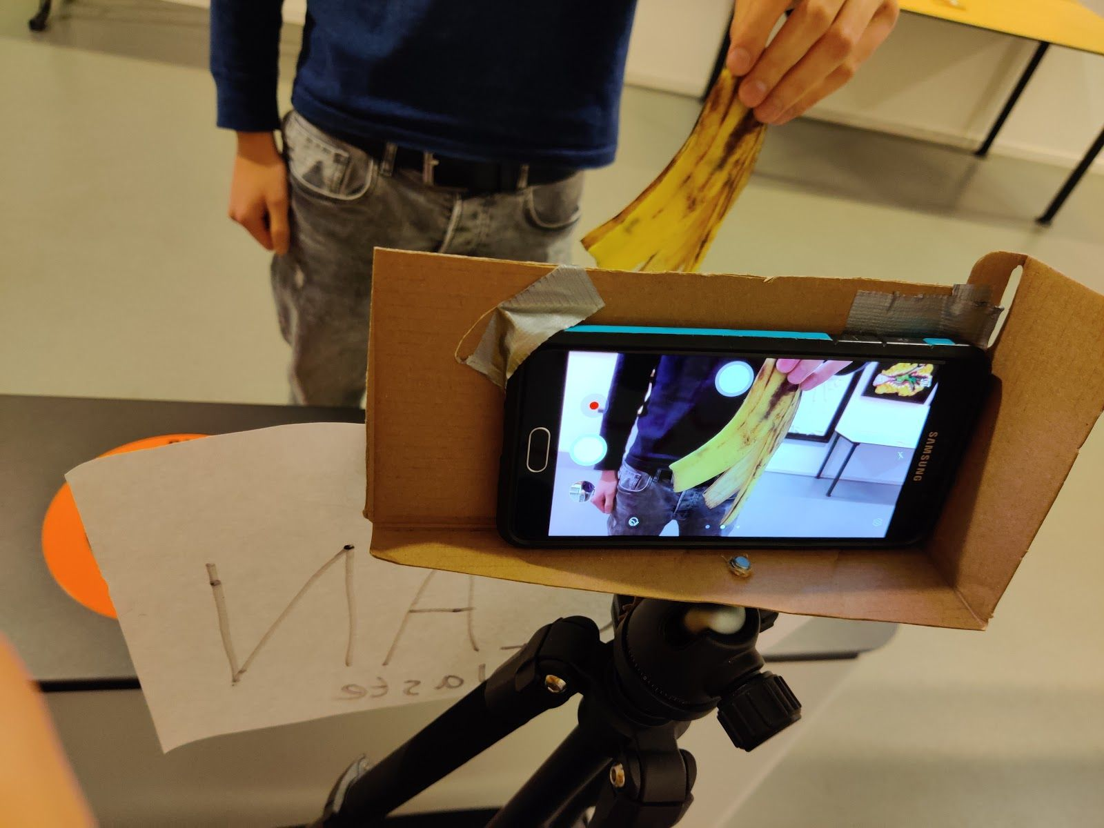
Expectation of the project: final report
The final report tells the story of the whole process, from concept ideation to hi-fi prototyping and the future experiments you designed.
Lo-fi prototype
Hi-fi prototype
Idea:
Smart bin to help people correctly separate trash
Interviews:
How do you separate trash?
Does it always go smoothly?
What do you do when you don’t know where to throw something?
…
Notes:
Example from last year to illustrate how the project progress goes: [0] First you find a problem in the domain (e.g. correctly separating trash), [1] you come up with a concept (smart bin that guides you), [2] interview other people to study the problem, how it is resolved now, and how this impacts your initial idea. [3] Then you build multiple lo-fi prototypes: [4] here you see a «smart bin» that indicates where to throw stuff with lights [5] or with a message – in addition to the text message there’s also a speaker underneat. This way you see how people would interact with your system, what problems it would have, what is the best design and what changes you still need to do, [6] and you use this info to develop a hi-fi prototype which is actually «smart», or pretends to be [7] (here you can see a phone with a camera that scans an object and automatically recognizes some types of trash using IBM Watson, and will indicate where to throw the item lighting up the inside of the correct bin). This process, the design choices, the feedback that motivated them, is all documented in the final report. As one student said last time, it’s not the destination, it’s the journey.

Slide 6
Expectation of the project: final report
The final report tells the story of the whole process, from concept ideation to hi-fi prototyping and the future experiments you designed.
The report is heavily based on your weekly assignments and on the formative feedback you received on them.
Only the final report is graded. Formative feedback on the assignments is there to improve your story and project. A clear and well-written assignment will get more informative and useful feedback, resulting in a better final report (and saves you time to write the final report)

Slide 7
Overview of this week
The goal of this assignment is to come up with possible concepts for your “Intelligent Assistant”. You will start by brainstorming and looking at different perspectives.
The first 15 minutes of this tutorial:
Agree on the application domain as a group. Select from:
  Eating (e.g. diet, dinner, cooking, …)
  Skills training for sports or language
  Sustainability of energy or waste

Slide 8
Overview of this week
In the next hour, each member (individual) of the group will think and find articles about these questions:
What is your application domain about? And what problems and challenges exist within this domain? Formulate your problem statement.
Who will be your target group?
What are the current solutions to solve the problem? What are the advantages and disadvantages of the current solutions?
What type of technologies can help to solve the problems or challenges in a better or smarter way (explain how)? Think about how to detect behavior and how to present feedback.

Slide 9
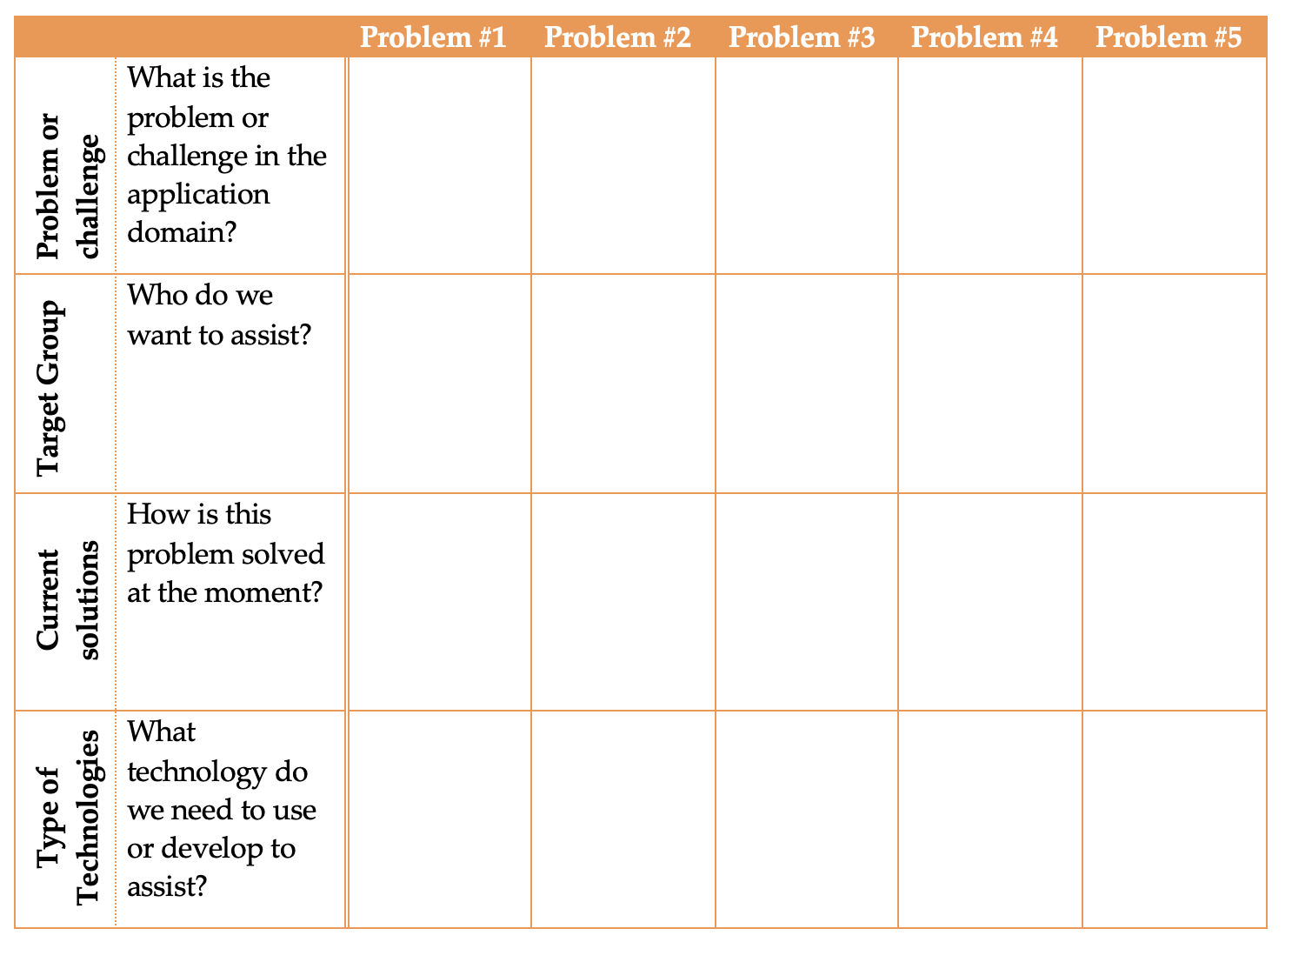
Overview of this week
Use the template to fill out the matrix with your individual findings.

Slide 10
Example
Kids forget to turn off lights
When should I turn of the heating
When to charge my car
Owner of house/
households
Kids
EV owners
Parents will tell/
learning at school
Nest thermostat
Energy meter of EV
Environmental sensors
Environmental sensors
Self learning algorithms
Smart power grid/agenda

Slide 11
Define your Intelligent Assistant
After the first hour:
  Get a coffee or tea ;)
  present your findings and ideas to each other.
  Try to make or find (new) combinations of ideas from each other. Combine the individual matrices into one final group matrix. This will be the starting point for the development of your concept of your intelligent assistant.
The problems in your application domain can be solved by more than one concept. By the end of this week you will need to have a top 3 of concepts for your domain. Per concept present one problem statement, one target group, and at least one current solution.

Slide 12
Deliverable (deadline 19-11-2021)
A report (including a title page, with names, group no., etc!) that includes:
The combined matrix with specific problems/challenges, target groups, current solutions and the technologies that can help or support.
Your top 3 concepts from the matrix; for each of your concepts:
  Reputable evidence (at least 1 article) that the problem to address is important (this refers to target application domain and/or general needs of target group)
  Brief explanation of the current solutions (including 1 articles) to this problem and why those solutions are lacking, or evidence that no previous solutions exist (this refers to current technology solutions)
  Explain how your concept will solve the problem in your domain, what technology will you need, why and how will it be applied.
  How this concept differs from current solutions and why those differences are valuable
  Potential impact of your concept in the application domain

Slide 13
Articles - reminder
You will need at least 10 articles (of which max 5 non-academic articles), i.e. at least 3 per concept.
What are academic/non-academic articles, and where to find them?
Academic literature: published in scientific journals, conferences, etc.
  Find them via Google Scholar, ACM Library, IEEE Library, Scopus, etc.
Non-academic literature
  Popular science articles, news articles, etc.

