Slide 1
P8.1: Advanced Java Facilities
Tom van Dijk
201700117-1B Module 2: Software Systems
15 January 2020

Slide 2
Programming line overview
Week 1 Values and variables Control flow | Week 2 Classes and objects Testing | Week 3 Interfaces and Inheritance Subtyping Security 1
Week 4 Arrays and Lists List implementations Collections | Week 5 Exceptions I/O Streams and MVC Security 2 | Week 6 Concurrency Project kick-off IDE Tips & Tricks
Week 7 Basic Networking Networking and Multithreading GUIs | Week 8/9 Advanced Java facilities Q&A Test | Week 10 Project Test resit

Slide 3
What is new in Java 8, 9, 10, 11
Small changes
  Improved switch
    Actually, this is already in Java 7, but not covered in the book
  Omitting generic type parameters
    Aka “diamonds” – let Java automatically derive the generic type
Bigger changes
  Lambdas
    Amazing what a bit of syntactic sugar can do
    Now, Java is moving in the direction of a functional language.
  Streams and Optionals
    Getting rid of loops and NullPointerExceptions
    Easier parallel programming
  Modules

Slide 4
switching on strings
Originally, switch only took integers & enums
    Types that can be compared by ==
For strings, you would have to do
      if (s.equals("Mon")) {
      d = 1;
      } else if (s.equals("Tue")) {
      d = 2;
      } else ...
Since Java 8:
      switch (s) {
      case "Mon": d = 1; break;
      case "Tue": d = 2; break;
      ...
      }
Main disadvantage of switch: remembering to insert the break
    Eclipse warns you about fall-throughs

Slide 5
Diamonds and vars
Strong typing is nice
  But sometimes you have to repeat the same thing often
  Map<Integer,Set<String>> map = new HashMap<Integer,Set<String>>();
Since Java 7:
  Map<Integer,Set<String>> map = new HashMap<>();
Since Java 10, a similar “abbreviation” is allowed for local variable declarations, using var:
  Java 6: Map<String, String> myMap = new HashMap<String, String>();
  Java 8: HashMap<String, String> myMap = new HashMap<>();
  Java 10: var myMap = new HashMap<String, String>();
Diamond

Slide 6
Lambdas -- Example
from named classes to anonymous classes to Lambda expressions
Consider an example where you run an instance of a “Worker” class inside a Java Thread:
  First define a “Runnable” class:
        public class Worker implements Runnable {
        @Override
        public void run() {
        System.out.println(“Working…”);
        }
        }
  Next, use a Worker instance as the “Runnable” for a Thread:
        public class Main {
        public static void main(String[] arg) {
        new Thread(new Worker()).start();
        }
        }
  This works. But it is rather verbose ….

Slide 7
anonymous classes, Lambda expressions
Interface can be implemented/instantiated in one of several ways
  Avoid the separate “Worker” class, use an anonymous class:
        public class Main {
        public static void main(String[] arg) {
        new Thread(new Runnable() {
        @Override
        public void run() { System.out.println(“Working…”); }
        }).start();
        }
        }
  Better. But now look at the new “Lambda expressions” solution:
        public class Main {
        public static void main(String[] arg) {
        new Thread( () -> System.out.println(“Working…”) ).start();
        }
        }

Slide 8
Lambda expressions
Why/how does this work?
The Thread constructor expects a “Runnable” argument.
“Runnable” is an interface, but a rather special type of interface:
it requires just a single method (the “run” method)
So, the Java compiler can infer that the lambda expression implements the run method method.
Of course, the lambda expression must “match” the typing of the “run” method:
        void run() { System.out.println(“Working...”); }
        () -> System.out.println(“Working...”)
Both have an “empty” argument list, and return “void”, in this example. So the types “match”.

Slide 9
Lambdas: example 2
Lambda expressions can have parameters, and “return” the value of the expression:
( parameters ) -> expression
Example. Define a class of “Students”:
      public class Student {
      private String name;
      private int age;
      public Student(String name, int age) {
      this.name = name;
      this.age = age;
      }
      public String getName() { return name; }
      ......
      }

Slide 10
Lambdas: example 2 (cont.)
Next, create some “Student” instances, and add them to a List:
    List<Student> students = new ArrayList<>();
    students.add(new Student(“Mike”, 21));
    students.add(new Student(“Alice”, 20));
    ...
Now we want to sort the list:
    Collections.sort(students, new Comparator<Student>() {
    @Override
    public int compare(Student s1, Student s2) {
    return s1.getName().compareTo(s2.getname());
    }
    });
Finally, look at the Lambda expression solution:
Collections.sort(students, (s1, s2) -> s1.getName().compareTo(s2.getname()) );

Slide 11
Lambdas
A functional interface is one with a single method only
      interface F { public int go(int a); }
Interface can be implemented/instantiated in one of several ways
  Define explicitly named implementing class
      class Plus implements F {
      public int go(int a) { return a+a; }
      }
      ...
      F plus = new Plus();
      System.out.println(plus.go(3)); // prints 6
  Instantiate anonymous class
      F times = new F() { public int go(int a) { return a*a; } };
      System.out.println(times.go(3)); // prints 9
Lambdas are syntactic sugar for anonymous class instantiation
      F succ = a -> a+1;
      System.out.println(succ.go(3)); // prints 4
This is the clever bit: no method name, types, braces, return, …

Slide 12
Lambdas (continued)
Also possible for different argument counts
  Parentheses required to distinguish arguments
  Lambda without arguments is called supplier
        interface F2 { public int go2(int a, int b); }
        interface F0 { public int show(); }
        F2 add = (a,b) -> a+b;
        System.out.println(add.go2(3,8)); // prints 11
        F0 one = () -> 1;
        System.out.println(one.show()); // prints 1
Also possible for void and non-pure methods
  Void lambda is called consumer
  Lambda body can have side effect
        interface Fvoid { public void eat(int a, int b); }
        Fvoid printSum = (a,b) -> System.out.println(a+b);
        printSum.eat(3, 4); // prints 7

Slide 13
Lambdas (continued)
  Some of the conciseness is lost: braces and return required
Also possible to use for multi-line methods
        F2 addSquare = (a,b) -> { int c = a+b; return c*c; };
        System.out.println(addSquare.go2(3,2)); // prints 25
Also possible to use existing methods as lambdas
  E.g., more interesting supplier lambda
        Iterator<Integer> it = Arrays.asList(3,4,5).iterator();
        F0 next = it::next;
        System.out.println(next.show()); // prints 3
        System.out.println(next.show()); // prints 4
  Wrapping your own methods
        public class MethodAsLambda {
        private int field = 5;
        public int add(int i) { field++; return i+field; }
        }
        MethodAsLambda instance = new MethodAsLambda();
        F lambda = instance::add;
        System.out.println("Apply to 2: "+lambda.go(2)); // prints 8
        System.out.println("Apply to 3: "+lambda.go(3)); // prints 10

Slide 14
Streams
A stream is a way to access a collection with very cool functionality
  Elements of the collection processed by lambdas
  Processing typically means: filtering, converting, searching
  Comparable to iterating in a for-loop for a List
    but much more compact & convenient
  Parallel processing within easy reach
Note: The “Streams” that we discuss here have nothing to do the stream-based IO, like “InputStream” or “OutputStream” etcetera). The naming might be confusing.

Slide 15
Streams: creating and filtering
Assume we have defined and initialised variables
        Integer[] ints;
        Set<Integer> intSet;
Creating a stream can be done in many ways. For example:
  Convert an array into a stream
        Stream<Integer> myStream = Stream.of(ints);
  Convert a collection into a stream
        Stream<Integer> myStream = intSet.stream();
Filtering a stream
  Add 1 to each element of stream and convert back to list
        List<Integer> plusOne = myStream
        .map(i -> i + 1).
        .collect(Collectors.toList());
        System.out.println(plusOne);
  The original “myStream” is now consumed, do not reuse
Use of lambda

Slide 16
Streams: Filtering and testing
Filtering: Select only certain elements by applying boolean test
  Filter a stream by selecting only even numbers
    Stream<Integer> even = Stream.of(ints).filter(i -> i % 2 == 0);
The “i -> i % 2 == 0” lambda is an example of a Predicate.
(So, “Predicate” is one of the new interfaces in Java 8)
Testing: Check if all or at least one element satisfies a boolean test
  Test if all elements satisfy a given property (being smaller than 10)
        if (!Stream.of(ints).allMatch(i -> i < 10)) {
        System.out.println("Not all elements are smaller than 10");
        }
  Test if any element satisfies a given property (being larger than 100)
        if (Stream.of(ints).anyMatch(i -> i > 100)) {
        System.out.println("There is an element larger than 100");
        }

Slide 17
Infinite streams and searching
Suppose we have defined (in class Streams)
        private static int seed = 0;
        private static int next() {
        seed++;
        return seed;
        }
Create an infinite stream using a supplier
        Stream<Integer> infiniteStream = Stream.generate(Streams::next);
Select some multiple of 10 (typically the first)
        Optional<Integer> multiple = infiniteStream
        .filter(i -> i % 10 == 0)
        .findAny();
        System.out.println("Multiple of 10: " + multiple.get());

Slide 18
Parallelism in streams
You can easily turn a (sequential) stream into a parallel one
  If possible, elements will be processed in parallel
  Only possible if there are no dependencies
Sequential processing:
    long start = System.nanoTime();
    Stream.of(manyInts)
    .map(i -> isPrime(i))
    .collect(Collectors.toList());
    System.out.println("Sequential processing: “ + (System.nanoTime() - start) / 1000);
Parallel processing:
    long start = System.nanoTime();
    Stream.of(manyInts)
    .parallel()
    .map(i -> isPrime(i))
    .collect(Collectors.toList());
    System.out.println("Parallel processing: “ + (System.nanoTime() - start) / 1000);
The only addition

Slide 19

Optionals
Hoare, 1934 --
Tony Hoare, 2009, on null:
  I call it my billion-dollar mistake. It was the invention of the null reference in 1965. At that time, I was designing the first comprehensive type system for references in an object oriented language (ALGOL W). My goal was to ensure that all use of references should be absolutely safe, with checking performed automatically by the compiler. But I couldn't resist the temptation to put in a null reference, simply because it was so easy to implement. This has led to innumerable errors, vulnerabilities, and system crashes, which have probably caused a billion dollars of pain and damage in the last forty years.
An “Optional” wraps a real value or null
  Provides functionality to process value only if non-null
        Optional<String> sOpt;
        if (sOpt.isPresent()) {
        System.out.println(sOpt.get());
        }
        sOpt.ifPresent(s -> System.out.println(s));
        Optional<Boolean> isEmpty = sOpt.map(s -> s.isEmpty());

Slide 20
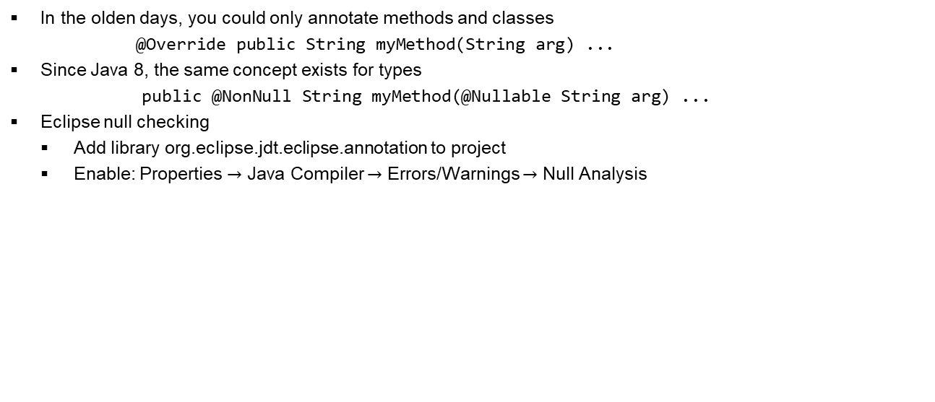
Non-null annotations
In the olden days, you could only annotate methods and classes
        @Override public String myMethod(String arg) ...
Since Java 8, the same concept exists for types
        public @NonNull String myMethod(@Nullable String arg) ...
Eclipse null checking
  Add library org.eclipse.jdt.eclipse.annotation to project
  Enable: Properties $→$ Java Compiler $→$ Errors/Warnings $→$ Null Analysis

Slide 21
Modules
Packages are a fairly weak structuring mechanism
  Hardly any control over who can see what
  Only “package” (i.e. absent) visibility modifiers for classes
From Java 9/10/11: modules as higher-level concept
  Declared in separate file module-info.java
  Explicitly Specifies incoming and outgoing dependencies
    For outgoing: also optionally specifies to which other module
  When running: apart from class-path, also specify module-path
To use: install Java 11 and enable your IDE
  For Eclipse: google Eclipse support java 11
module ss.slides {
exports ss.week8.lambda;
exports ss.week8.stream;
// and more
requires org.eclipse.jdt.annotation;
// and more
}

Slide 22
Modules
Modules are mostly relevant for complex, large-scale projects.
Typical example: the Java runtime system itself. This was the original motivation for project “Jigsaw” that started the idea of modularization.
Advantage: the new Java runtimes can be much more concise and more suitable for systems with limited hardware capabilities, like “cards”, small embedded hardware etcetera.
Example: the JavaFX graphical system was part of Java, in Java 8.
In Java 9 and later, it has become an optional module.
We don’t discuss it in this course, but the Module ideas of one versioned piece of software requiring other pieces of (versioned) software has similar goals. This is broader than just Java. In practice one uses “build” systems often based on tools like “Maven”. Such tools allow for precise specifications of dependencies, including “versioning”.

Slide 23
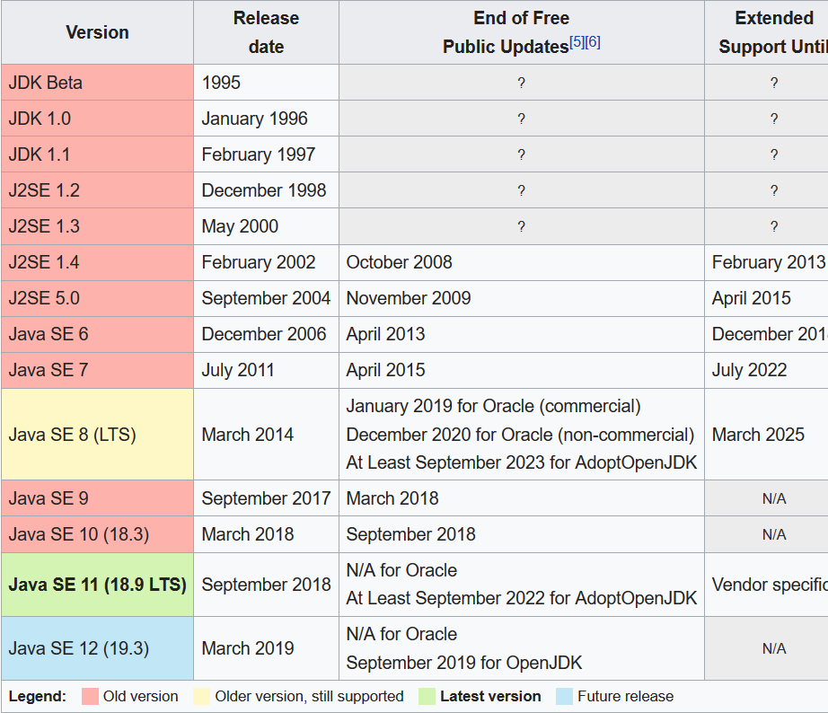
Java releases

Slide 24
Java future releases
Oracle has changed the “release train” as well as the Java license for future updates:
Some releases (Java 8, Java 11, Java 17) are so called “LTS” releases: if you pay, you can get Long Term Service patches.
Releases like Java 9, 10, 12, 13… should be considered intermediate releases, more like “patch” releases in the past, only with a “new” Java version number for each patch, and released every 6 month. These versions get support only until the next version is released, so that means support for only 6 months.
There are several “free” versions, based on the OpenJDK, supported by Oracle.
Developing Java will remain free anyway, also when using the Oracle JDK.
You can read about this by googling “Java is Still Free”, by Javachampions.

