Slide 1
P7.3: Graphical User interfaces
(GUIs)
L. Ferreira Pires
201700117-1B Module 2: Software Systems
8 January 2020

Slide 2
Programming line overview
Week 1 Values and variables Control flow | Week 2 Classes and objects Testing | Week 3 Interfaces and Inheritance Subtyping Security 1
Week 4 Arrays and Lists List implementations Collections | Week 5 Exceptions I/O Streams and MVC Security 2 | Week 6 Concurrency Project kick-off IDE Tips & Tricks
Week 7 Basic Networking Networking and Multithreading GUIs | Week 8/9 Advanced Java facilities Test | Week 10 Project Test resit

Slide 3
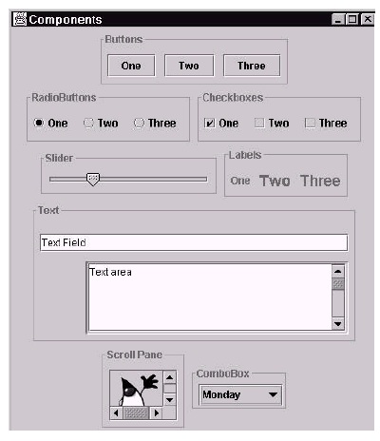
Graphical user interface
A class for each GUI component (Type)
HBox
Button
RadioButton
Checkbox
Slider
Labels
Text field
Text area
Scroll panel
Choice box

Slide 4
GUI Ingredients
Components for a reactive GUI
Graphical components
  Model-view-controller pattern
  View components to display model state
  Controller components for user input
Layout managers: regulate how components are shown
Reaction to user actions
  Action listeners (Observer pattern)

Slide 5
A Bit of History: AWT and Swing
Java Toolkits for GUIs
Abstract Windowing Toolkit (AWT, package java.awt)
  In principle portable → should work in each platform!
  Java wrappers around native platform libraries
  Too much original behaviour → portability was lost!
Swing (package javax.swing)
  Since Java 1.2 (!) part of JFC (Java Foundation Classes)
  Complete Java GUI → uses only native canvas, and draws Java (lightweight) components on it

Slide 6
Current GUI toolkit: JAVAFX
JavaFX is a software platform for creating and delivering desktop applications
Brings desktop applications closer to Internet Rich Applications (IRAs), which run on different devices
Developed to replace Swing on the long run
Not distributed with JDK 11 → download from https://gluonhq.com/products/javafx/ and define your own User Library
Used in this lecture (and in Eck’s book)

Slide 7
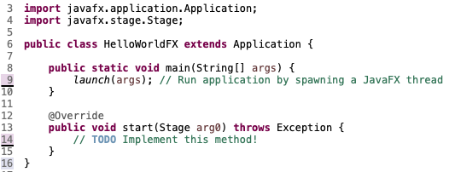
Application
class to represent a program with a GUI
Strongly recommended!
Programs should extend Application and implement main() method
In main() method, application is launched
→ Objects are created and start method is called (JavaFX thread)
Called with a Stage (window, from the OS)

Slide 8
Application methods
init() to initialise the application before calling start()
stop() to shut down the application, e.g., releasing resources if necessary
Both methods have a dummy (empty) default implementation
Normally it is enough to implement start()

Slide 9
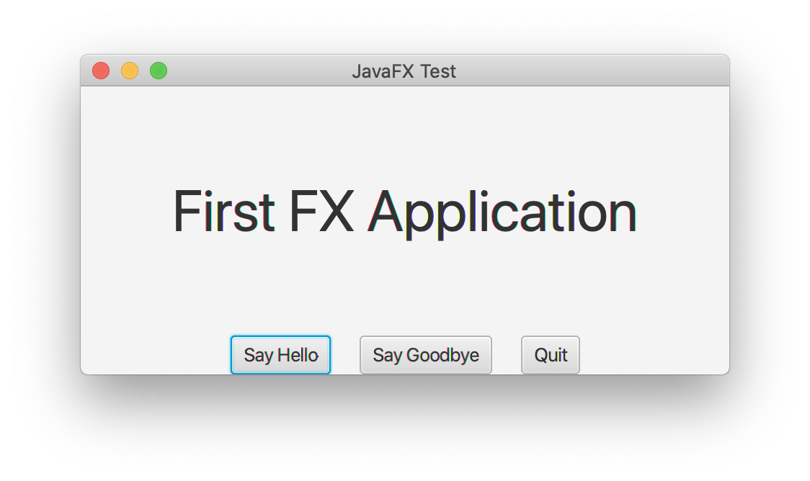
Simple Example
to Introduce the main concepts
Stage
Scene
BorderPane
Label
HBox
Buttons

Slide 10
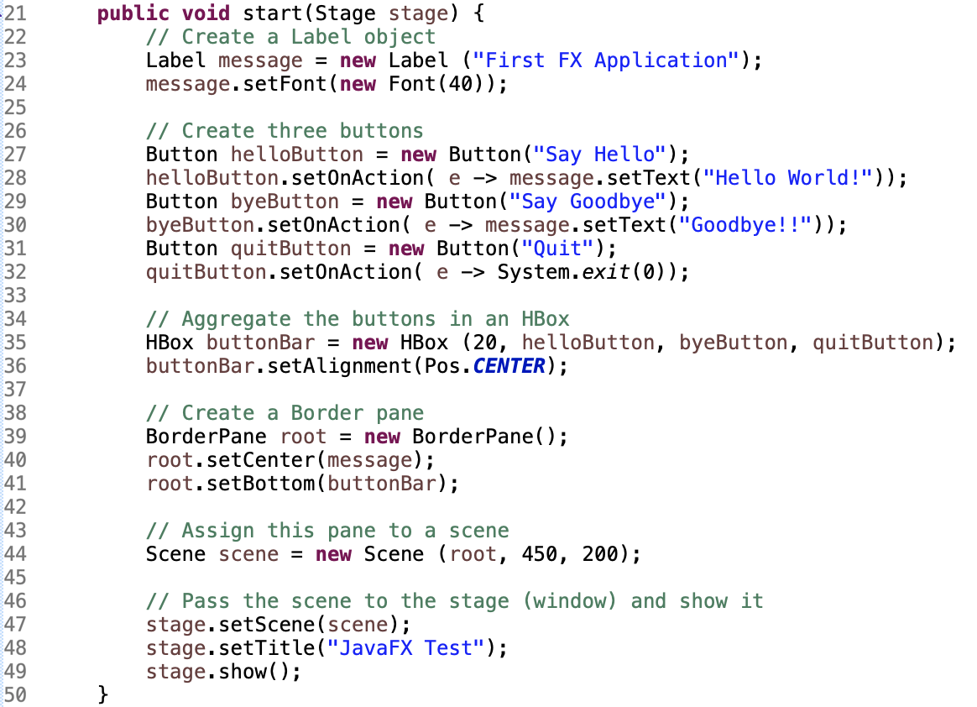

Slide 11
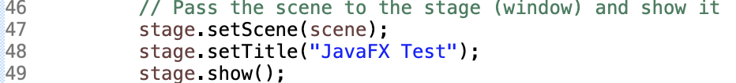
STAGE AND SCENE
Application gets a Stage with the start() method, which represents a window on the screen (main window of a program)
New windows can be created by creating more Stage objects
Application needs to fill in and show the main window
A Stage shows a Scene, which is a container for GUI components

Slide 12
GUI containers
A Scene is a container for GUI components, which can be itself also GUI containers, forming a so-called scene graph
In the example:
  Scene contains a BorderPane (root of the graph)
  BorderPane contains a Label and an HBox
  HBox contains three Buttons

Slide 13
Scene graph of Example
root:BorderPane
message:Label
buttonBar:HBox
helloButton:Button
byeButton:Button
quitButton:Button

Slide 14
SCENE Graph nodes
To stress the scene graph structure, parts of a scene graph are nodes (subclasses of javafx.scene.Node)
A graph object can only be a container if it is a subclass of javafx.scene.Parent
Since Parent nodes can have children nodes, these must be somehow arranged on the screen (layout)
Different Parent nodes may have different layout policies (e.g., HBox uses horizontal rows, BorderPane uses 5 regions, etc.)

Slide 15
Parent nodes and containment In the Example

Slide 16
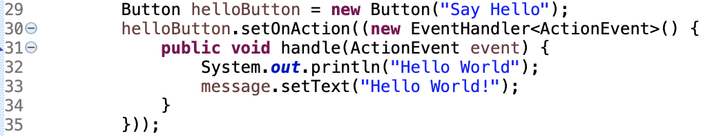
Event-driven programming
How to make something happen when button is pressed?
Events like pressing a button have to be handled
An Event contains information about what happened
An EventHandler handles an Event
Example without lambda expression

Slide 17
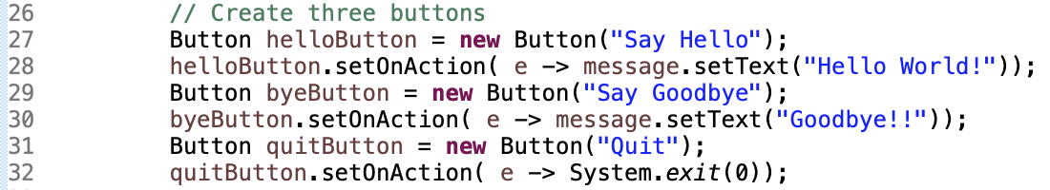
EventHandler
Defined with a lambda expression
EventHandler is a functional interface (defines a single function handle(Event e)), so it can be used as target for a lambda expression

Slide 18
Event-Driven programming
Event Queue
JVM
Event handlers
Keystrokes, mouse clicks, etc.
Event thread (event loop)
handle(ev)
handle(ev)
handle(ev)
Callback methods

Slide 19
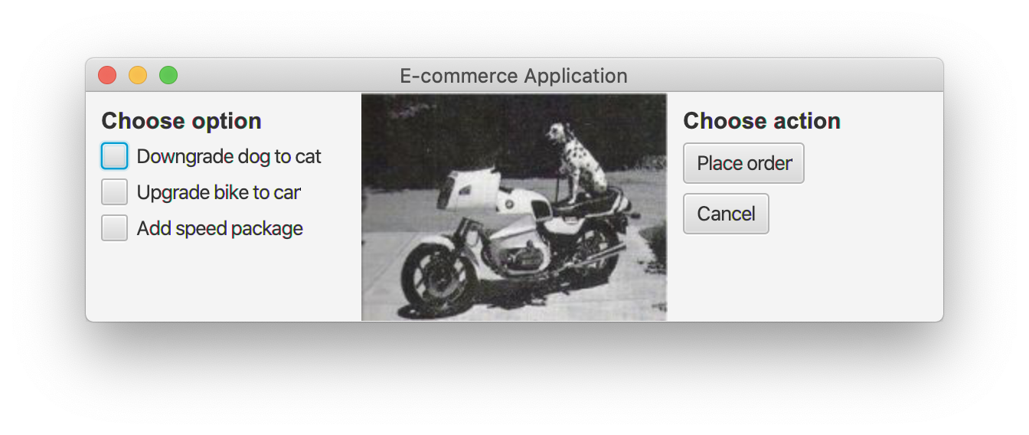
Yet aNother example

Slide 20
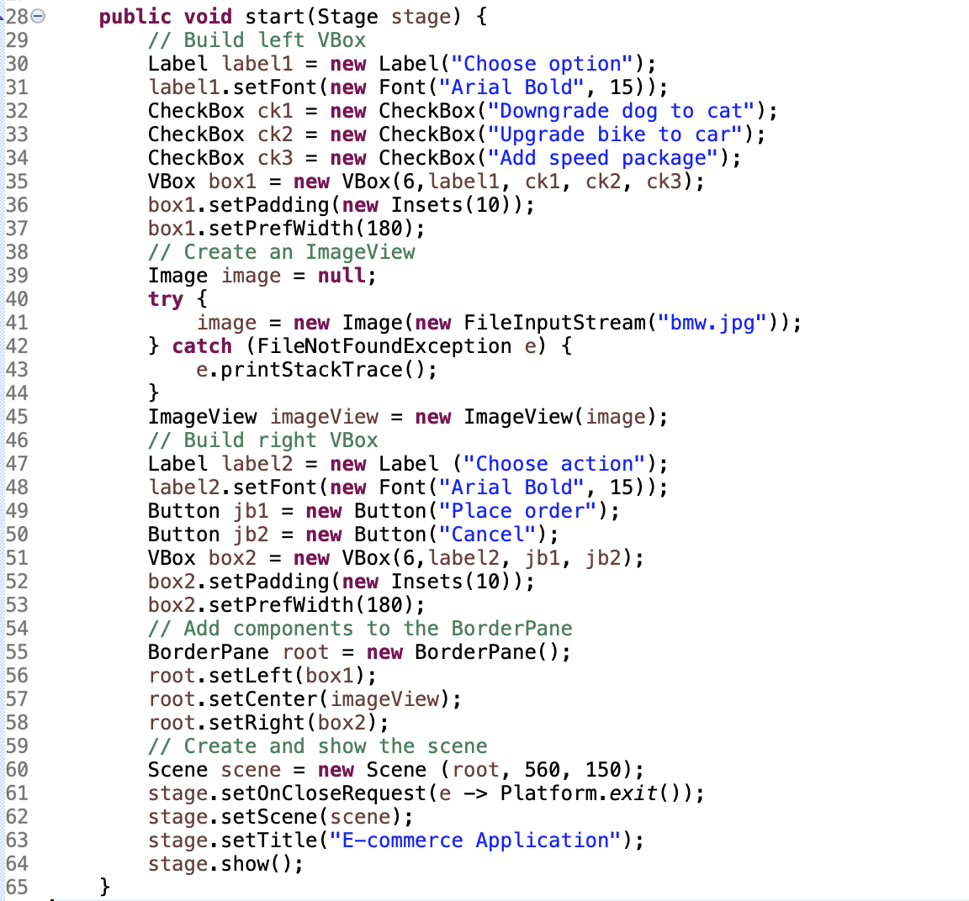
Change font
Define padding
Create ImageView
Add components to BorderPane
Define what to do when window is closed

Slide 21
Take Home messages
GUI component classes: Button, Label, CheckBox, RadioButton, etc.
Layout policies are used to position components in a parent node (e.g., a BorderPane)
EventHandler: controller in the MVC pattern, to be added to GUI components (similar to Observer role)
Many more facilities not discussed here!
GUIs can get complex, so tools like Scene Builder can help!

