Slide 1
Programming: IDE Tips & Tricks
Tom van Dijk
201700117-1B Module 2: Software Systems
19 December 2019

Slide 2
Programming line overview
Week 1 Values and variables Control flow | Week 2 Classes and objects Testing | Week 3 Interfaces and Inheritance Subtyping Security 1
Week 4 Arrays and Lists List implementations Collections | Week 5 Exceptions I/O Streams and MVC Security 2 | Week 6 Concurrency Project kick-off IDE Tips & Tricks
Week 7 Basic Networking Networking and Multithreading GUIs | Week 8/9 Advanced Java facilities Test | Week 10 Project Test resit

Slide 3


Debugging
How Do you check what the program is doing?
Set breakpoints (double-click in left-margin)
Start program using Debug instead of Run
  When breakpoint is reached, change to Debug Perspective
  Step/Step Into code, inspect variables
Advanced
  Conditional breakpoints
  Global exception breakpoints
  Watch/Inspect expressions

Slide 4
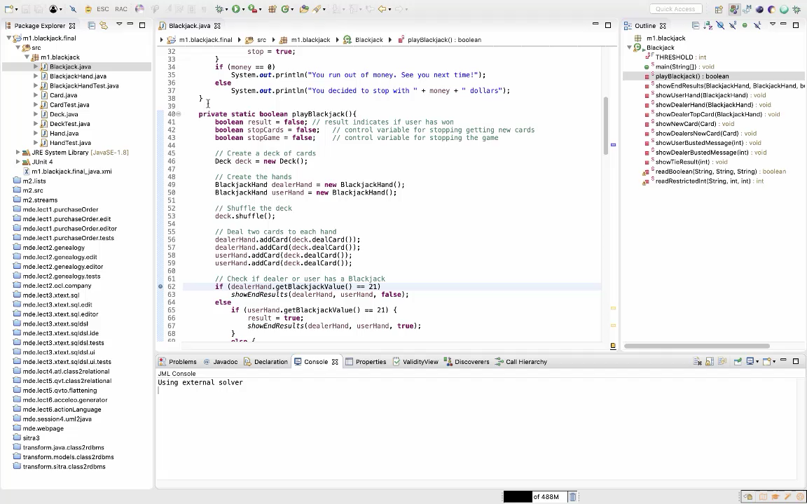

Slide 5
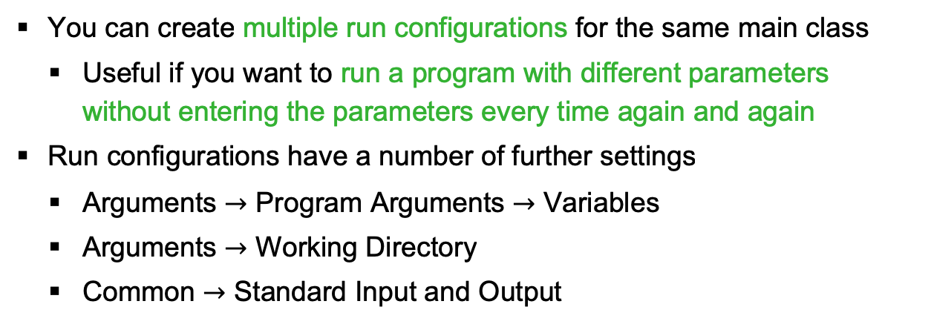
Run configurations
How Do you start your program?
You can create multiple run configurations for the same main class
  Useful if you want to run a program with different parameters without entering the parameters every time again and again
Run configurations have a number of further settings
  Arguments $→$ Program Arguments $→$ Variables
  Arguments $→$ Working Directory
  Common $→$ Standard Input and Output

Slide 6
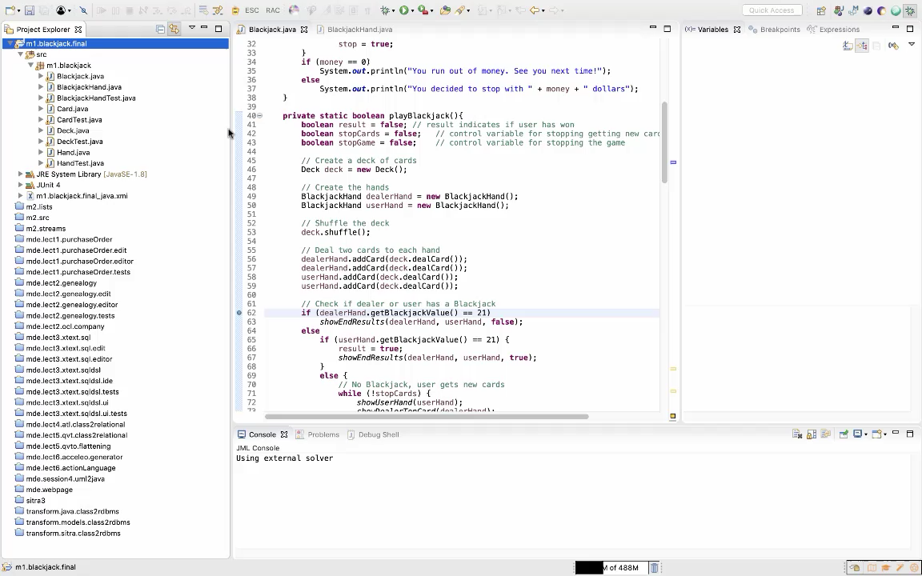

Slide 7
Refactoring
How Do You Change classes and other things in your project?
Rename: always use Eclipse support for changing names!
  Ensures global renaming
Change method to add, remove parameters or return type
  All calls are also modified
Extract method to simplify methods or share code
Move to move around classes, improve package structure
  Drag-and-drop also works fine

Slide 8
Code generation
Boilerplate code
Constructors (from fields or from constructor of superclass)
Getters and setters, mandatory abstract/ overridden methods, etc.
Standard implementation of default methods
  toString, equals and hashCode
Code completion (Ctrl-Space or leave cursor at some point)
  Search for appropriate method/field/type
  Insert template for/while loop

Slide 9
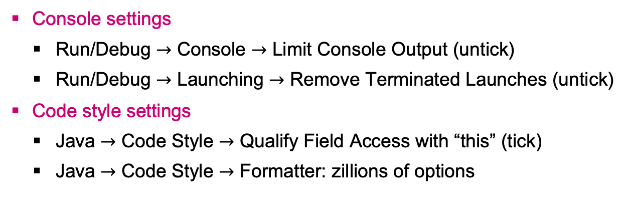
Eclipse (project and global) preferences
Console settings
  Run/Debug $→$ Console $→$ Limit Console Output (untick)
  Run/Debug $→$ Launching $→$ Remove Terminated Launches (untick)
Code style settings
  Java $→$ Code Style $→$ Qualify Field Access with “this” (tick)
  Java $→$ Code Style $→$ Formatter: zillions of options

Slide 10
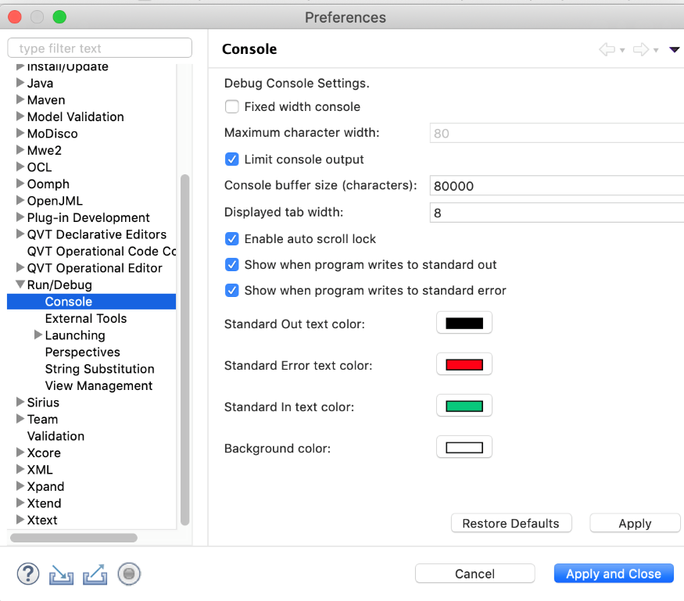
Eclipse (project and global) preferences
Run/Debug: Console settings

Slide 11
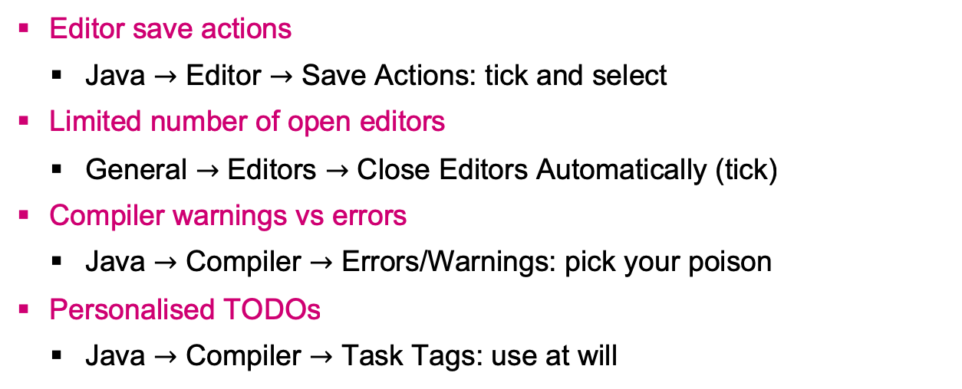
Eclipse (project and global) preferences
Editor save actions
  Java $→$ Editor $→$ Save Actions: tick and select
Limited number of open editors
  General $→$ Editors $→$ Close Editors Automatically (tick)
Compiler warnings vs errors
  Java $→$ Compiler $→$ Errors/Warnings: pick your poison
Personalised TODOs
  Java $→$ Compiler $→$ Task Tags: use at will

Slide 12
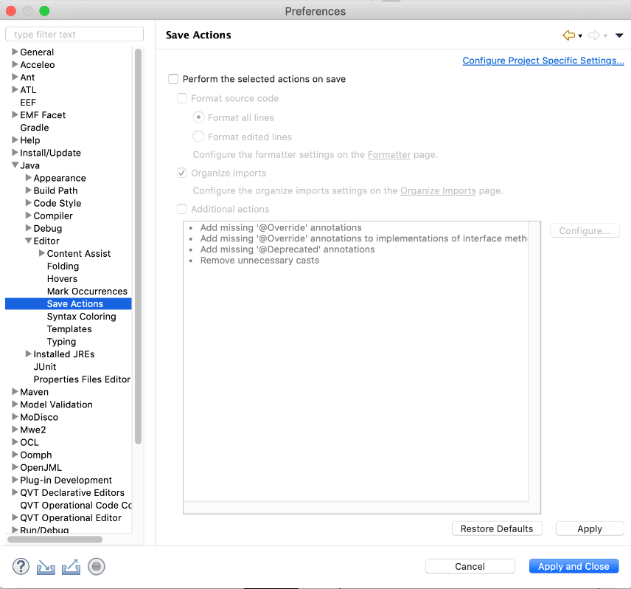
Eclipse (project and global) preferences
JavA Editor: Save Actions

Slide 13
Project management
Healthy Programming habits
Do you want to be sloppy or neat?
You should have no remaining problems
  No errors, warning markers nor TODOs
Actions, in decreasing order of preference
  Solve the issue
  Use Eclipse “quick fixes”
  Tell Eclipse not to generate the warning in the first place
  Remove all TODO comments

Slide 14
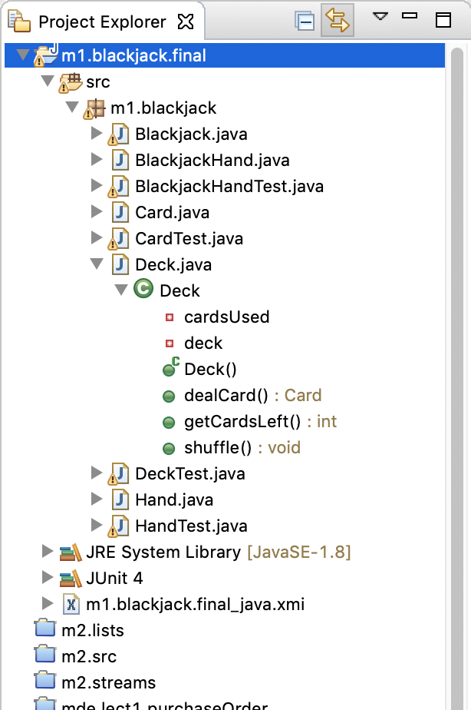
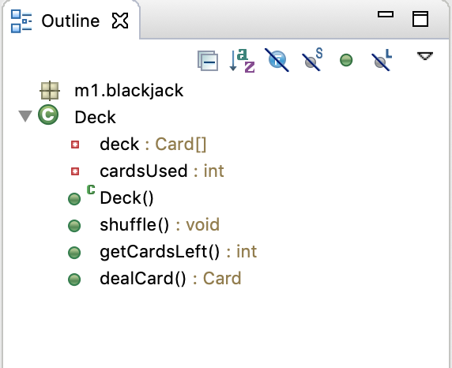
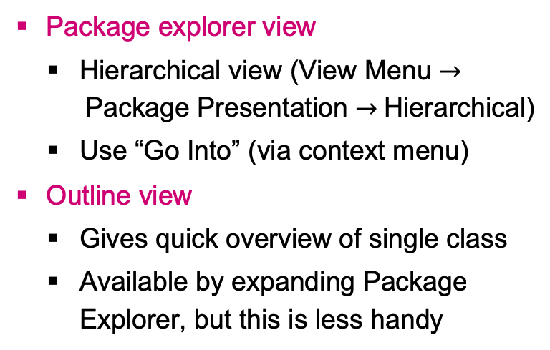
Perspectives and views
JAVA and Debug perspectives
Package explorer view
  Hierarchical view (View Menu $→$Package Presentation $→$Hierarchical)
  Use “Go Into” (via context menu)
Outline view
  Gives quick overview of single class
  Available by expanding Package Explorer, but this is less handy

Slide 15
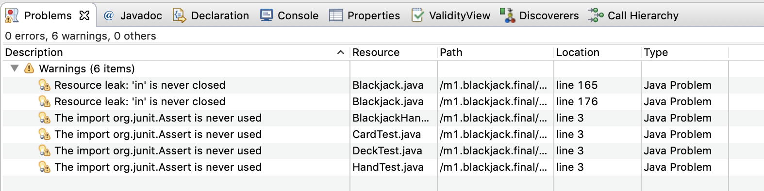
Perspectives and views
Problems view
  All errors and warnings in a glance
  Multiple projects? Close those you are not working on

Slide 16
Keyboard shortcuts
Examples
Ctrl-G go to declaration (of called method or type)
Ctrl-Space Code completion
Ctrl-F11 Re-run most recent, F11 Re-debug most recent
Alt-Shift-S All code generation options
Alt-Shift-T All refactoring options
Alt-Shift-R Rename
Alt-Shift-Z Surround with try/catch
Ctrl-Shift-T Find type

Slide 17
Take Home messages
Eclipse is a complex IDE, bug it gives a lot of control over the behaviour of the Java editor, run configurations, project properties, etc.
By properly using these capabilities you can be more productive
→ do more work correctly in less time
We hope you hate Eclipse a bit less now!

