Slide 1

Module ii – academic skills
Technical computer science program
Week 5: WorkSHOP in Effective Feedback

Slide 2

QUESTIONS ABOUT VIDEOS OF LAST WEEK?
WELCOME ILO KAHOOT GIVING FEEDBACK RECEIVING FEEDBACK GUESS WHO? NEXT STEPS
ANY QUESTIONS

Slide 3

LEARNING GOAL OF TODAY
WELCOME ILO KAHOOT GIVING FEEDBACK RECEIVING FEEDBACK GUESS WHO? NEXT STEPS
“Applying the basics about giving and receiving effective feedback on the work of a partner.”

Slide 4

EXERCISE 1: WHO KNOWS MORE?
WELCOME ILO KAHOOT GIVING FEEDBACK RECEIVING FEEDBACK GUESS WHO? NEXT STEPS
Will you make your team win?
EXERCISE 1 - 15 MINUTES
Go to www.kahoot.it (One laptop per group)
Enter the pin Code showed in the screen
Use the group number as a name of the team
Use the name of the members

Slide 5
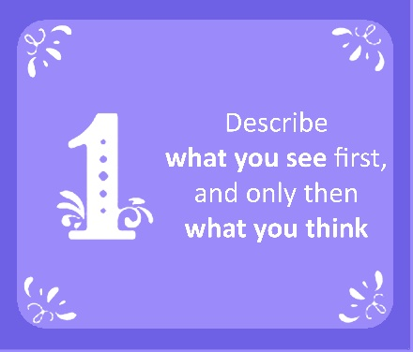
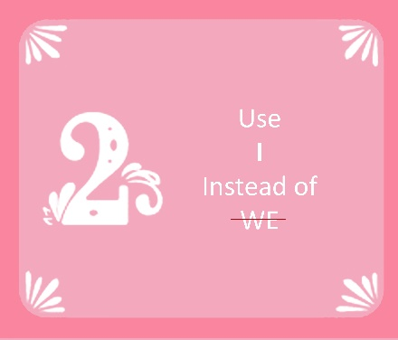
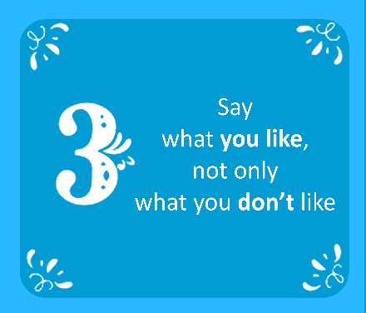
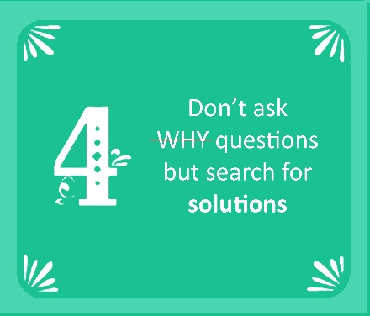
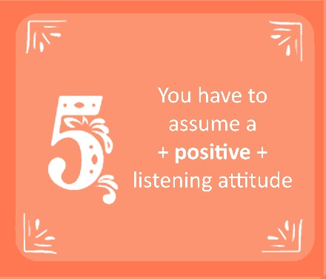

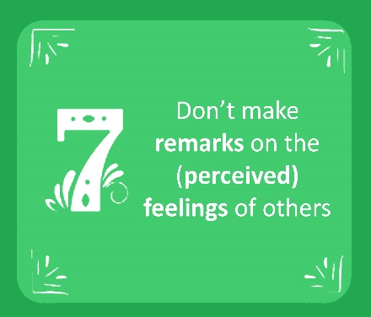
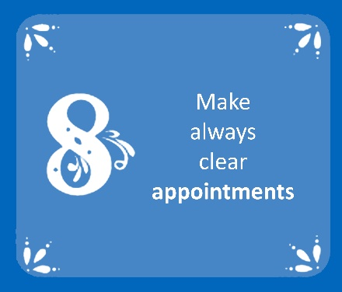
RULES FOR GIVING EFFECTIVE FEEDBACK
WELCOME ILO KAHOOT GIVING FEEDBACK RECEIVING FEEDBACK GUESS WHO? NEXT STEPS
The most important rule: Give feedback only when asked

Slide 6
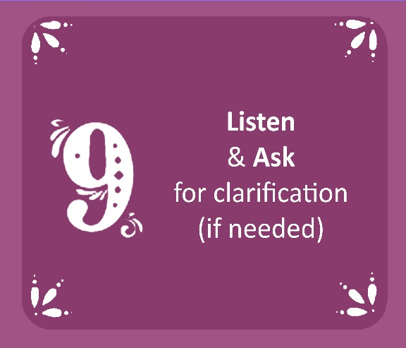
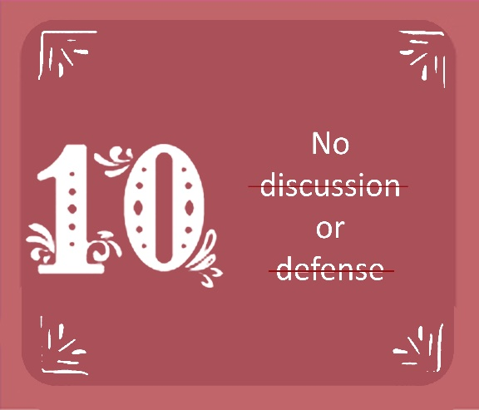
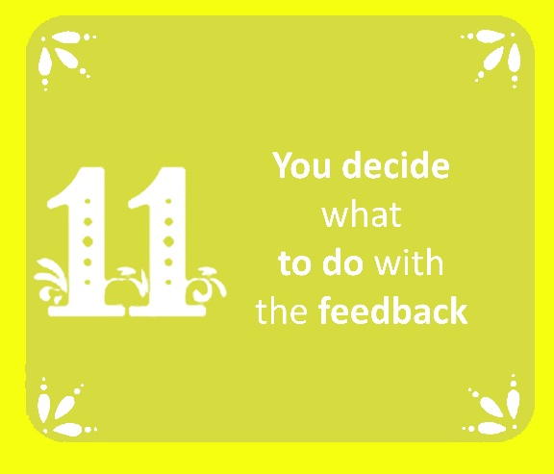
RULES FOR RECEIVING EFFECTIVE FEEDBACK
WELCOME ILO KAHOOT GIVING FEEDBACK RECEIVING FEEDBACK GUESS WHO? NEXT STEPS
And what happens if we ask for feedback?
Keep this in mind whenever you are receiving feedback from someone

Slide 7

EXERCISE 2: GUESS WHO? – PART ONE
WELCOME ILO KAHOOT GIVING FEEDBACK RECEIVING FEEDBACK GUESS WHO? NEXT STEPS
Feedback
Write feedback to your partners
EXERCISE 2 – 10 MINUTES
Repeat this until you have done it for all your teammates:
Take a new card and fill it with what you think of one of your teammates
On the other side of the card, (and without anyone seeing it), write the name of the partner you were referring to.
Put the card in the center deck (with the recipient's name face down)

Slide 8

EXERCISE 2: GUESS WHO? – PART TWO
WELCOME ILO KAHOOT GIVING FEEDBACK RECEIVING FEEDBACK GUESS WHO? NEXT STEPS
Assigning the feedback
EXERCISE 2 - 10 MINUTES
Somebody mix the cards in the center deck
Now, in turns, each player must:
  Take a card from the center deck. Remember not to see or show the name on the back
  Read the feedback aloud to the rest of your partners
  Place the card in front of the person you think the card refers to (with the name still face down). Important!
  No one can have more cards than n_team_members – 1
  4. Turn to the next player
FEED
BACK

Slide 9

EXERCISE 2: GUESS WHO? – PART THREE
WELCOME ILO KAHOOT GIVING FEEDBACK RECEIVING FEEDBACK GUESS WHO? NEXT STEPS
Guessing whose feedback is
EXERCISE 2 - 5 MINUTES
When the deck is empty, it's time to check who knows you
Flip all your cards
For cards that don't have your name on the back. Find out now why someone thought that feedback was talking about you. Then, deliver the card to the right person
For the cards that have your name on the back, you can read the feedback again and ask who wrote it if you need to clarify something

Slide 10
WHAT YOU HAVE TO DO BEFORE SUNDAY?
WELCOME ILO KAHOOT GIVING FEEDBACK RECEIVING FEEDBACK GUESS WHO? NEXT STEPS
Remember that you must finish the assignment A-4 before this Sunday. After finishing the deadline, you must give feedback to two of your classmates anonymously randomly assigned by Canvas.
  Teachers will ensure that all feedback is effective.
Watch the interactive video on “Week 5” Canvas page
If you failed an assignment, do the resit (last deadline January 5, 2020)
If you fail the resit or lose the last deadline, you will not pass module 2
BEFORE SUNDAY DECEMBER 15, 23:59

Slide 11

MODULE 2: SOFTWARE SYSTEMS
ACADEMIC SKILLS
WORKSHOP 3: PROCRASTINATION
Have a nice day
See you next week

