Slide 1

Module ii – academic skills
Technical computer science program
Week 4: WorkSHOP in PROCRASTINATION

Slide 2

QUESTIONS ABOUT VIDEOS OF LAST WEEK?
WELCOME ILO PROCRASTINATION VALUE EXPECTANCY DELAY IMPULSIVINESS NEXT STEPS
ANY QUESTIONS

Slide 3

LEARNING GOAL OF TODAY
WELCOME ILO PROCRASTINATION VALUE EXPECTANCY DELAY IMPULSIVINESS NEXT STEPS
“Applying these principles to make a personal planning for a medium long-term period, e.g., a study semester, and for a medium-sized project.”

Slide 4

WHAT IS PROCRASTINATION?
WELCOME ILO PROCRASTINATION VALUE EXPECTANCY DELAY IMPULSIVINESS NEXT STEPS
Unnecessarily postponing things for so long that it harms your interests

Slide 5

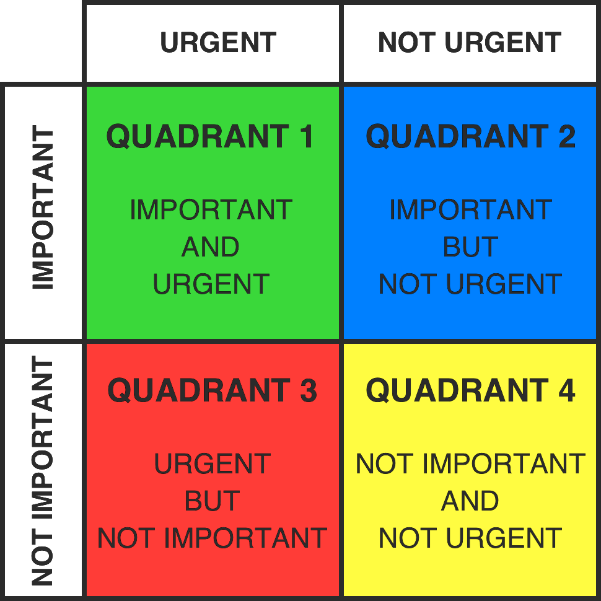
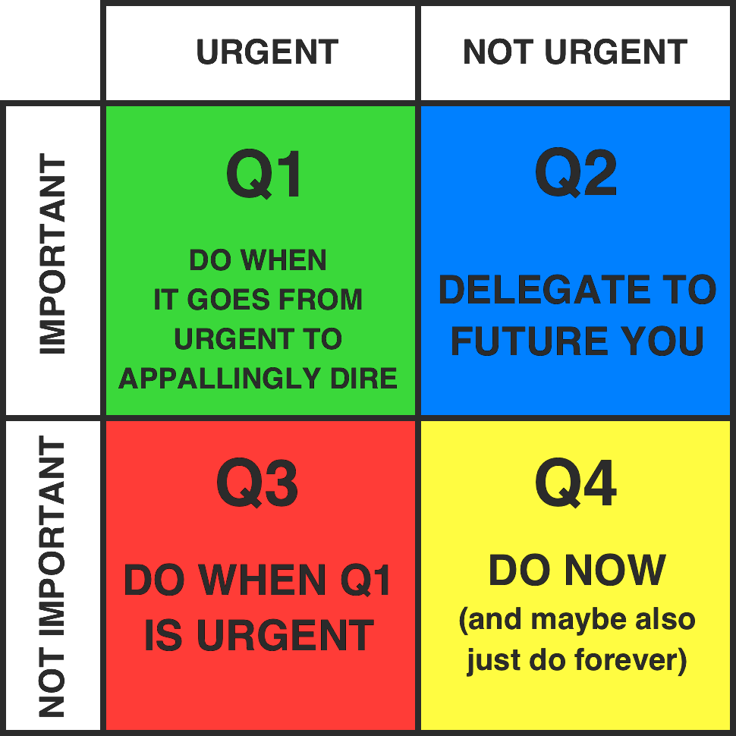
EISENHOWER BOX VS PROCRASTINATION BOX
WELCOME ILO PROCRASTINATION VALUE EXPECTANCY DELAY IMPULSIVINESS NEXT STEPS
Eisenhower Box
Procrastination Box

Slide 6
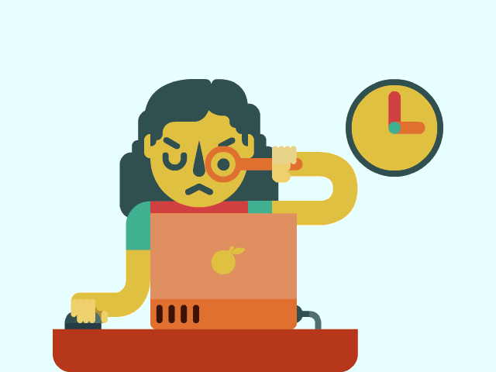

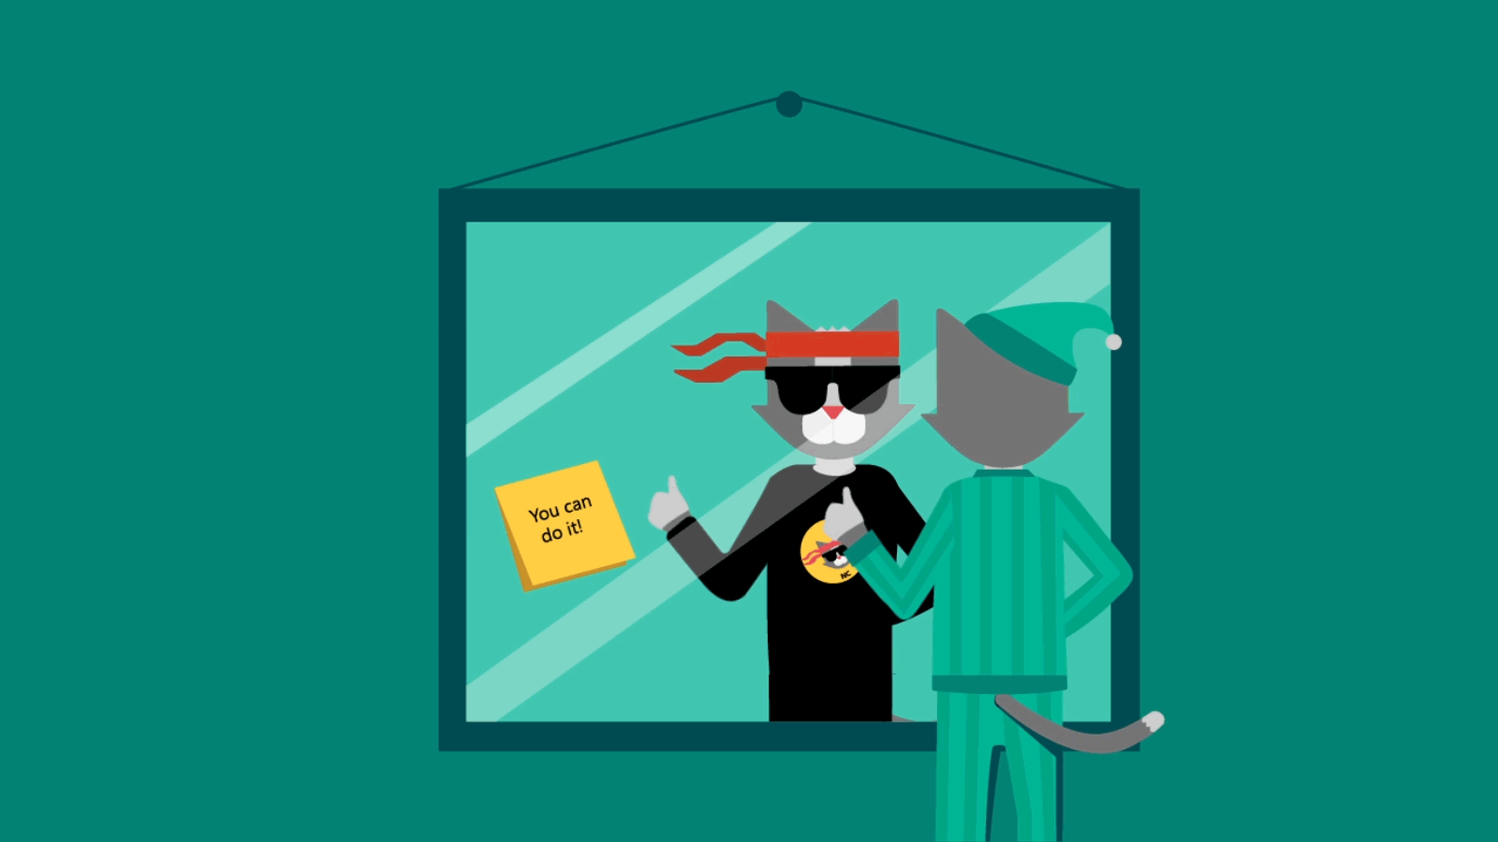
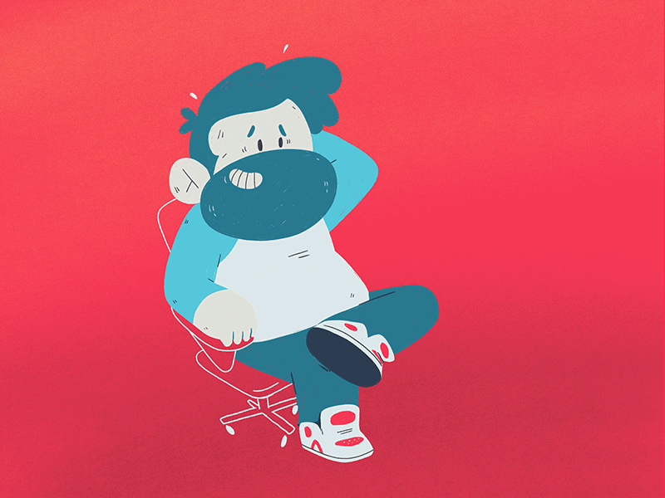
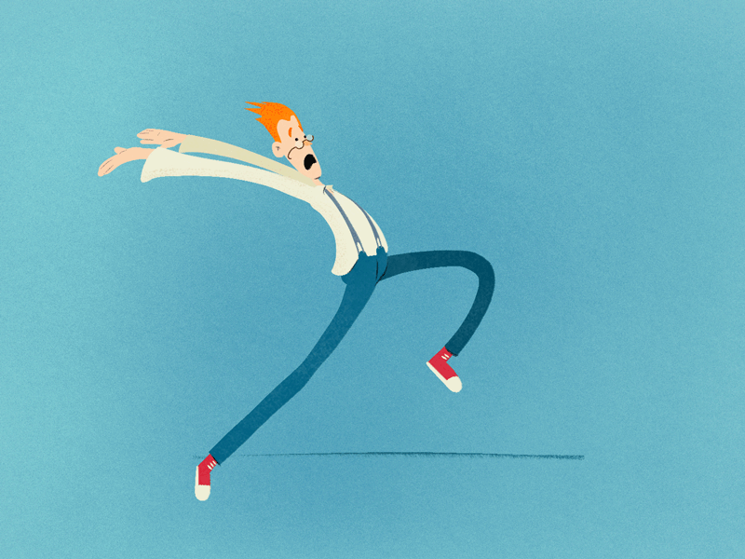

TYPES OF PROCRASTINERS
WELCOME ILO PROCRASTINATION VALUE EXPECTANCY DELAY IMPULSIVINESS NEXT STEPS
The person is a perfectionist to the fullest for fear of being judged or ashamed. They consume too much time in the details and many of their projects finish them in a hurry. Instead of avoiding mistakes, they commit them in excess, causing more fear of the judgment of others.
Perfectionist
Procrastinator
Imposter
Procrastinator
People that, for fear of being labeled as incompetent, monopolizes an excess of work that reaffirms their responsibility. However, this attitude can end in learned helplessness, a feeling linked to depressive states.
Overwhelmed
Procrastinator
People who have so much to do and so many tasks in mind that he doesn't know where to start with them. Finally, it is common to lead to a mental block that prevents you from even starting work.
Fearful
Procrastinator
People who constantly postpones tasks or obligations because it is unpleasant or boring. This trend is related to the lack of motivation in repetitive tasks or in which there are any feedback for improving.
Lucky?
Procrastinator
People who believe they only work well when they are under pressure. So they postpone their homework until it gets late and they are at the limit to do what they have or intend to do on time.

Slide 7

EXERCISE 1: RECOGNIZING PROCRASTINATION
WELCOME ILO PROCRASTINATION VALUE EXPECTANCY DELAY IMPULSIVINESS NEXT STEPS
Recognizing procrastination
EXERCISE 1 - 5 MINUTES
Write on a sheet of paper three kinds of activities (study-related or otherwise) for which you suffer from procrastination.
Number them 1–3 in order of severity
Show the result to your partner next and discuss whether you recognize each other’s problems

Slide 8
TOP 3 PROCRASTINATION OF STUDENTS
WELCOME ILO PROCRASTINATION VALUE EXPECTANCY DELAY IMPULSIVINESS NEXT STEPS
Study related
Personal
Big assignments
Uninteresting subjects
Studying for resit exams
Health (sleeping, exercising)
Cleaning
Maintaining relationships

Slide 9
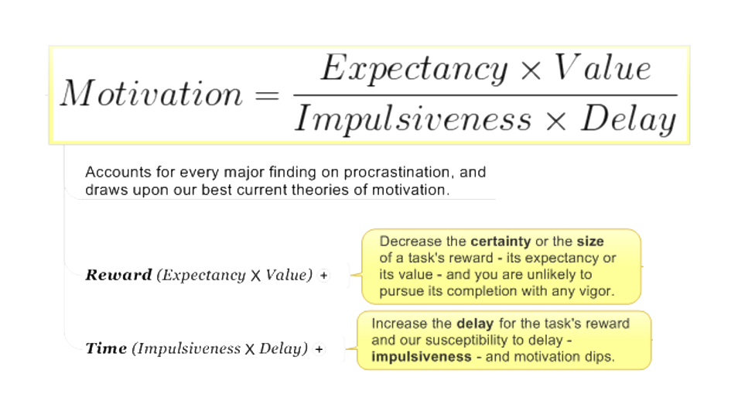
THE PROCRASTINATION EQUATION
WELCOME ILO PROCRASTINATION VALUE EXPECTANCY DELAY IMPULSIVINESS NEXT STEPS

Slide 10
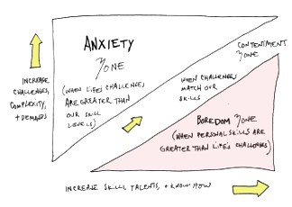
EXPECTANCY
WELCOME ILO PROCRASTINATION VALUE EXPECTANCY DELAY IMPULSIVINESS NEXT STEPS
Main causes
Low confidence:
  - Fear of failure
  - Sense of pointlessness
High confidence:
  - Lack of urgency
  - No challenge = no enjoyment
Solution: Creating an optimum of confidence
Confidence too low:
  - Break down task in subtasks, that are sufficiently challenging but not overwhelming;
  - Enlist others = “control” expectations;
  - Keep your ideas positive;
  - Seek help when you get stuck
Confidence too high:
  - Raise the bar, set higher goals;
  - Build in a reality check (are you really that good?).

Slide 11
VALUE
WELCOME ILO PROCRASTINATION VALUE EXPECTANCY DELAY IMPULSIVINESS NEXT STEPS
Main causes
Unknown Value:
  - Don't know what value a task has
  - Don't know in what order you should act
Undervalued tasks:
  - This task is unimportant to you
  - The task doesn’t seem related to “higher” goals
Unpleasant tasks:
  - You feel resistance towards executing this task
  - You see the task as a necessary evil
  - There are far more pleasant activities at hand
Solution: Increase value and fun
Priorization tasks:
  - Eisenhower Matrix (classifying tasks)
  - Ivy Lee method (What to do today)
Get the value clear
  - See how the task is related to other goals;
  - Commit yourself to your choices;
  - Make a clear choice when there is a conflict of values underneath;
Try to work around reluctance
  - Think of rewards;
  - Try to do the task in another (easier) way;
  - Eat the largest frog first;
  - Use routines, so you don’t have to decide everytime.

Slide 12

IMPULSIVENESS
WELCOME ILO PROCRASTINATION VALUE EXPECTANCY DELAY IMPULSIVINESS NEXT STEPS
Main causes
Low emotional courage:
  - Feelings of discomfort when starting a postponed task
  - Brake in large and uncertain tasks
Variance within person:
  - Unrest, use of substances, fatigue increase impulsiveness
Solution: Dealing with distractions
Bring down distractions in direct (study) environment:
  - Create quiet and clean surroundings
  - Pomodoro thenique
  - Take care with online distractions and “multitasking”
OF MASS DISTRACTION

Slide 13
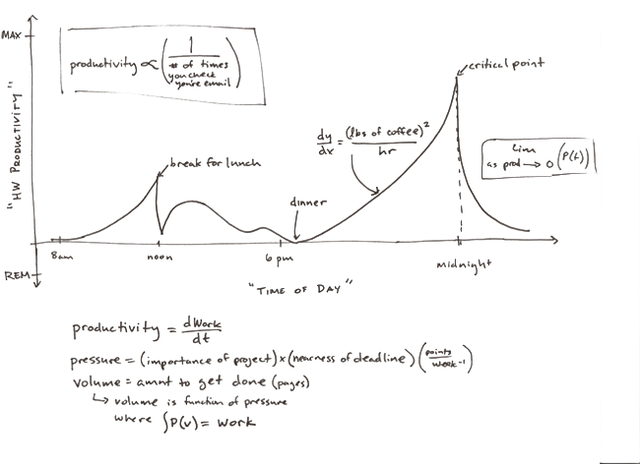
DELAY
WELCOME ILO PROCRASTINATION VALUE EXPECTANCY DELAY IMPULSIVINESS NEXT STEPS
Main causes
No sense of urgency since “punishment” or “reward” is far away:
  - The usual “dip” between start and finish is getting too deep
    - I can do it another time;
    - There seems no progress, even after a day of hard work;
  - Distractions at hand will give quick gratification
Solution: Decrease delay
Create faster cycle of “punishment” or reward
  - Break down activity in subtasks
  - Mark your progress (check off subtasks)
  - Create more moments of feedback (and perhaps some rewards)

Slide 14
WINDING UP
WELCOME ILO PROCRASTINATION VALUE EXPECTANCY DELAY IMPULSIVINESS NEXT STEPS
We have gained some general knowledge about
time management concepts
Not possible: learning professional time management in a lecture
  If you have serious problems with this, contact the study advisor to see what options are available

Slide 15
WHAT YOU HAVE TO DO BEFORE SUNDAY?
WELCOME TOPICS & ILO WHY TO PLAN? STEP 1: LIST & PRIORITIZE STEP 2: PLAN NEXT STEPS
Write a personal time management plan. Follow the instructions in the assignment A-4. You will have to upload it to Canvas
Watch the interactive video on “Week 3” Canvas page
BEFORE SUNDAY DECEMBER 8, 23:59

Slide 16

MODULE 2: SOFTWARE SYSTEMS
ACADEMIC SKILLS
WORKSHOP 3: PROCRASTINATION
Have a nice day
See you next week

