Slide 1

Module ii – academic skills
Technical computer science program
Week 2: WorkSHOP in Priorization and time management

Slide 2

QUESTIONS ABOUT VIDEOS OF LAST WEEK?
WELCOME TOPICS & ILO WHY TO PLAN? STEP 1: LIST & PRIORITIZE STEP 2: PLAN NEXT STEPS
ANY QUESTIONS

Slide 3

LEARNING GOAL OF TODAY
WELCOME TOPICS & ILO WHY TO PLAN? STEP 1: LIST & PRIORITIZE STEP 2: PLAN NEXT STEPS
“Applying these principles to make a personal planning for a medium long-term period, e.g., a study semester, and for a medium-sized project.”

Slide 4
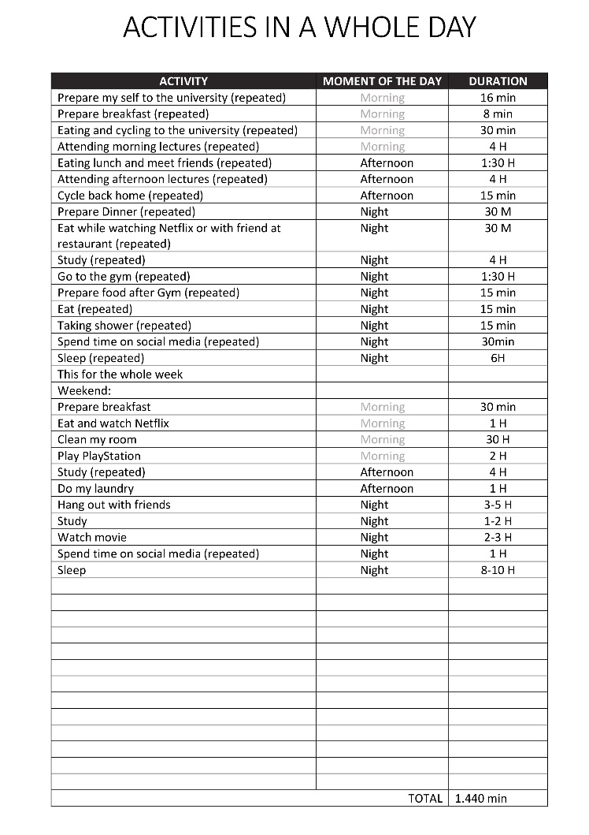
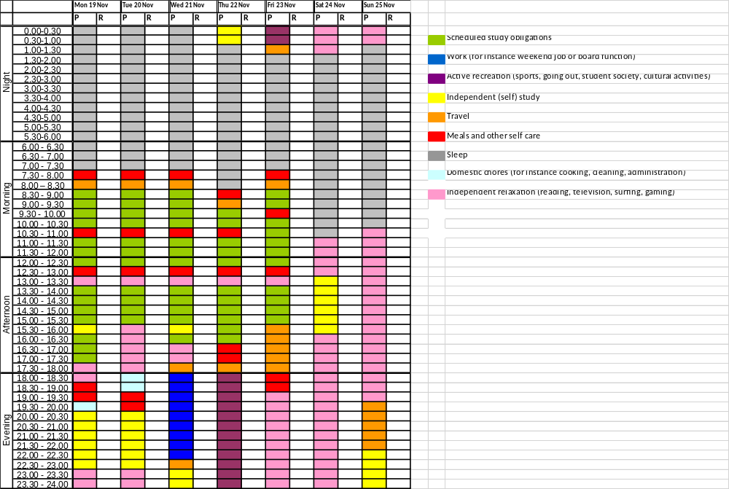
WHAT WE DID AND WHAT WE WILL DO
WELCOME TOPICS & ILO WHY TO PLAN? STEP 1: LIST & PRIORITIZE STEP 2: PLAN NEXT STEPS
From my daily activities
To the Personal Time Management Plan

Slide 5
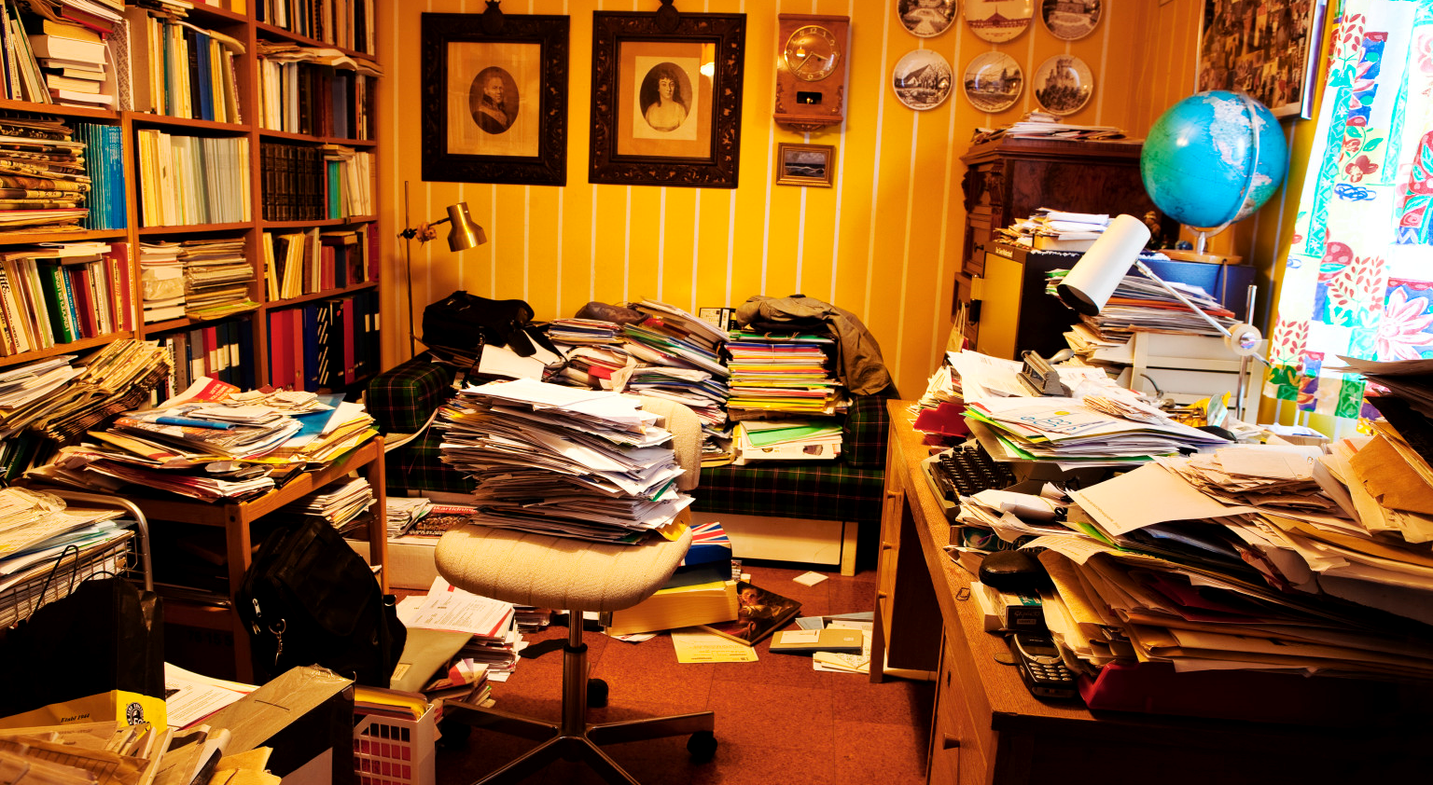
WHY SHOULD I TO PLAN MY TIME?
WELCOME TOPICS & ILO WHY TO PLAN? STEP 1: LIST & PRIORITIZE STEP 2: PLAN NEXT STEPS

Slide 6

BENEFITS OF PLANNING YOUR PERSONAL TIME
WELCOME TOPICS & ILO WHY TO PLAN? STEP 1: LIST & PRIORITIZE STEP 2: PLAN NEXT STEPS
Reduces your stress level
Help you remain focused on the task
Minimises procrastination
Augments your productivity

Slide 7
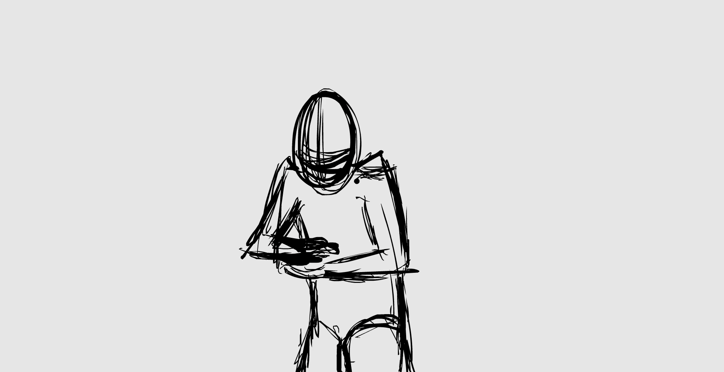
MAGIC SOLUTIONS? NOT AT ALL
WELCOME TOPICS & ILO WHY TO PLAN? STEP 1: LIST & PRIORITIZE STEP 2: PLAN NEXT STEPS
There is NO magic solution for everyone.
What works for one can be a disaster for another

Slide 8

WORKING STYLES
WELCOME TOPICS & ILO WHY TO PLAN? STEP 1: LIST & PRIORITIZE STEP 2: PLAN NEXT STEPS

Slide 9
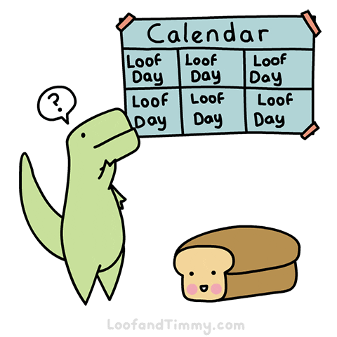

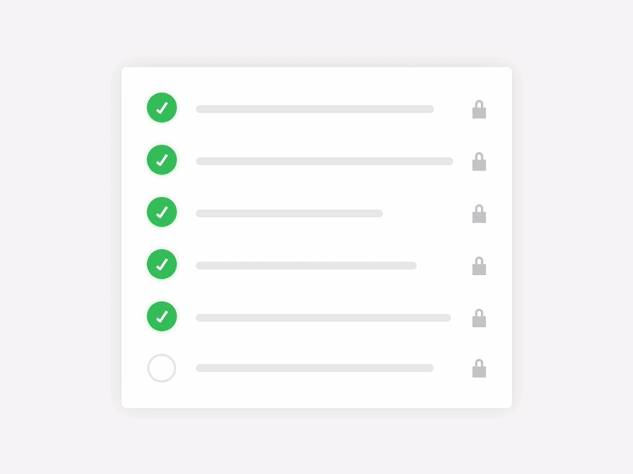


CYCLE OF SUCCESSFUL TIME MANAGEMENT
WELCOME TOPICS & ILO WHY TO PLAN? STEP 1: LIST & PRIORITIZE STEP 2: PLAN NEXT STEPS
Prioritising
Planning
Execution
Evaluation

Slide 10
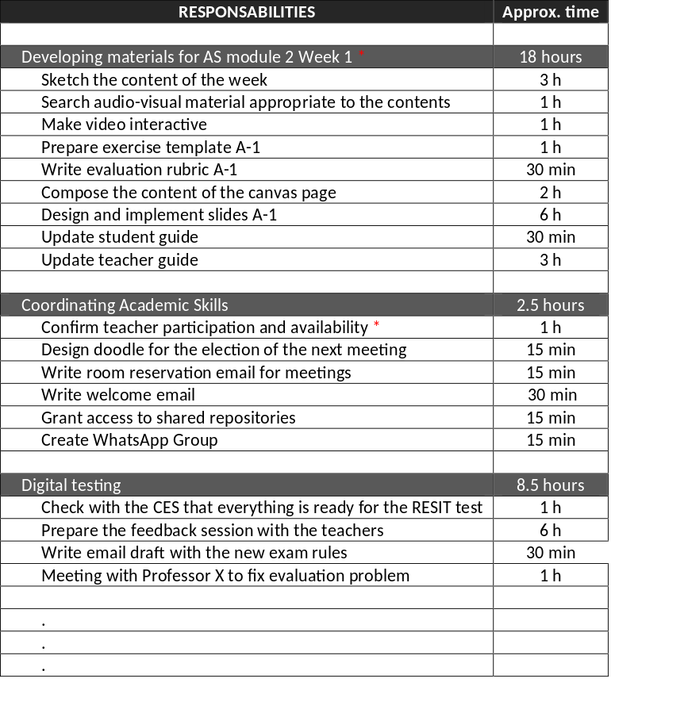

STEP 1: LIST AND PRIORIZITE
WELCOME TOPICS & ILO WHY TO PLAN? STEP 1: LIST & PRIORITIZE STEP 2: PLAN NEXT STEPS
Do a
BRAIN DUMP
of your
MAIN RESPONSABILITIES
- Estimate the time you need for each of them.
- Also indicate the deadline (if any)
- Point out if a task is important with an asterisk

Slide 11
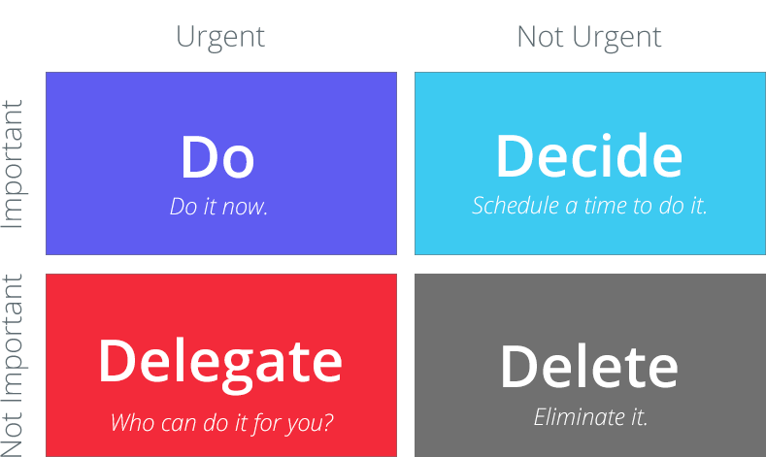
THE EISENHOWER BOX/MATRIX
WELCOME TOPICS & ILO WHY TO PLAN? STEP 1: LIST & PRIORITIZE STEP 2: PLAN NEXT STEPS
How to PRIORIZITE when EVERYTHING feels like a PRIORITY?

Slide 12
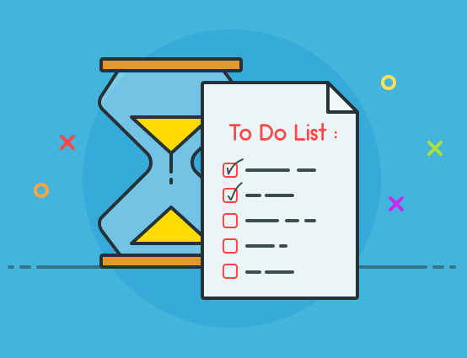
EXERCISE 1
WELCOME TOPICS & ILO WHY TO PLAN? STEP 1: LIST & PRIORITIZE STEP 2: PLAN NEXT STEPS
Listing and prioritizing tasks
EXERCISE 1 - 20 MINUTES
Write in an empty list all the tasks you have pending right now. Use the template that we provide you!
Create an Eisenhower matrix or use colors to classify tasks according to:
  Important and urgent
  Important but not urgent
  Not important but urgent
  Not important nor urgent
Explain to your partner next chair why you made the decisions you made

Slide 13
STEP 2: PLANNING (the assignment of this week)
WELCOME TOPICS & ILO WHY TO PLAN? STEP 1: LIST & PRIORITIZE STEP 2: PLAN NEXT STEPS
TIME MANAGEMENT MODULE II |  | Night |  |  |  |  |  |  |  |  |  |  |  |  |  |  |  |  |  |  |  |  |  |  |  |  |  |  |  | Morning |  |  |  |  |  |  |  |  |  |  |  |  |  |  |  |  |  |  |  |  |  |  |  | Afternoon |  |  |  |  |  |  |  |  |  |  |  |  |  |  |  |  |  |  |  |  |  |  |  | Evening
 |  | 0:00 |  |  |  | 1:00 |  |  |  | 2:00 |  |  |  | 3:00 |  |  |  | 4:00 |  |  |  | 5:00 |  |  |  | 6:00 |  |  |  | 7:00 |  |  |  | 8:00 |  |  |  | 9:00 |  |  |  | 10:00 |  |  |  | 11:00 |  |  |  | 12:00 |  |  |  | 13:00 |  |  |  | 14:00 |  |  |  | 15:00 |  |  |  | 16:00 |  |  |  | 17:00 |  |  |  | 18:00 |  |  |  | 19:00 |  |  |  | 20:00 |  |  |  | 21:00 |  |  |  | 22:00 |  |  |  | 23:00
November | lunes, 25 |  |  |  |  |  |  |  |  |  |  |  |  |  |  |  |  |  |  |  |  |  |  |  |  |  |  |  |  |  |  |  |  |  |  |  | Calculus |  |  |  |  |  |  |  | Calculus lecture |  |  |  |  |  |  |  | Other |  |  |  | Programming practical
 | martes, 26
 | miércoles, 27 |  |  |  |  |  |  |  |  |  |  |  |  |  |  |  |  |  |  |  |  |  |  |  |  |  |  |  |  |  |  |  |  |  |  |  | Design practical |  |  |  |  |  |  |  | Design lecture |  |  |  |  |  |  |  |  |  |  |  | Design project |  |  |  |  |  |  |  | AS work
 | jueves, 28 |  |  |  |  |  |  |  |  |  |  |  |  |  |  |  |  |  |  |  |  |  |  |  |  |  |  |  |  |  |  |  |  |  |  |  | Diagnostic test |  |  |  |  |  |  |  | Calculus tutorial |  |  |  |  |  |  |  | Other |  |  |  | Programming practical
 | viernes, 29 |  |  |  |  |  |  |  |  |  |  |  |  |  |  |  |  |  |  |  |  |  |  |  |  |  |  |  |  |  |  |  |  |  |  |  | Prog. Lect |  |  |  | Programming practical |  |  |  |  |  |  |  |  |  |  |  | Other |  |  |  | Design practical
 | sábado, 30
December | domingo, 01
 | lunes, 02 |  |  |  |  |  |  |  |  |  |  |  |  |  |  |  |  |  |  |  |  |  |  |  |  |  |  |  |  |  |  |  |  |  |  |  | Programming practical
 | martes, 03 |  |  |  |  |  |  |  |  |  |  |  |  |  |  |  |  |  |  |  |  |  |  |  |  |  |  |  |  |  |  |  |  |  |  |  | Design lecture |  |  |  |  |  |  |  | Programming lecture |  |  |  |  |  |  |  | Other |  |  |  | Programming practical
 | miércoles, 04
 | jueves, 05
 | viernes, 06
 | sábado, 07
 | domingo, 08
 | lunes, 09
 | martes, 10
 | miércoles, 11
 | jueves, 12
 | viernes, 13
 | sábado, 14
 | domingo, 15
 | lunes, 16
 | martes, 17
 | miércoles, 18
 | jueves, 19
 | viernes, 20
 | sábado, 21
 | domingo, 22
 | lunes, 23
 | martes, 24
 | miércoles, 25
 | jueves, 26
 | viernes, 27
 | sábado, 28
 | domingo, 29
 | lunes, 30
 | martes, 31
January | miércoles, 01
 | jueves, 02
 | viernes, 03
 | sábado, 04
 | domingo, 05
 | lunes, 06
 | martes, 07
 | miércoles, 08
 | jueves, 09
 | viernes, 10
 | sábado, 11
 | domingo, 12
 | lunes, 13
LEGEND
 | Scheduled study obligations
 | Work (for instance weekend job or board function)
 | Active recreation (sports, going out, student society, cultural activities)
 | Independent (self) study
 | Travel
 | Meals and other self care
 | Sleep
 | Domestic chores (for instance cooking, cleaning, administration)
 | Independent relaxation (reading, television, surfing, gaming)

Slide 14
WHAT YOU HAVE TO DO BEFORE SUNDAY?
WELCOME TOPICS & ILO WHY TO PLAN? STEP 1: LIST & PRIORITIZE STEP 2: PLAN NEXT STEPS
Write a personal time management plan. Follow the instructions in the assignment A-3. You will have to upload it to Canvas
Watch the interactive video on “Week 3” Canvas page
BEFORE SUNDAY DECEMBER 1, 23:59

Slide 15

MODULE 2: SOFTWARE SYSTEMS
ACADEMIC SKILLS
WORKSHOP 2: PRIORIZATION AND TIME MANAGEMENT
Have a nice day
See you next week

