Slide 1

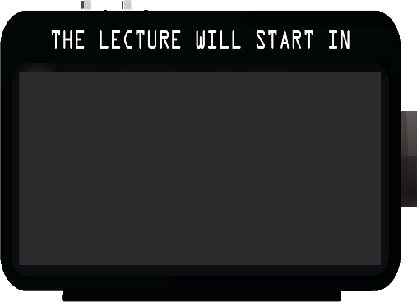
Module ii – academic skills
Technical computer science program
Week 1: introductory lecture

Slide 2
Module ii – academic skills
Technical computer science program
Week 1: introductory lecture

Slide 3












WHO WE ARE?
WELCOME TOPICS & ILO TIME SCHEDULE WORKFLOW ASSESSMENT NEXT STEPS

Slide 4


WHO ARE YOU?
WELCOME TOPICS & ILO TIME SCHEDULE WORKFLOW ASSESSMENT NEXT STEPS
Let's learn now how to interact with ...
Follow the rules:
Go to Shakespeak.me
Log in with the code Free25423
Get ready to vote!

Slide 5



Which of the situations best suits you?
Q’ - Which of the situations best suits you?
The question will open when you start your session and slideshow.
WELCOME TOPICS & ILO TIME SCHEDULE WORKFLOW ASSESSMENT NEXT STEPS
Deliver all tasks several days before the deadline
I had some problems to do things on time
I had serious problems doing things on time
My agenda was chaos and I never had time for anything but homework
This presentation has been loaded without the Shakespeak add-in.
Want to download the add-in for free? Go to http://shakespeak.com/en/free-download/.
Internet | "Description of message sending methods"
TXT | "It will be inserted after you've started a session"
1
1
Closed

Slide 6

Which of the situations best suits you?
A.
Deliver all tasks several days before the deadline
100.0%
B.
I had some problems to do things on time
0.0%
C.
I had serious problems doing things on time
0.0%
D.
My agenda was chaos and I never had time for anything but homework
0.0%
Internet | "Description of message sending methods"
TXT | "It will be inserted after you've started a session"
This presentation has been loaded without the Shakespeak add-in.
Want to download the add-in for free? Go to http://shakespeak.com/en/free-download/.
Closed

Slide 7
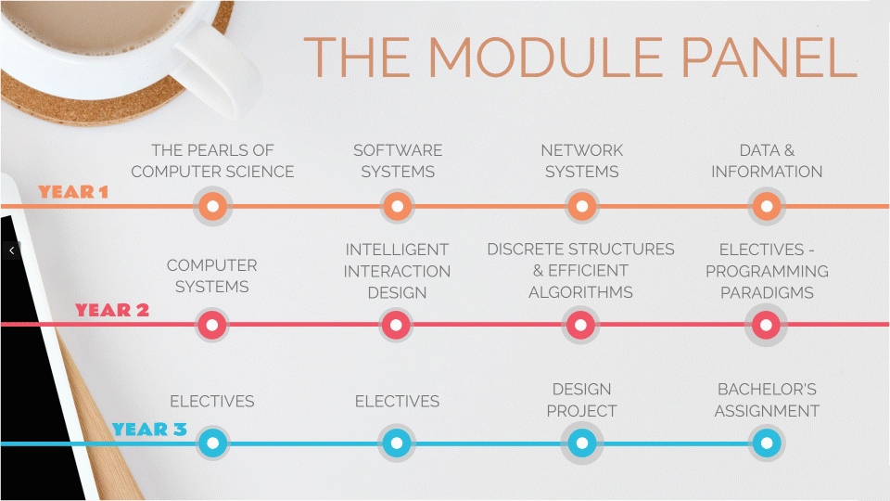
WHAT IS ACADEMIC SKILLS?
WELCOME TOPICS & ILO TIME SCHEDULE WORKFLOW ASSESSMENT NEXT STEPS

Slide 8
Has it ever happened to you that you have to study for an exam or finish an assignment and suddenly you feel the need to clean your room?
The question will open when you start your session and slideshow.
No, it has never happened to me nor will it happen to me ;)
It happened to me, but I end up using netflix instead of studying or cleaning
I know perfectly what you are talking about. It's called procastination and it's happened to me
This presentation has been loaded without the Shakespeak add-in.
Want to download the add-in for free? Go to http://shakespeak.com/en/free-download/.
Internet | "Description of message sending methods"
TXT | "It will be inserted after you've started a session"
1
1
Closed

Slide 9
Has it ever happened to you that you have to study for an exam or finish an assignment and suddenly you feel the need to clean your room?
A.
No, it has never happened to me nor will it happen to me ;)
100.0%
B.
It happened to me, but I end up using netflix instead of studying or cleaning
0.0%
C.
I know perfectly what you are talking about. It's called procastination and it's happened to me
0.0%
This presentation has been loaded without the Shakespeak add-in.
Want to download the add-in for free? Go to http://shakespeak.com/en/free-download/.
Internet | "Description of message sending methods"
TXT | "It will be inserted after you've started a session"
Closed

Slide 10
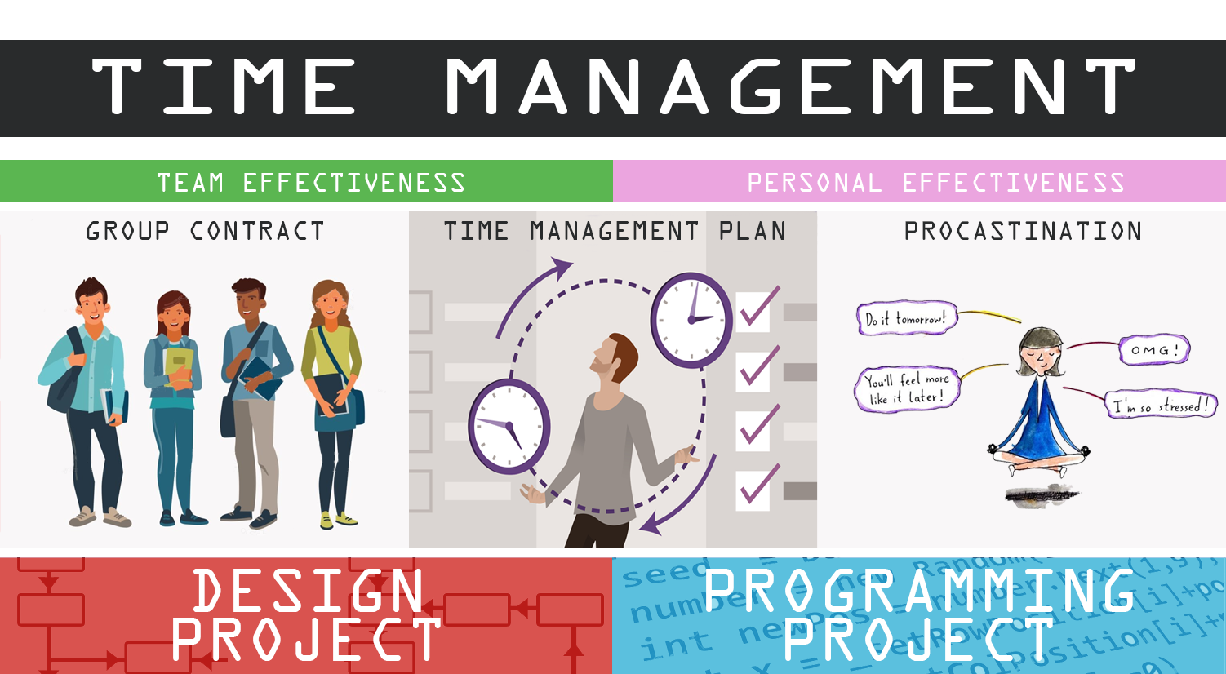
WHY SHOULD I STUDY ACADEMIC SKILL IN M2?
WELCOME TOPICS & ILO TIME SCHEDULE WORKFLOW ASSESSMENT NEXT STEPS

Slide 11
And speaking of projects, when working in a group, how do you prefer it to be built?
The question will open when you start your session and slideshow.
By choosing partner among ourselves
By letting the teacher build the groups for us
I do not care at all
This presentation has been loaded without the Shakespeak add-in.
Want to download the add-in for free? Go to http://shakespeak.com/en/free-download/.
Internet | "Description of message sending methods"
TXT | "It will be inserted after you've started a session"
1
1
Closed

Slide 12
And speaking of projects, when working in a group, how do you prefer it to be built?
A.
By choosing partner among ourselves
0.0%
B.
By letting the teacher build the groups for us
100.0%
C.
I do not care at all
0.0%
This presentation has been loaded without the Shakespeak add-in.
Want to download the add-in for free? Go to http://shakespeak.com/en/free-download/.
Internet | "Description of message sending methods"
TXT | "It will be inserted after you've started a session"
Closed

Slide 13
LEARNING GOALS
WELCOME TOPICS & ILO TIME SCHEDULE WORKFLOW ASSESSMENT NEXT STEPS
MILO
MODULE INTENDED LEARNING OUTCOMES
Applying the most important principles and techniques for effective time management, like personal planning elaboration and reflection, identification of personal strengths and weaknesses, giving and receiving feedback, and procrastination avoidance in a project of limited complexity
Writing, executing and evaluating a group contract in order to improve intercommunication between group members.
Formulating personal strengths and weaknesses with regard to time management, study behavior and project work.
Applying these principles to make a personal planning for a medium long-term period, e.g., a study semester, and for a medium-sized project.
Applying these principles when reflecting on some previous project planning.
Applying the basics about giving and receiving effective feedback on the work of a partner.
Describing the major principles of effective time management.
Describing the major principles for defining a general project planning.
Identifying major personal pitfalls concerning procrastination behavior.
ILO
INTENDED LEARNING OUTCOMES

Slide 14


LEARNING GOALS AS FEATURES
WELCOME TOPICS & ILO TIME SCHEDULE WORKFLOW ASSESSMENT NEXT STEPS
I am able to:
Collaborate with people of different nationalities
Recognize and avoid fraud in my academic work
YOU
AFTER THE MODULE 1
I Will be able to:
  Work in groups under certain agreed rules.
  Solve communication problems between members of your team
  Define yourself based on your strengths and weaknesses
  Identify and solve your own procrastination problems
  Manage your time effectively and efficiently
  Give and receive feedback effectively
YOU
AFTER THE MODULE 2

Slide 15
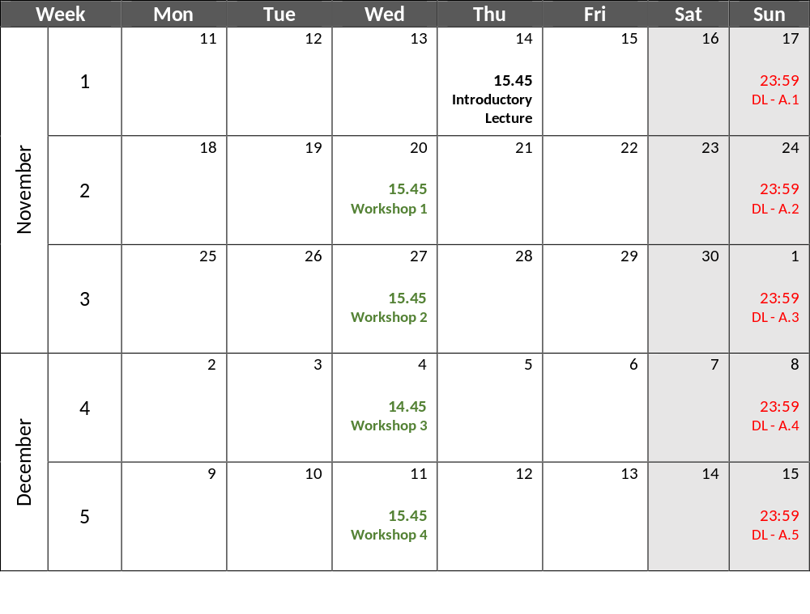
THE CALENDAR OF ACADEMIC SKILLS
WELCOME TOPICS & ILO TIME SCHEDULE WORKFLOW ASSESSMENT NEXT STEPS
1h Lecture
1,5h Self-study
1h Workshop
2,5h Self-study
1h Workshop
2h Self-study
1h Workshop
1,5h Self-study
1h Workshop
1,5h Self-study

Slide 16
Do you know what an inverted or flipped classroom methodology is?
The question will open when you start your session and slideshow.
Yes, we have already used it in other educational environments
I have a slight idea of what it is but I have never used it
No, but I guess what is on the next slide
This presentation has been loaded without the Shakespeak add-in.
Want to download the add-in for free? Go to http://shakespeak.com/en/free-download/.
Internet | "Description of message sending methods"
TXT | "It will be inserted after you've started a session"
0
1
Closed

Slide 17
Do you know what an inverted or flipped classroom methodology is?
We will set these example results to zero once you've started your session and your slide show.
In the meantime, feel free to change the looks of your results (e.g. the colors).
A.
Yes, we have already used it in other educational environments
33.3%
B.
I have a slight idea of what it is but I have never used it
66.7%
C.
No, but I guess what is on the next slide
100.0%
This presentation has been loaded without the Shakespeak add-in.
Want to download the add-in for free? Go to http://shakespeak.com/en/free-download/.
Internet | "Description of message sending methods"
TXT | "It will be inserted after you've started a session"
Closed

Slide 18

METHODOLOGY
WELCOME TOPICS & ILO TIME SCHEDULE WORKFLOW ASSESSMENT NEXT STEPS

Slide 19

WORKFLOW
WELCOME TOPICS & ILO TIME SCHEDULE WORKFLOW ASSESSMENT NEXT STEPS

Slide 20
HOW TO PASS ACADEMIC SKILLS?
WELCOME TOPICS & ILO TIME SCHEDULE WORKFLOW ASSESSMENT NEXT STEPS
 | WEEK 1 | WEEK 2 | WEEK 3 | WEEK 4 | WEEK 5
FIRST ATTEMPT
RESIT ATTEMPT
To approve it is necessary to watch all the videos and submit all the tasks on time
Goals & Expectations
Nov, 17 23:59
Written report
Time management
Nov, 24 23:59
Signed Contract
List of daily tasks
Priorization Matrix
Dec, 1 23:59
Personal TMP
Pitfalls and procastination
Dec, 8 23:59
Personal TMP (reviewed)
Giving & Receiving Feedback
Dec, 15 23:59
Feedback report
Module TMP
If you fail/miss…
Written report
Extra Reflection
If you fail/miss…
Signed Contract
List of daily tasks
Extra Reflection
If you fail/miss…
Extended Personal TMP
If you fail/miss…
Personal TMP (reviewed)
Extra reflection
If you fail/miss…
Feedback report
Module TMP
Oral presentation

Slide 21



If AS were rated with a score between 0 and 10 instead of passing / failing, do you think you would invest more time and / or energy? Explain your argument
I think that esto y lo otro y cuando me pado que una cosa que vi y luego se fue pero volvio y asi es como termino esta respuesta
1. Your audience's responses will appear here. Please feel free to change the font, color etc. This text disappears after starting your session and slideshow.
2. Your audience's responses will appear here. Please feel free to change the font, color etc. This text disappears after starting your session and slideshow.
This presentation has been loaded without the Shakespeak add-in.
Want to download the add-in for free? Go to http://shakespeak.com/en/free-download/.
Internet | "Description of message sending methods"
TXT | "It will be inserted after you've started a session"
1
1

Slide 22
WHAT YOU HAVE TO DO BEFORE SUNDAY?
WELCOME TOPICS & ILO TIME SCHEDULE WORKFLOW ASSESSMENT NEXT STEPS
Watch the interactive video on “Week 1” Canvas page
Answer the questions following the template of “assignment A-1”
BEFORE SUNDAY NOVEMBER 17, 23:59

Slide 23

MODULE 2: SOFTWARE SYSTEMS
ACADEMIC SKILLS
INTRODUCTORY LECTURE
Have a nice day
See you next week

