Slide 1
feeding agents with event logs
23RD IEEE INTERNATIONAL EDOC CONFERENCE - THE ENTERPRISE COMPUTING CONFERENCE
An agent-based process mining architecture for
emergent behavior analysis
R.H. Bemthuis, M. Koot, M.R.K. Mes, F.A. Bukhsh, M.-E. Iacob, & N. Meratnia

Slide 2
1
2
3
4
Research opportunity
Requirements
&
Architecture
Experimental
proof-of-concept
Further
Research

Slide 3


1. Research opportunity
A. Challenges
Trillion information flows gushing from a colossal numbers of devices
Decision-making in supply chains can be done at all times, based on real-time information originating from ubiquitous sources
Source: www.pixabay.com
Source: www.pixabay.com
Notes:
https://pixabay.com/photos/logistics-truck-frachtschiff-group-3125131/
https://pixabay.com/photos/block-chain-smartphone-control-3569793/

Slide 4


1. Research opportunity
A. Challenges
Discrepancies between process specifications and observed reality System-wide impact is not properly assessed before implementation of new systems (e.g., due to time and budget contrainst) | Stakeholders often have divergent objectives No or limited consensus Autonomous, self-interested and not necessarily cooperative Individual stakeholders may not: (1) trust the system, (2) be willing to share their information, or (3) comply with the systems outcome
https://unsplash.com/

Slide 5
1. Research opportunity
B. Inspirational video

Slide 6

1. Research opportunity
B. Inspirational video

Slide 7
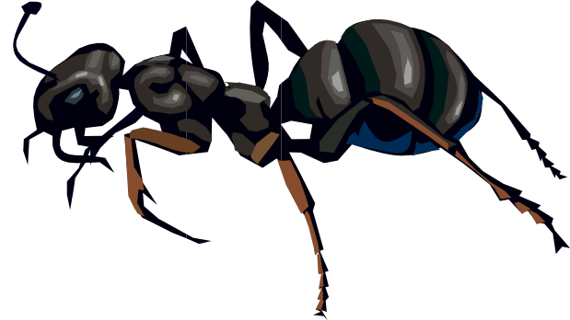
1. Research opportunity
C. Lessons Learned
Each ‘agent’ has:
Its own goal
Limited domain knowledge (e.g., incomplete or uncertain)
Bounded rationality
The ability to take decision in real-time
Limited capabilities
However, the group of distributed decision-making entities is capable of realizing a form op optimization!

Slide 8


1. Research opportunity
D. Research Initiatives
Process mining can help to discover and analyze processes:
Diversity of supply chain players
Analyze system-wide performance
Mismatch between expected behavior and realized behavior
Wealth of data available in (ERP) information systems

Slide 9

1. Research opportunity
E. Objective
Emergent behavior* =
  Result of unfamiliar and unique behavior that has been occurred
  Unrecognized behavior that has been a possibility from inception
Multi-agent system
Process mining
Analyze emergence
*: M. Grieves and J. Vickers, “Digital twin: Mitigating unpredictable, undesirable emergent behavior in complex systems,” in Transdisciplinary perspectives on complex systems. Springer, 2017, pp. 85–113.

Slide 10

1. Research opportunity
E. Objective
Join agent-based process mining architecture to evaluate emergence resulting from ‘simple’ agent-based decision rules
Focus on transport & logistics domain:
Natural recourse for modeling flexible, adaptable, and reconfigurable systems

Slide 11
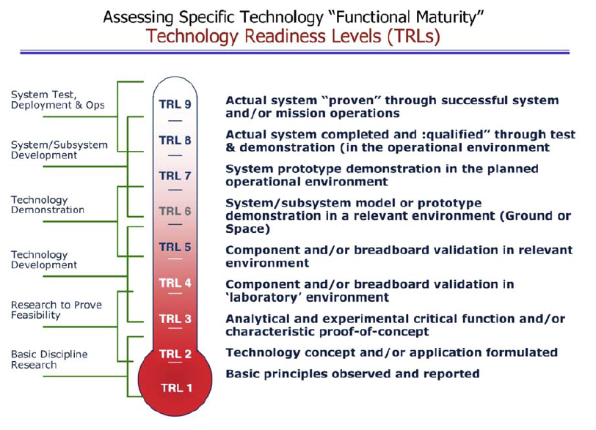
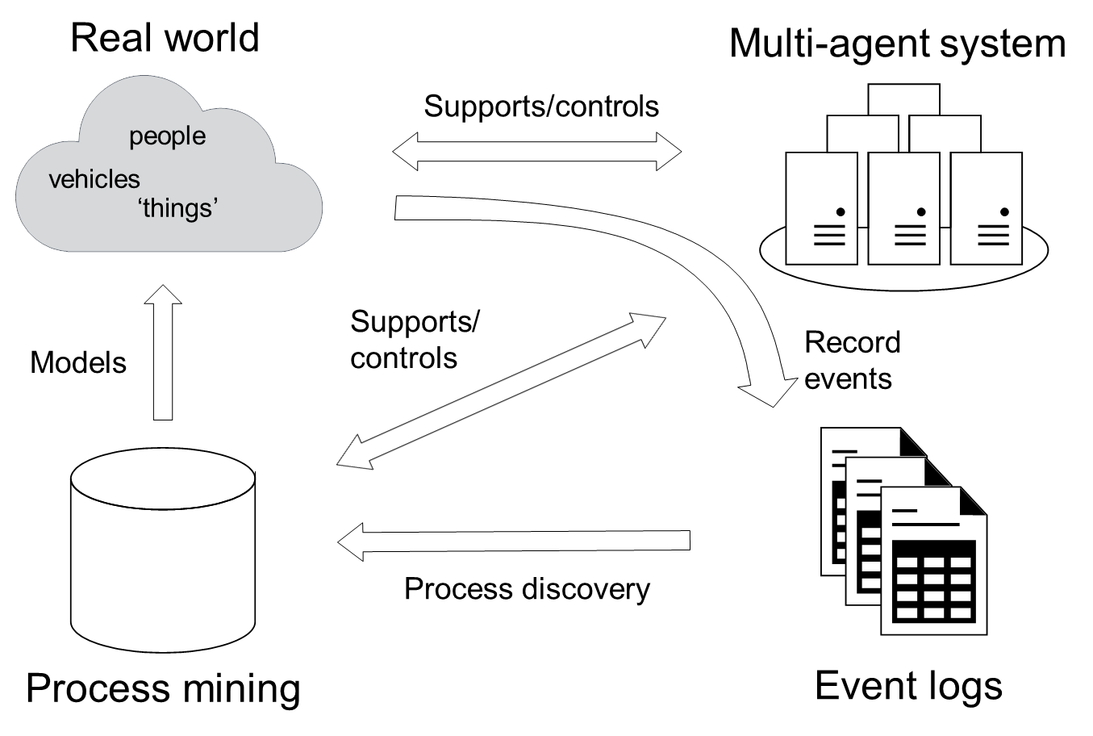



1. Research opportunity
F. Methodology
Focus

Slide 12
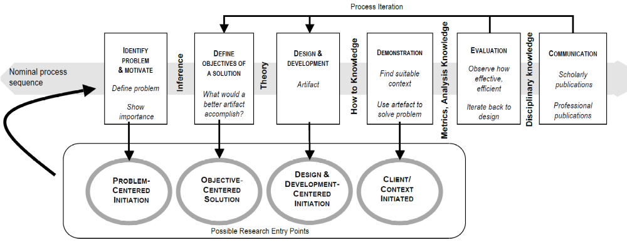
1. Research opportunity
G. Design science methodology
Source: Peffers, K., Tuunanen, T., Rothenberger, M. A., & Chatterjee, S. (2007). A design science research methodology for information systems research. Journal of management information systems, 24(3), 45-77.

Slide 13
1
2
3
4
Research opportunity
Requirements
&
Architecture
Experimental
proof-of-concept
Further
Research

Slide 14
2. Requirements & architecture
A. Design science methodology
Source: Peffers, K., Tuunanen, T., Rothenberger, M. A., & Chatterjee, S. (2007). A design science research methodology for information systems research. Journal of management information systems, 24(3), 45-77.

Slide 15
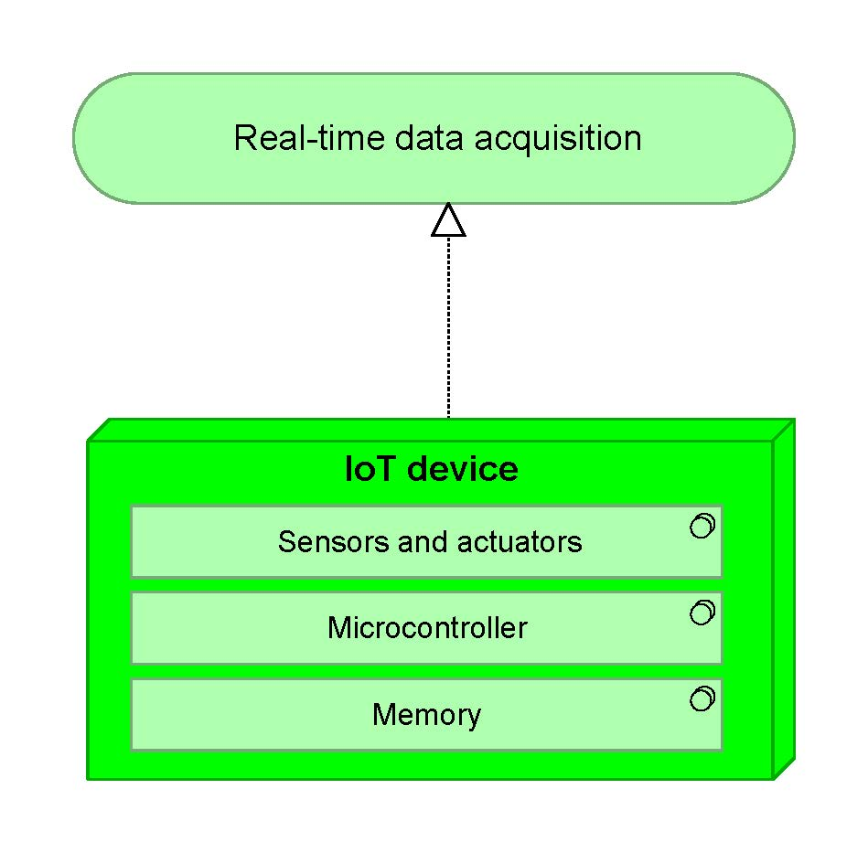
2. Requirements & architecture
B. Objective-centered solution
List of requirements:
Real-time data acquisition

Slide 16
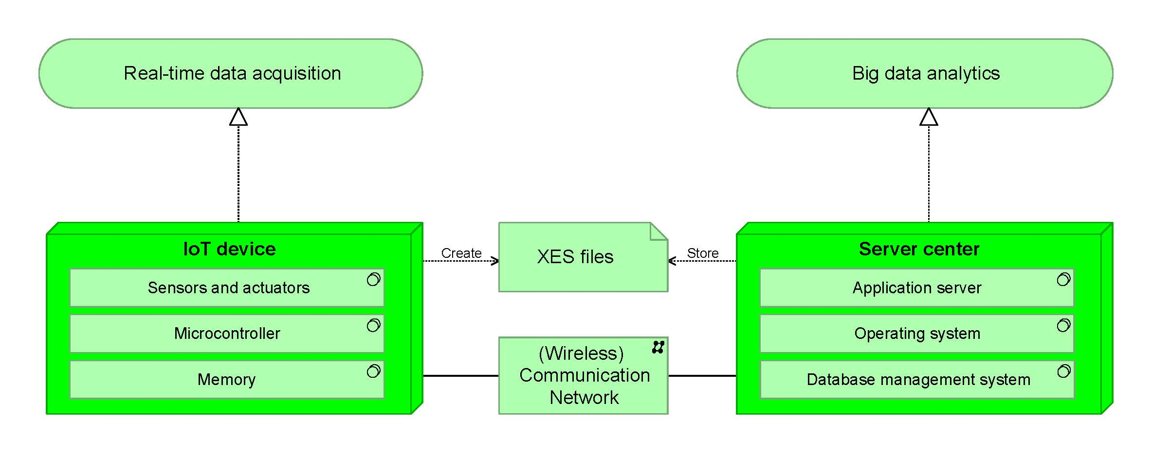
2. Requirements & architecture
B. Objective-centered solution
List of requirements:
Real-time data acquisition
Interoperability

Slide 17
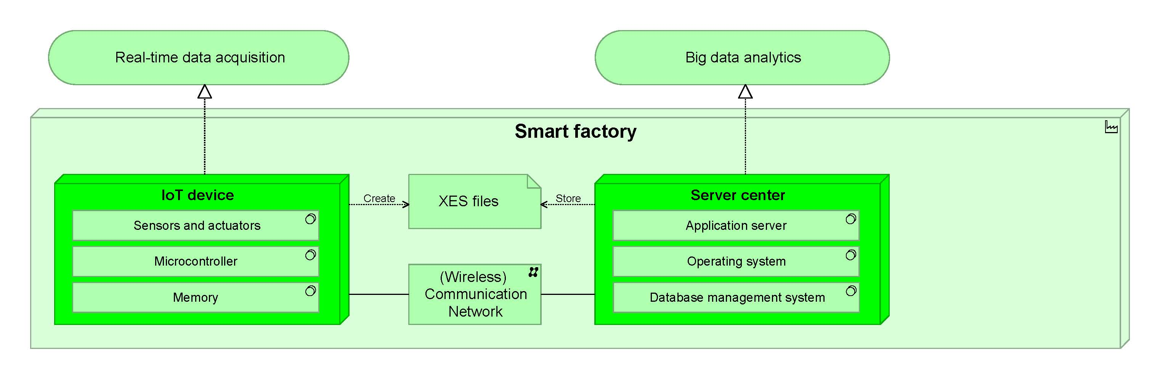
2. Requirements & architecture
B. Objective-centered solution
List of requirements:
Real-time data acquisition
Interoperability
Modularity

Slide 18
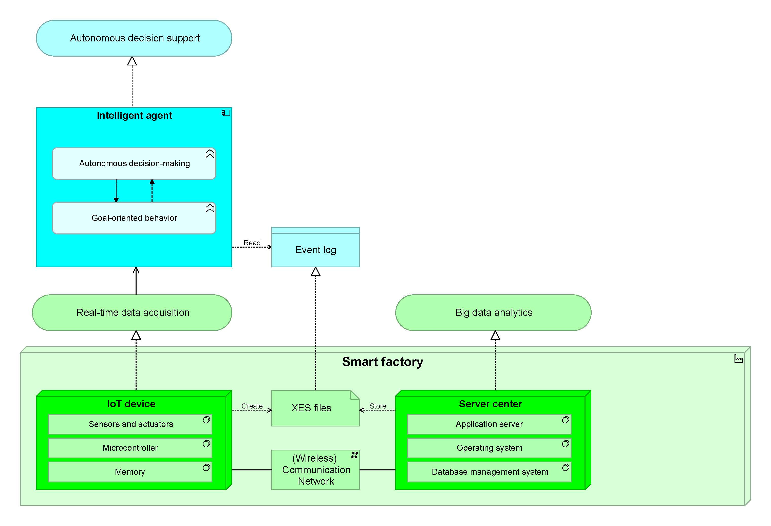
2. Requirements & architecture
B. Objective-centered solution
List of requirements:
Real-time data acquisition
Interoperability
Modularity
Decentralized decision-making

Slide 19
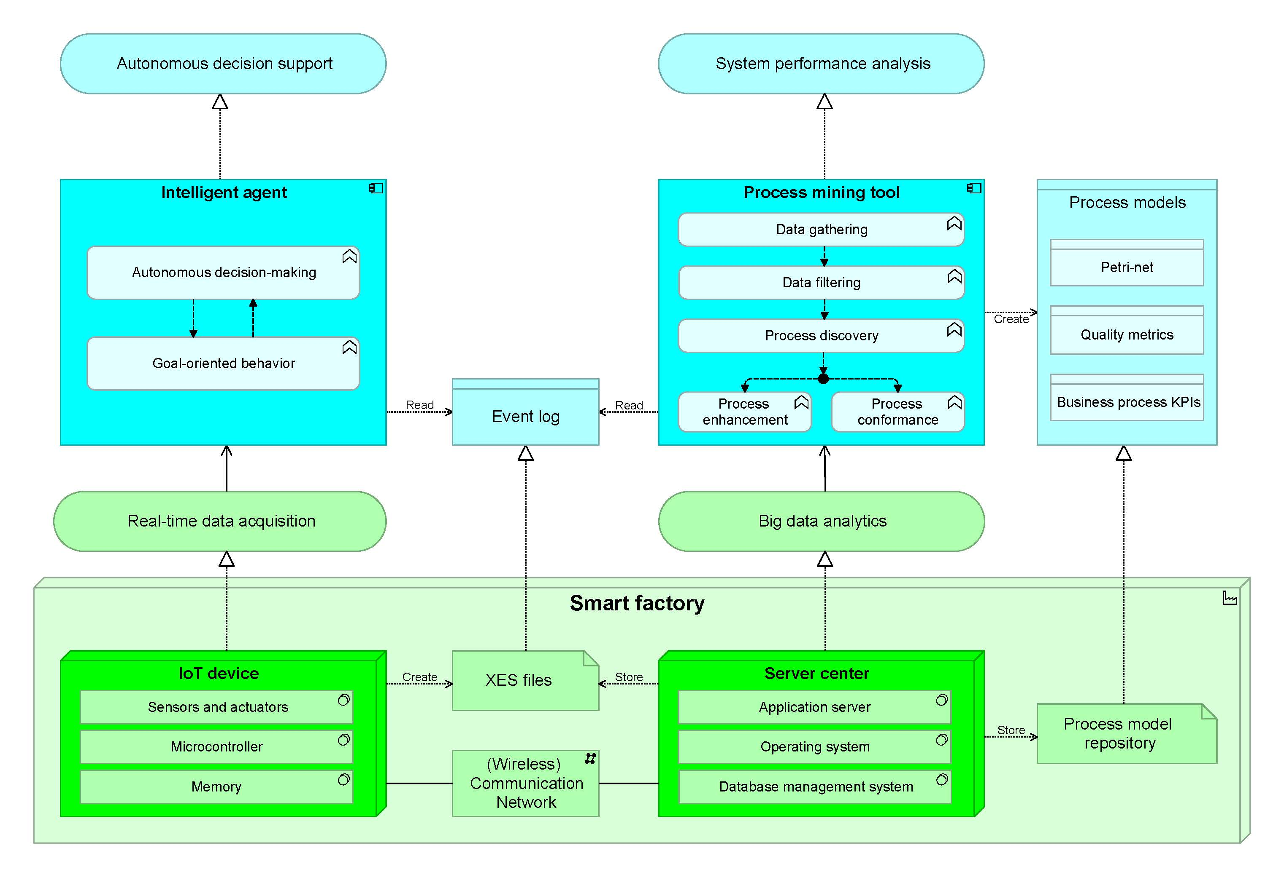
2. Requirements & architecture
B. Objective-centered solution
List of requirements:
Real-time data acquisition
Interoperability
Modularity
Decentralized decision-making
System performance evaluation

Slide 20
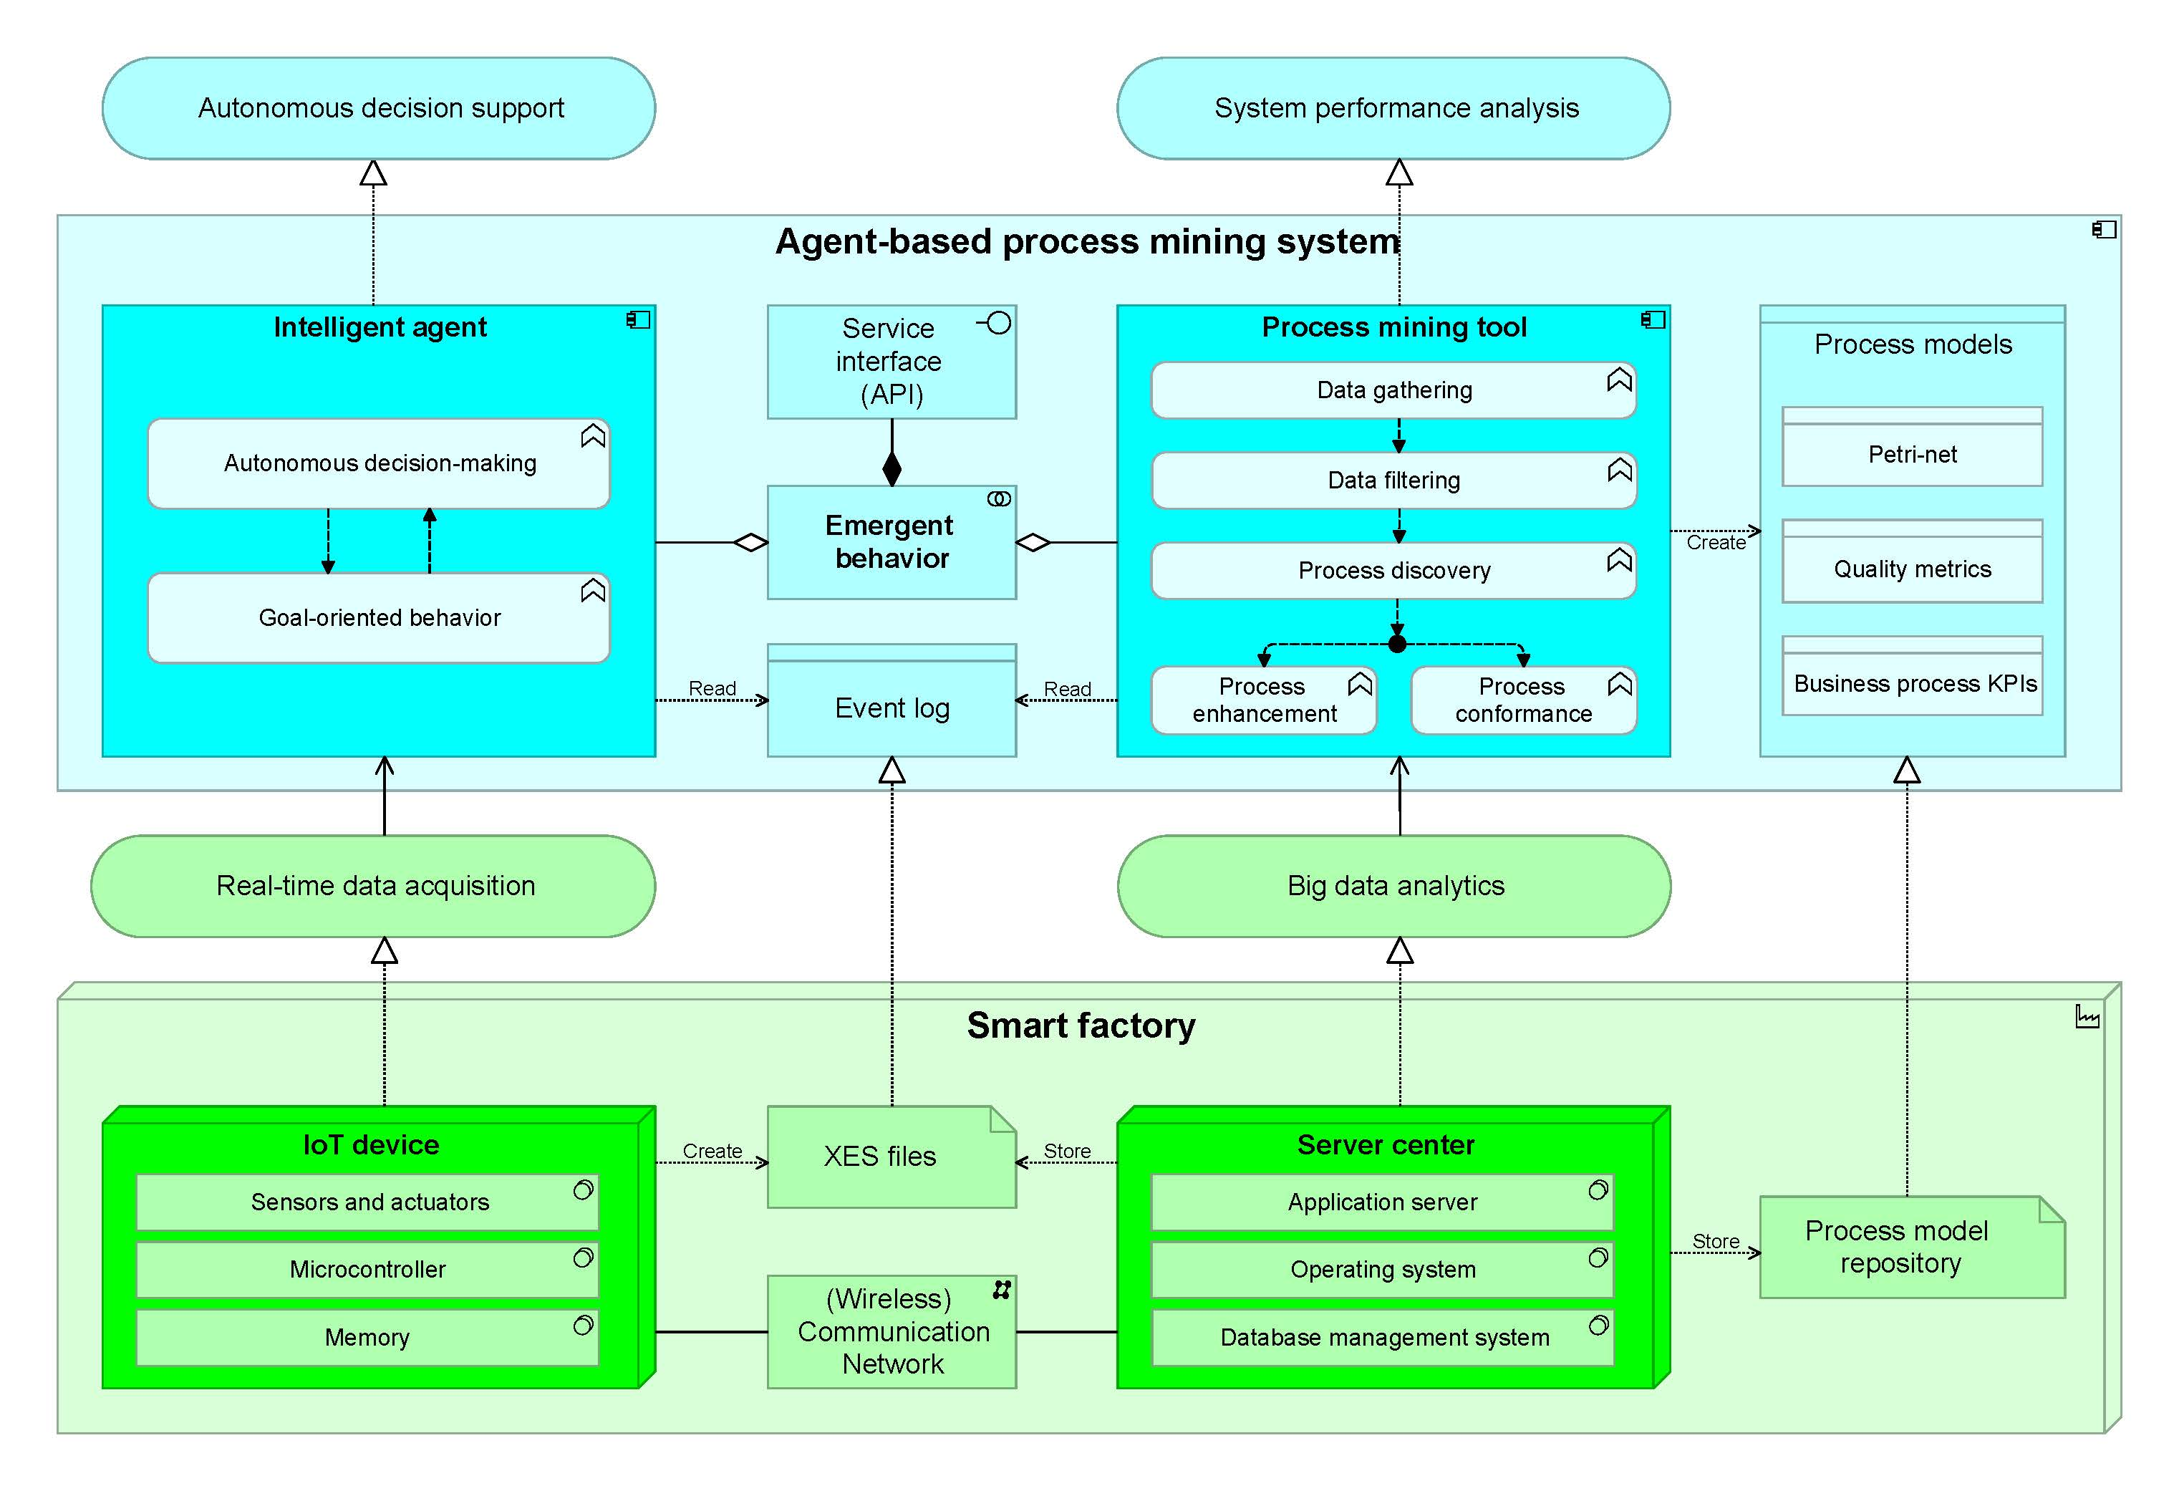
2. Requirements & architecture
B. Objective-centered solution
List of requirements:
Real-time data acquisition
Interoperability
Modularity
Decentralized decision-making
System performance evaluation
Strategic decision support

Slide 21
2. Requirements & architecture
B. Objective-centered solution
List of requirements:
Real-time data acquisition
Interoperability
Modularity
Decentralized decision-making
System performance evaluation
Strategic decision support

Slide 22
1
2
3
4
Research opportunity
Requirements
&
Architecture
Experimental
proof-of-concept
Further
Research

Slide 23
3. Experimental proof-of-concept
A. Design science methodology
Source: Peffers, K., Tuunanen, T., Rothenberger, M. A., & Chatterjee, S. (2007). A design science research methodology for information systems research. Journal of management information systems, 24(3), 45-77.

Slide 24
3. Experimental proof-of-concept
B. Experimental setting
Source: W. Van Der Aalst, A. Adriansyah, A. K. A. De Medeiros, F. Arcieri, T. Baier, T. Blickle, J. C. Bose, P. Van Den Brand, R. Brandtjen, J. Buijs et al., “Process mining manifesto,” in International Conference on Business Process Management.Springer, 2011, pp. 169–194.

Slide 25


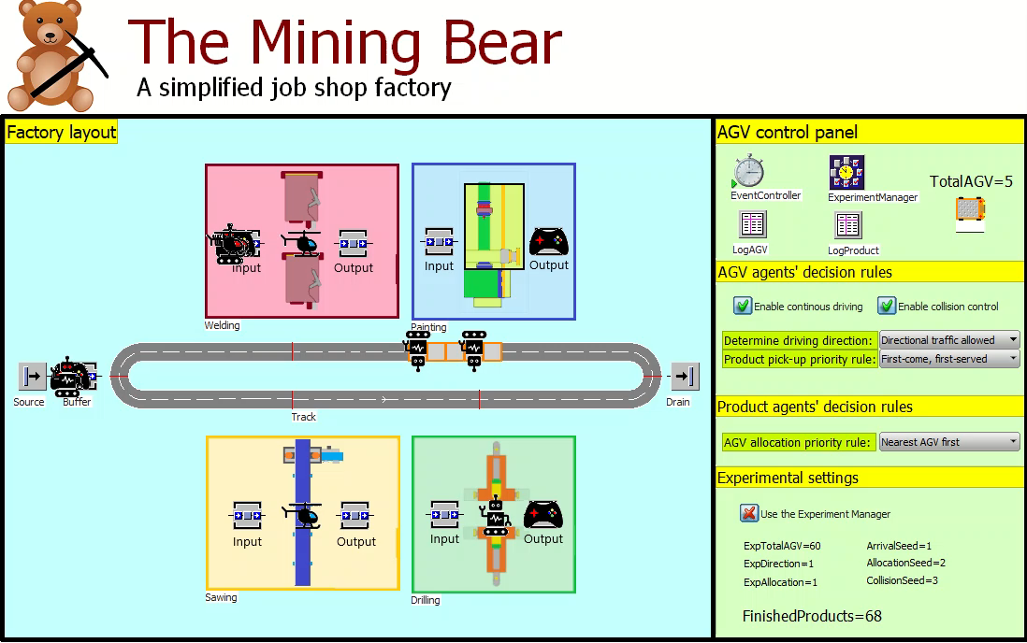
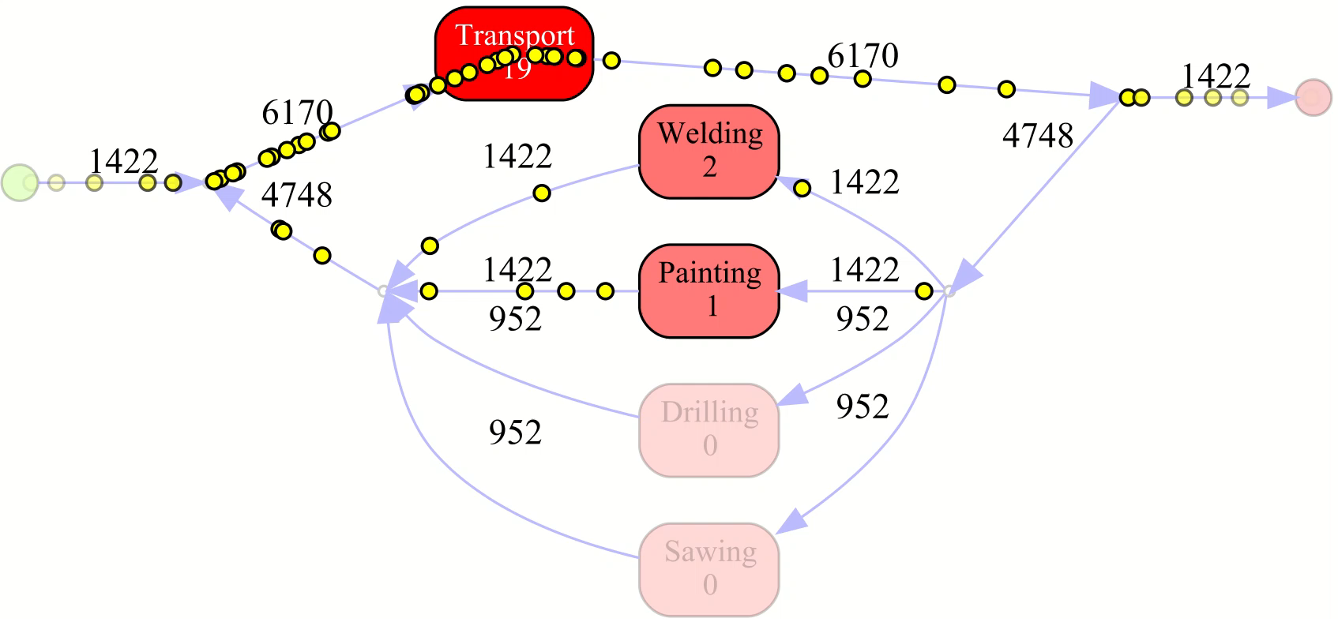

3. Experimental proof-of-concept
B. Experimental setting
Real world
Agent-based simulation model
people
Conceptual model
vehicles
‘things’
emergence
Generate event logs
Discover process models
Performance analysis
Process discovery

Slide 26
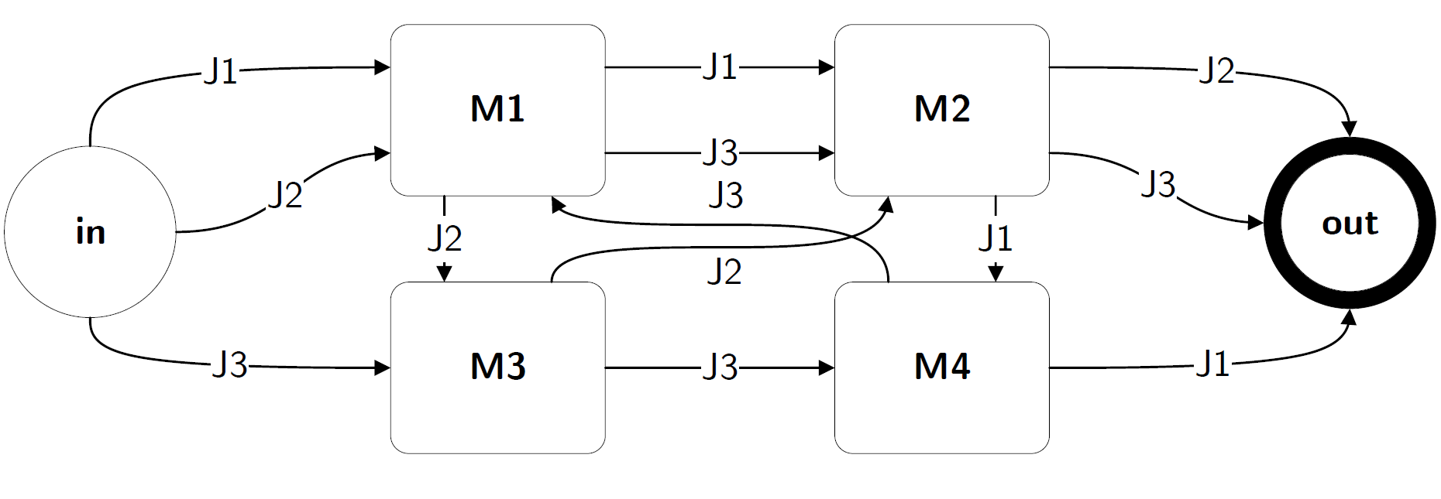
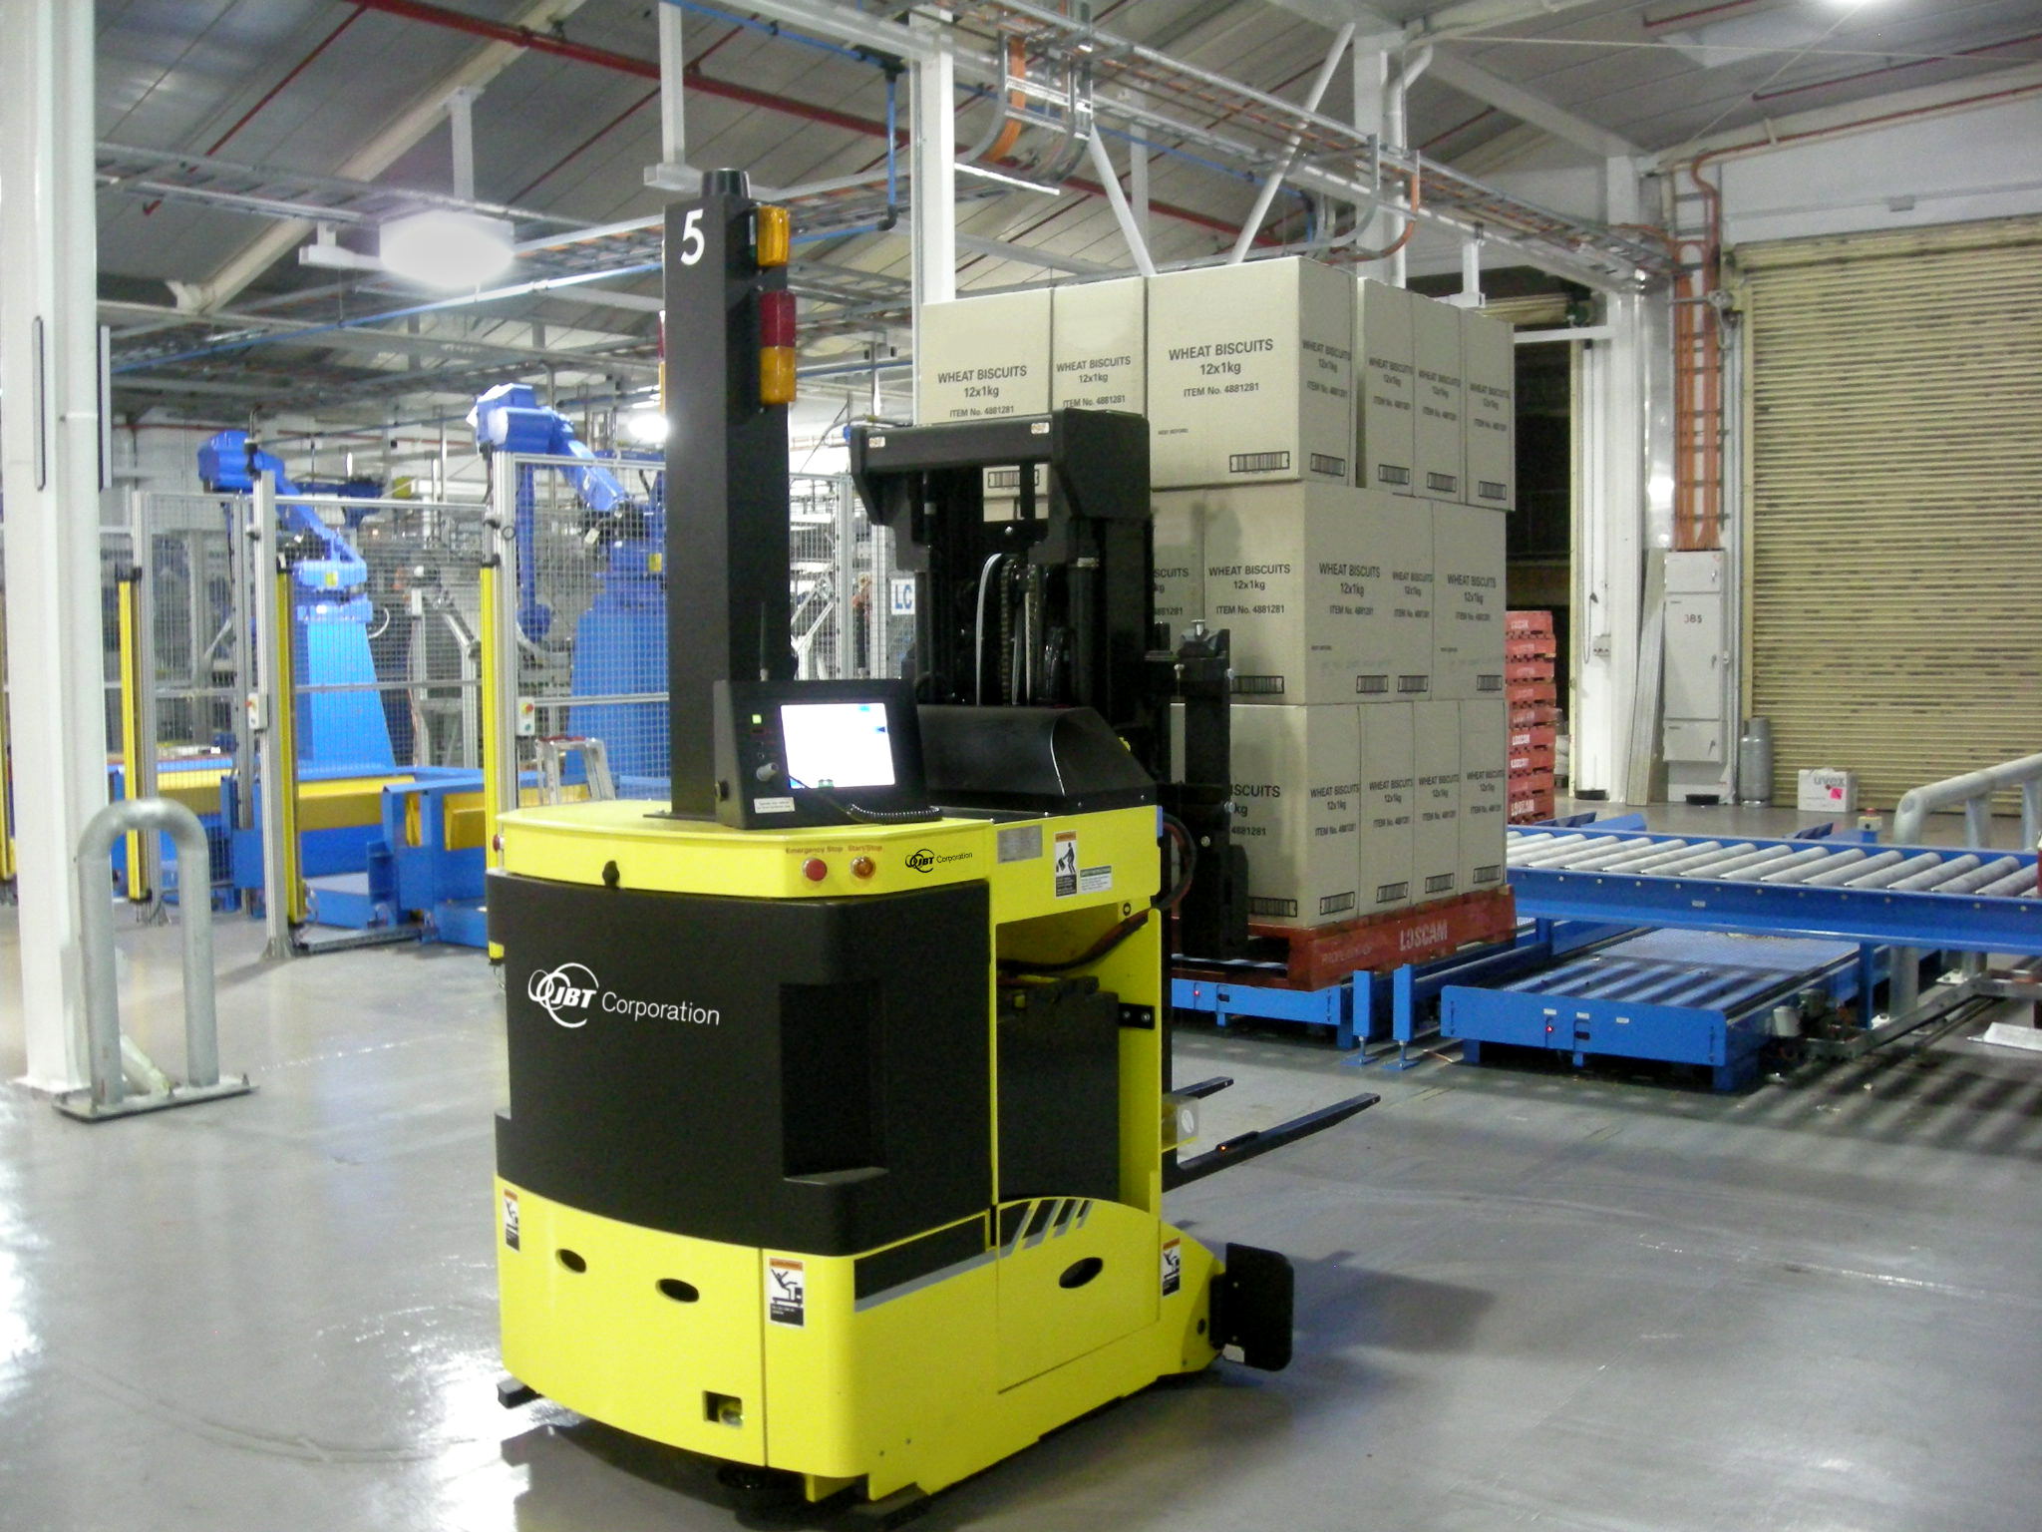
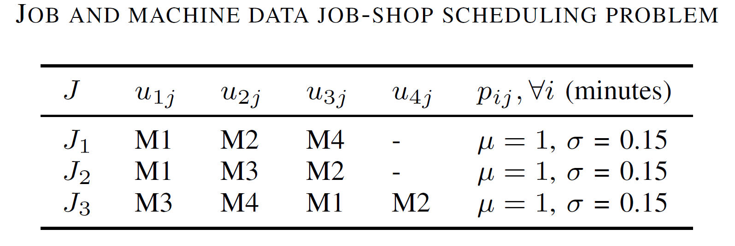
3. Experimental proof-of-concept
C. Use case description

Slide 27
3. Experimental proof-of-concept
D. Simulation model
LIVE
DEMONSTRATION!
Experimental factors:
Number of vehicles
Driving direction
Dispatching rule

Slide 28
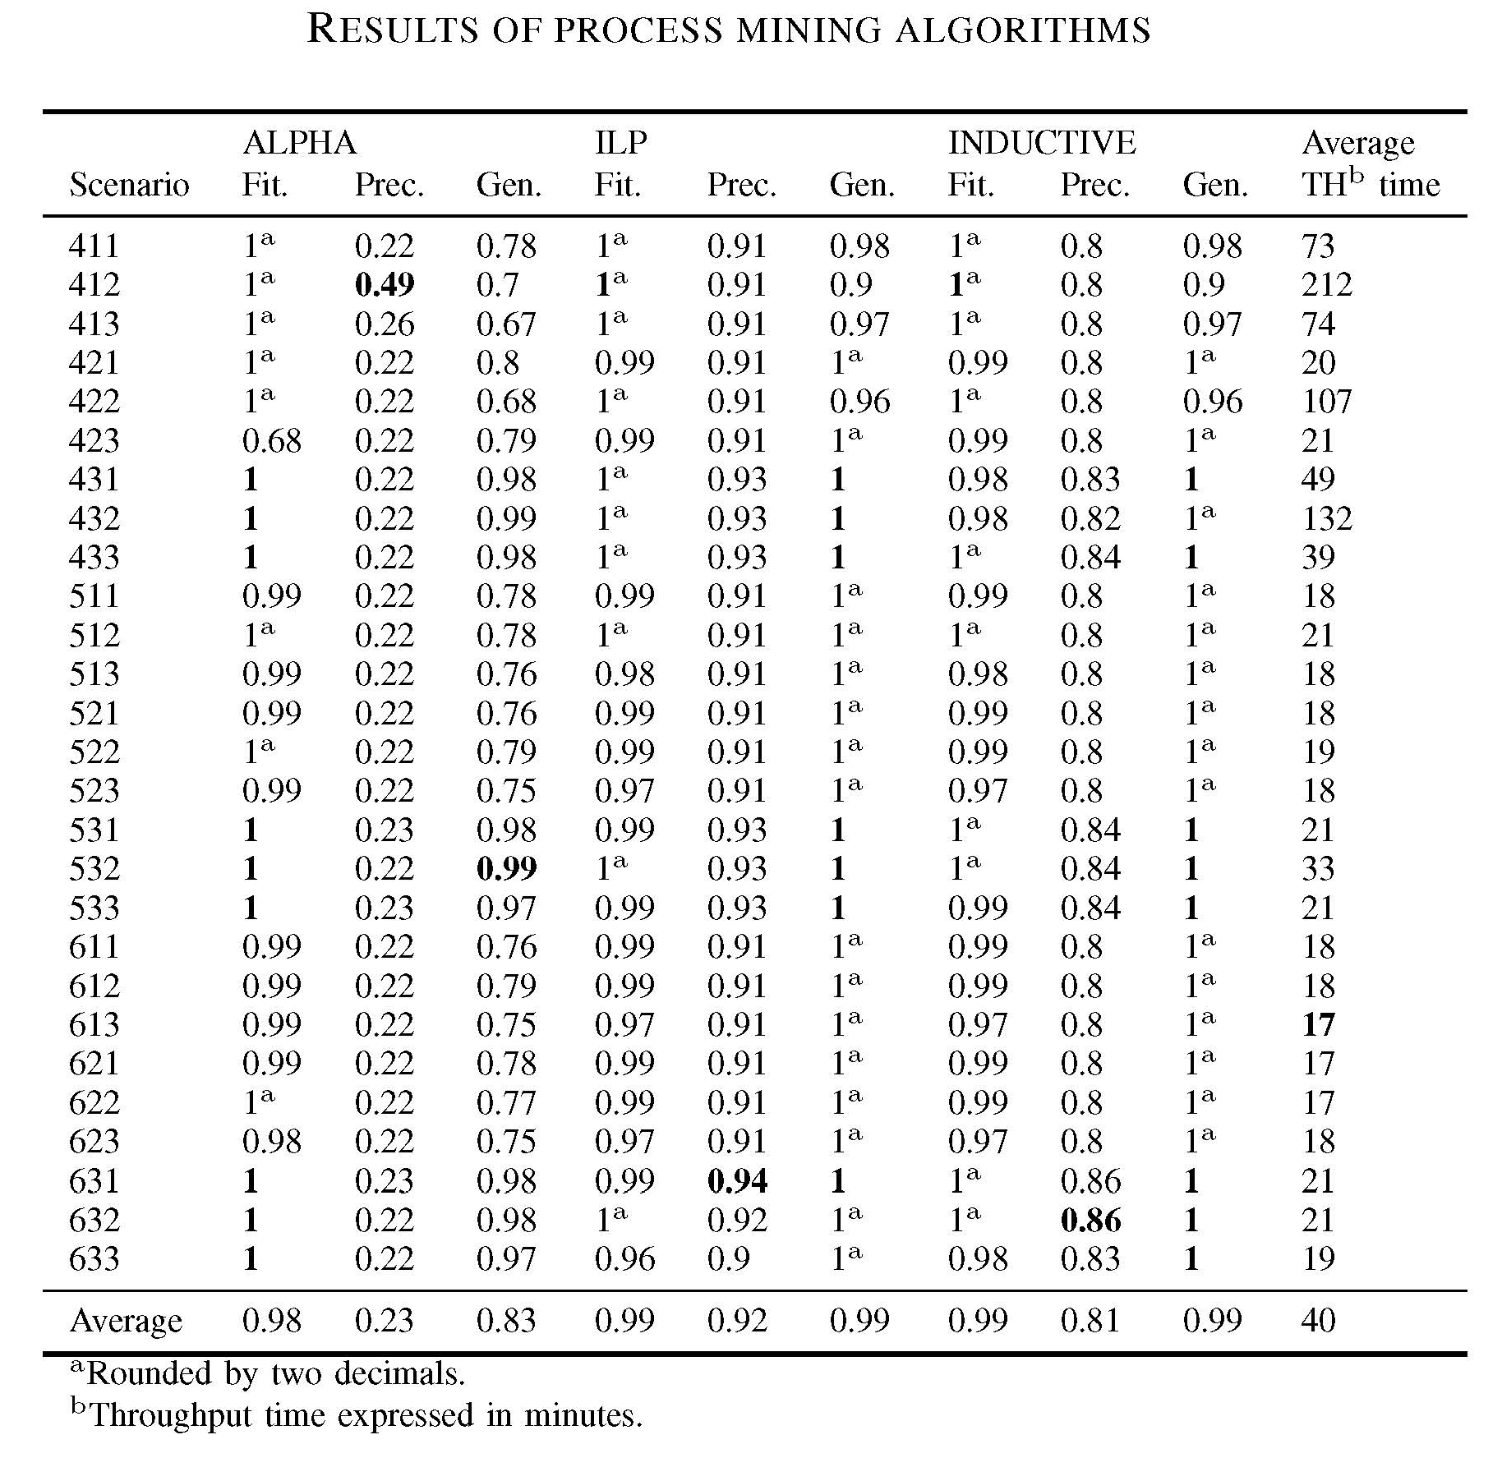

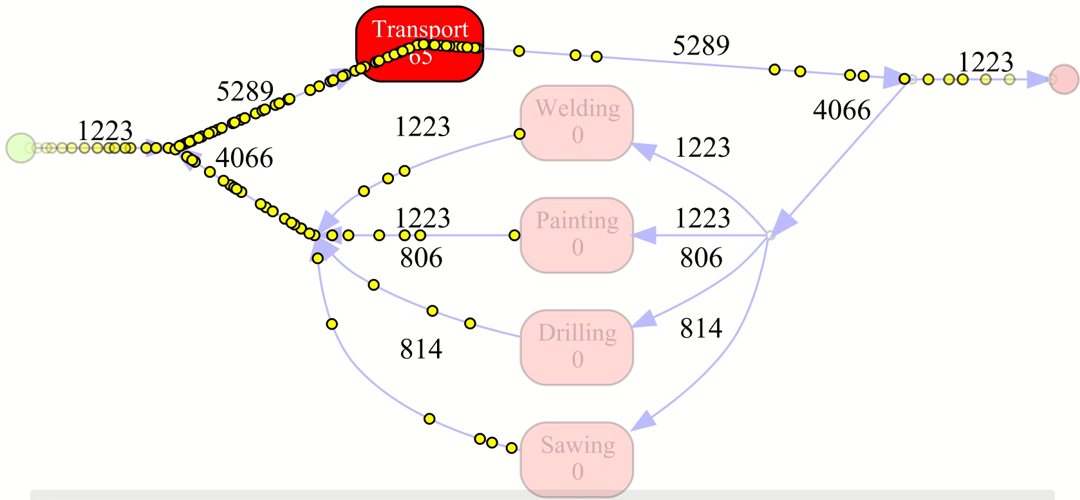
3. Experimental proof-of-concept
E. Process mining results
Exp 421
Exp 422

Slide 29
1
2
3
4
Research opportunity
Requirements
&
Architecture
Experimental
proof-of-concept
Further
Research

Slide 30
4. Further research a. New research opportunities
Our focus
Agents <> process mining <> emergent behavior
Architecture (validation) requirements
Advance decision-making intelligence:
  reflect real human behavior (e.g., game theoretical approaches)
  self-learning mechanisms (e.g., feedback loops)
Real-life case study
Integrated optimization suite:
  connect data sources, extract data, build event log, implement process mining algorithms, etc.
Mature TRL(4+)
Source: Peffers, K., Tuunanen, T., Rothenberger, M. A., & Chatterjee, S. (2007). A design science research methodology for information systems research. Journal of management information systems, 24(3), 45-77.

Slide 31
4. Further research
B. To remember
Analyze emergent behavior by joint process mining and agent-based modeling
Architecture validation by conducting a simulation study, comprising a classical transportation problem
Preliminary study of impact of agent decision-rules on emergent behavior
Further research is required to validate the architecture’s requirements and the impact of the intelligence of the agents
Multi-agent system
Process mining
Analyze emergence

Slide 32








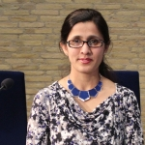
Questions?
Faculty of Behavioral & Social Sciences (BMS) Industrial Engineering & Business Information Systems (IEBIS) |  | Martijn Koot PhD Student | Maria-Eugenia Iacob Professor | Martijn Mes Associate Professor
 |  | m.koot@utwente.nl | m.e.iacob@utwente.nl | m.r.k.mes@utwente.nl
 |  | https://www.linkedin.com/in/ martijn-koot-msc/ | https://www.linkedin.com/in/maria-iacob-0579741/ | https://www.linkedin.com/in/martijnmes/
Faculty of Electrical Engineering, Mathematics & Computer Science Pervasive Systems (PS) + Datamanagement & Biometrics (DMB) |  | Rob Bemthuis PhD Student | Nirvana Meratnia Associate Professor | Faiza Bukhsh Assistant Professor
 |  | r.h.bemthuis@utwente.nl | n.meratnia@utwente.nl | f.a.bukhsh@utwente.nl
 |  | https://www.linkedin.com/in/robbemthuis | https://www.linkedin.com/in/nirvanameratnia/ | https://www.linkedin.com/in/faiza-a-bukhsh-00ab3b20/

